Slide 1
디지털 시스템 및 마이크로컴퓨터 I
Digital System and Microcomputer I

Slide 2
Digital System and Microcomputer I
교재
  Fundamentals of Logic Design (7th Ed.) by Charles H. Roth, Jr.
  http://airlab.inje.ac.kr
부교재
  Digital Fundamentals (10th Ed.) by Thomas L. Floyd
평가
  출석: 20%, 퀴즈: 40%, 중간고사: 20%, 기말고사: 20%

Slide 3
본 교과목을 왜 배워야 하는가?
Electronic Components
inside
Medical Equipment

Slide 4
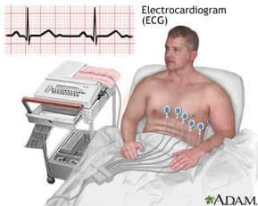
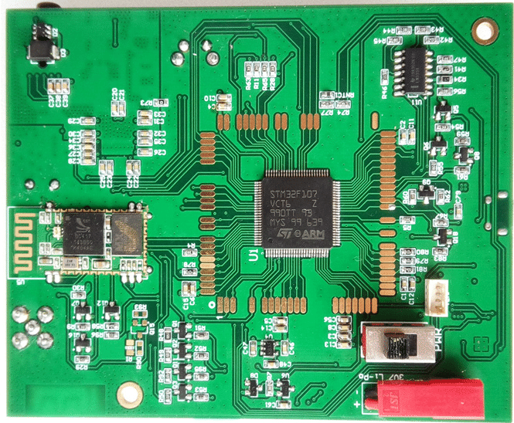
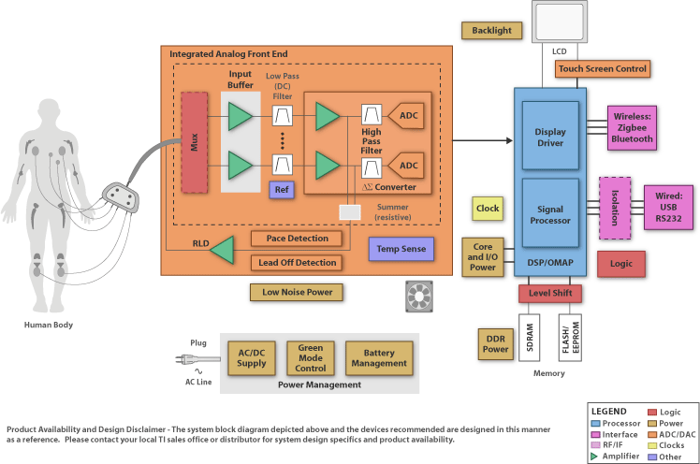
ECG: Electrocardiography

Slide 5
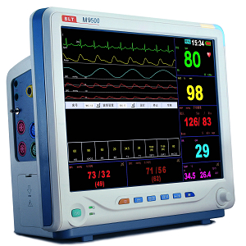
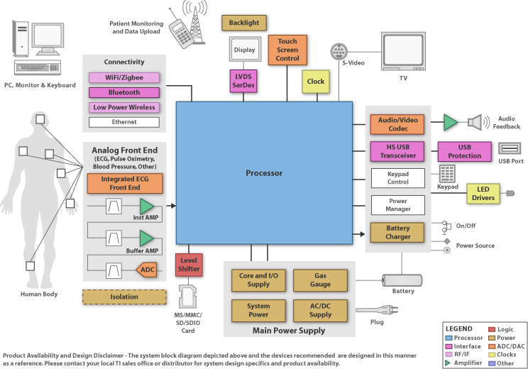
Patient Monitor

Slide 6
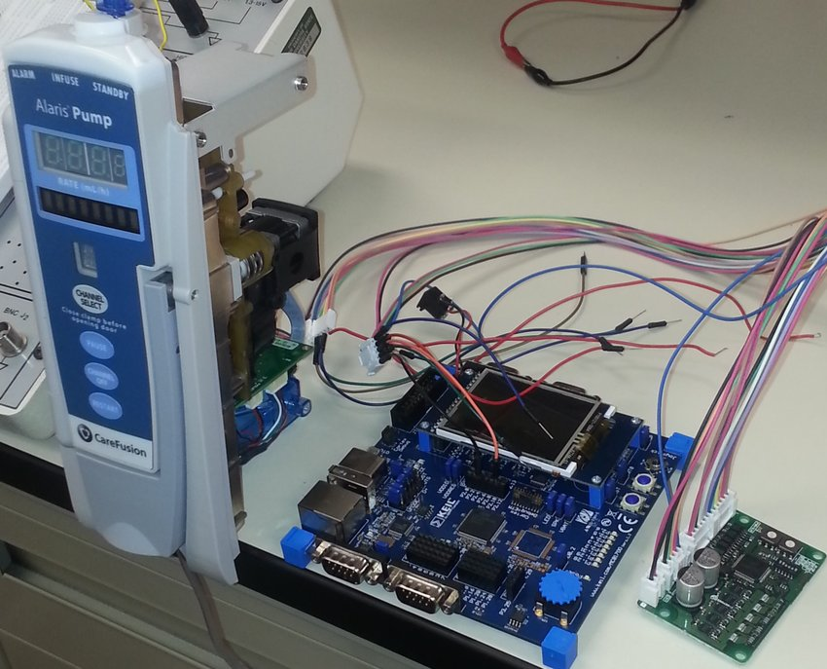
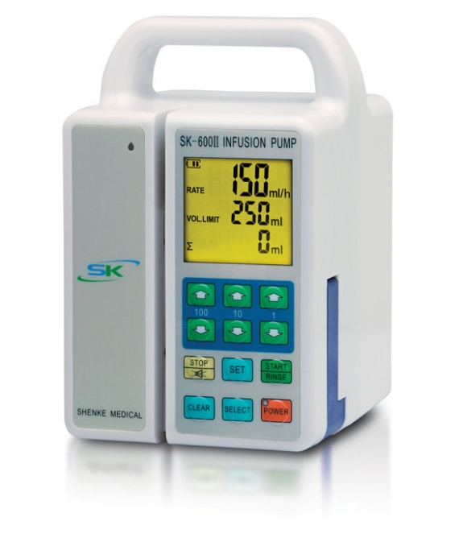
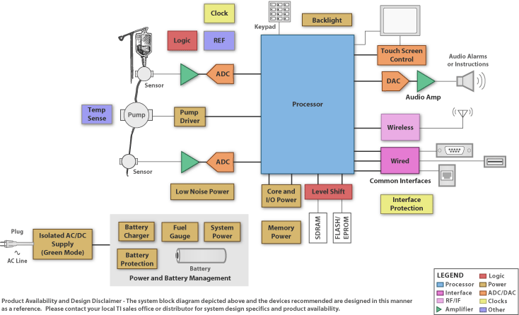
Infusion Pump

Slide 7
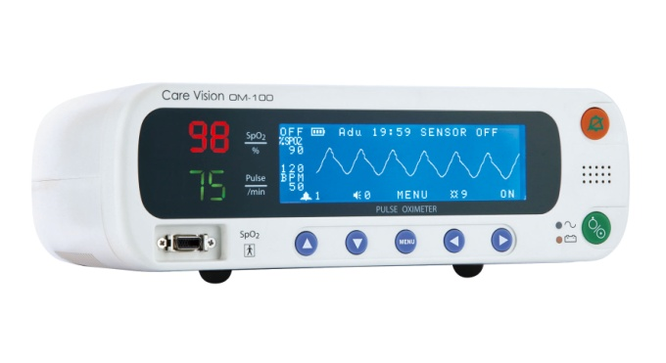
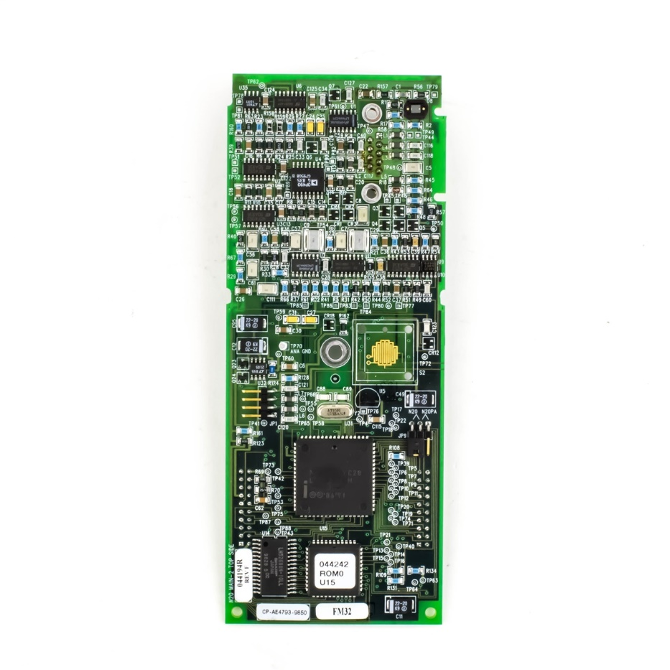
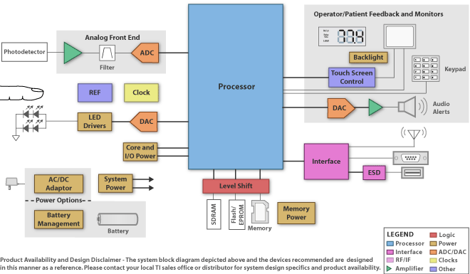
Pulse Oximeter

Slide 8
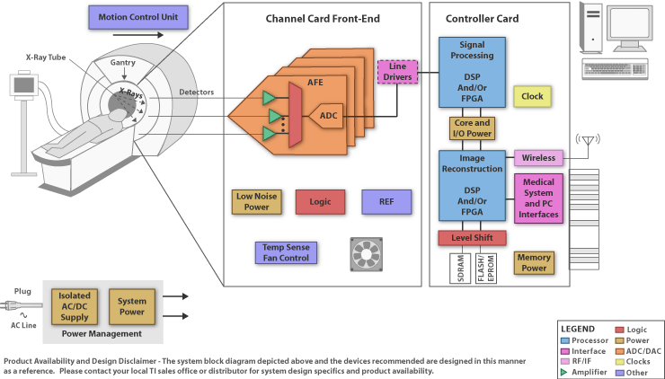
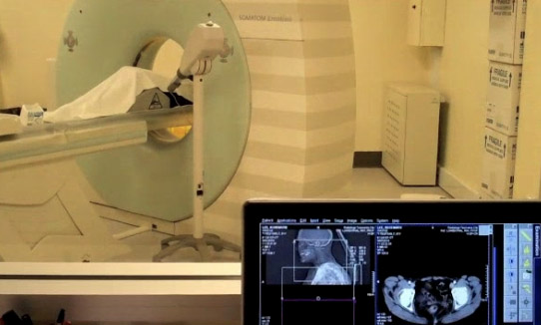
CT Scanner

Slide 9
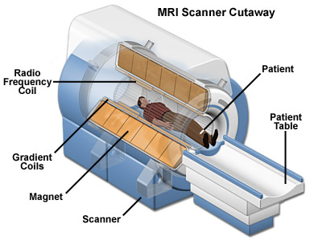
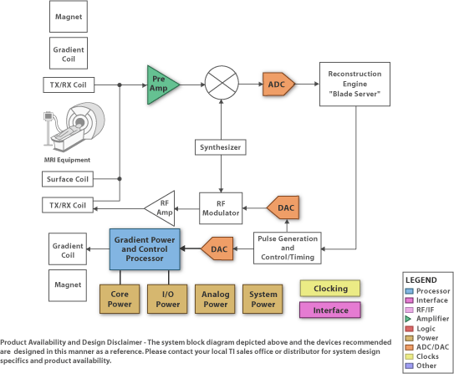
MRI: Magnetic Resonance Imaging

Slide 10
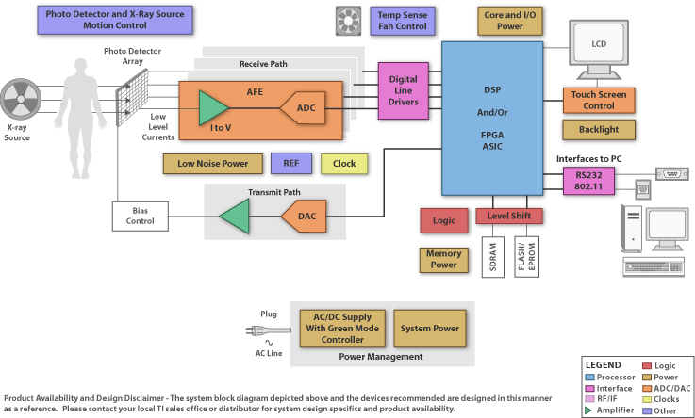

X-Ray

Slide 11
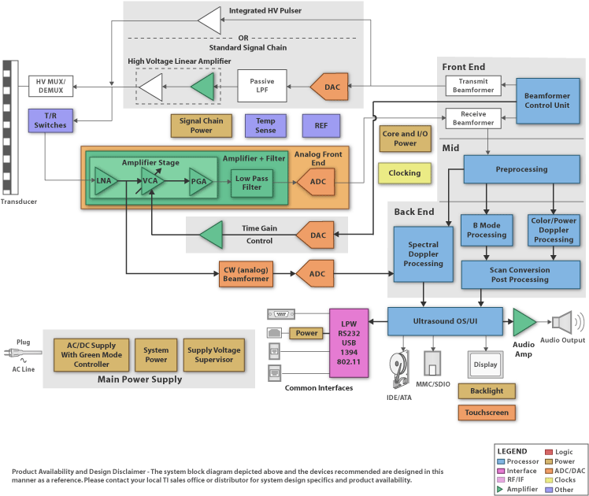
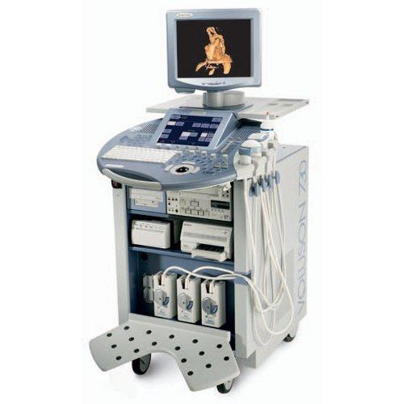
Ultrasound System

Slide 12
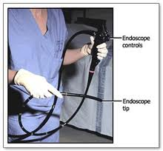
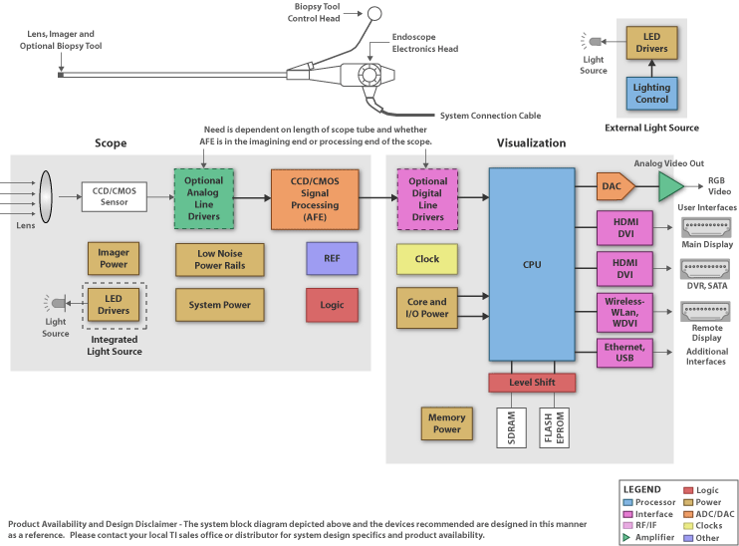
Endoscope

Slide 13
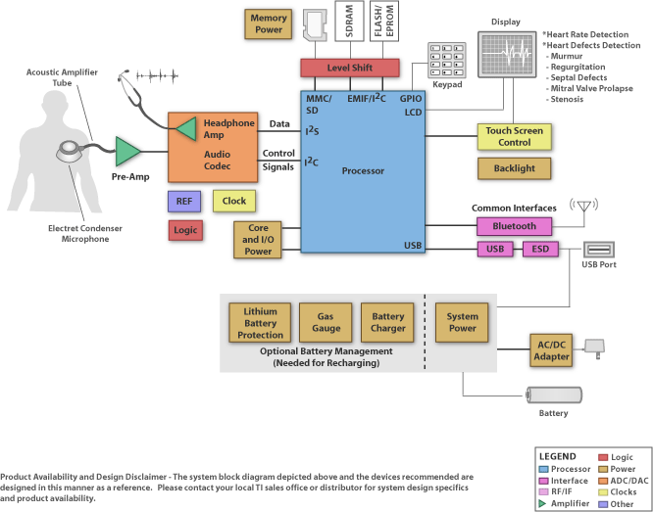
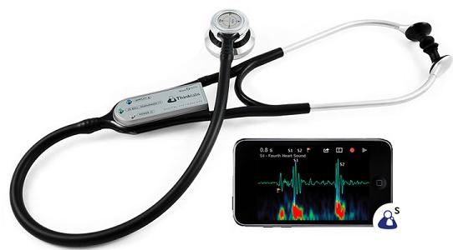
Digital Stethoscope

Slide 14
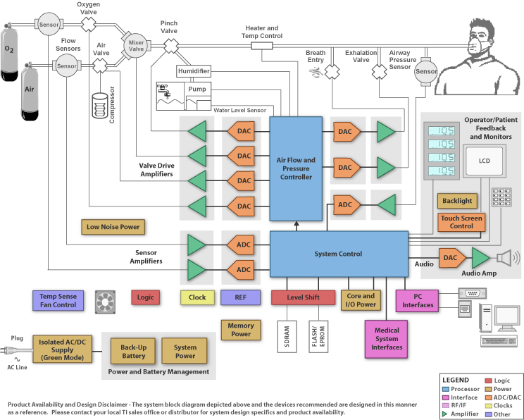
Ventilator

Slide 15
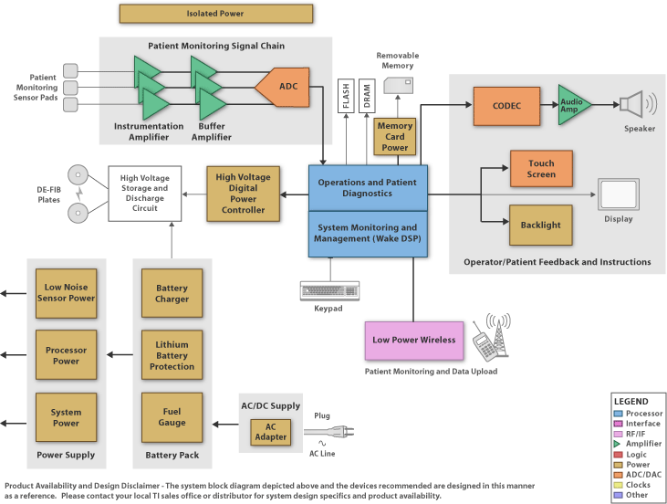
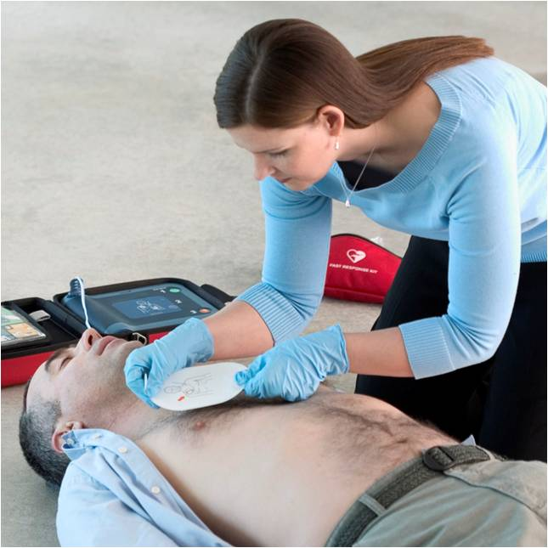
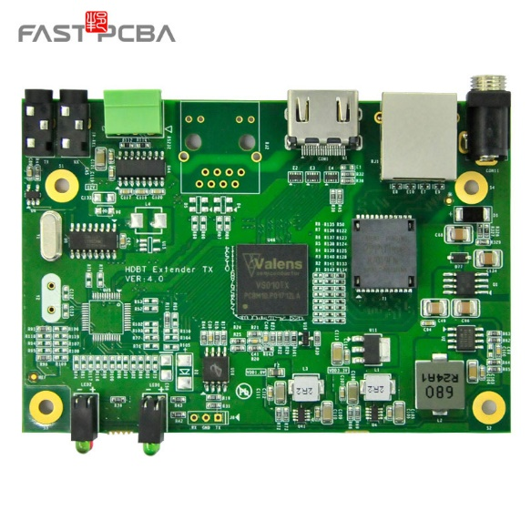
AED: Automated External Defibrillator

Slide 16
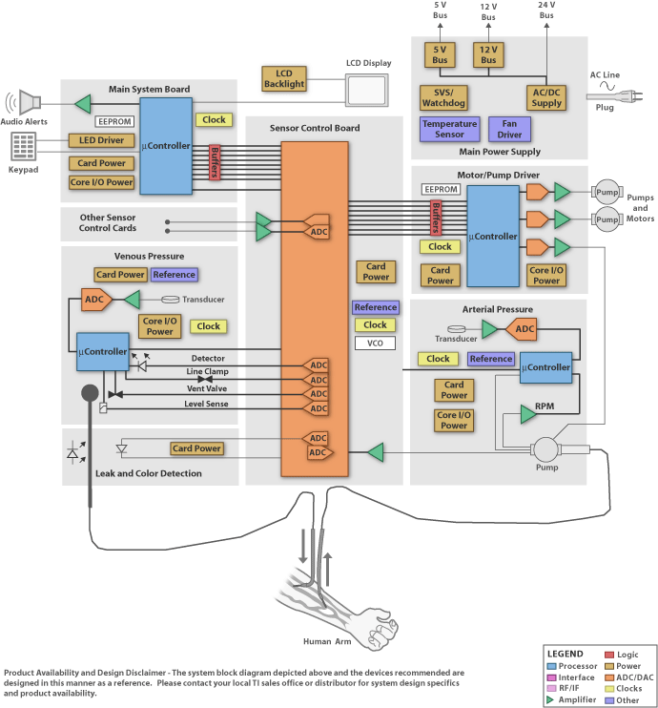
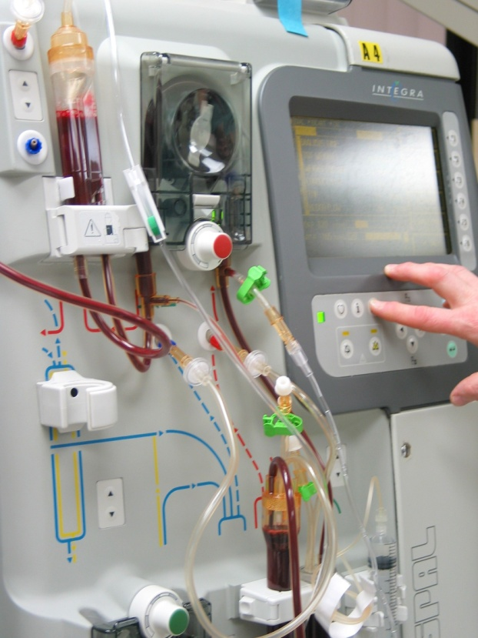
Dialysis Machine

Slide 17
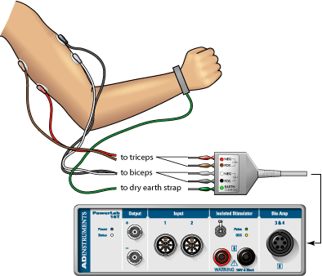
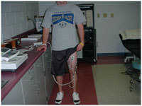
EMG: Electromyography

Slide 18
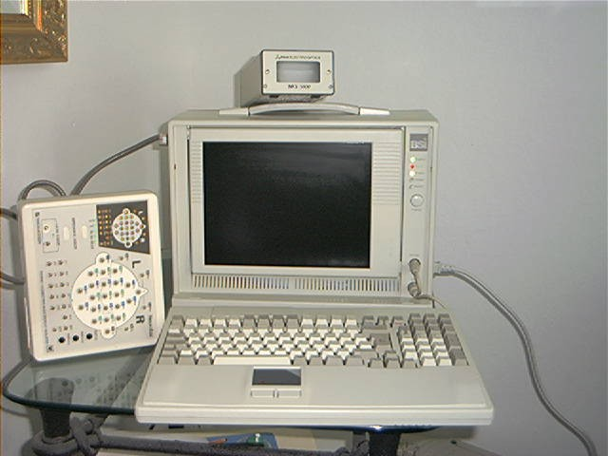
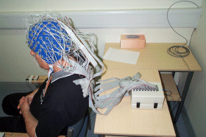
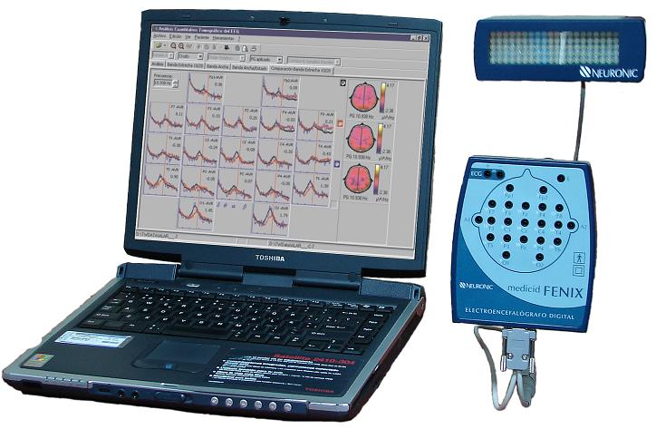
EEG: Electroencephalography

Slide 19
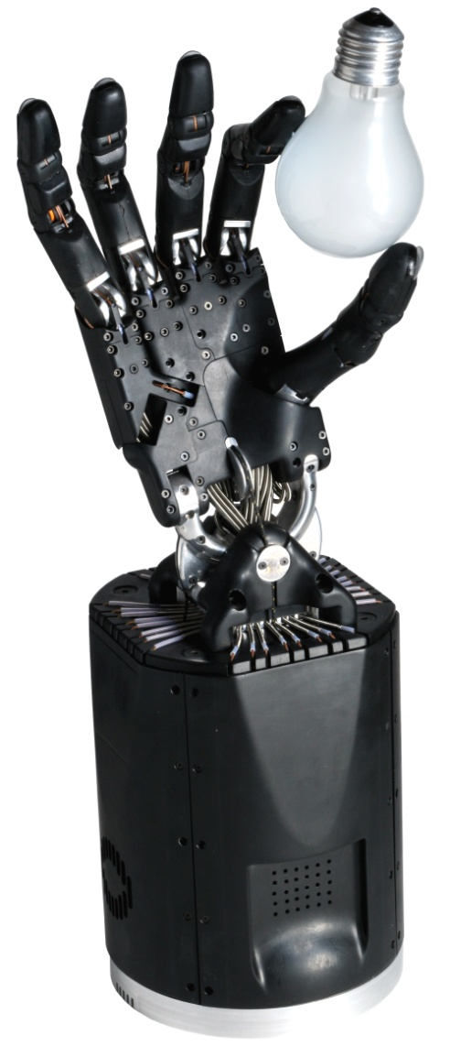
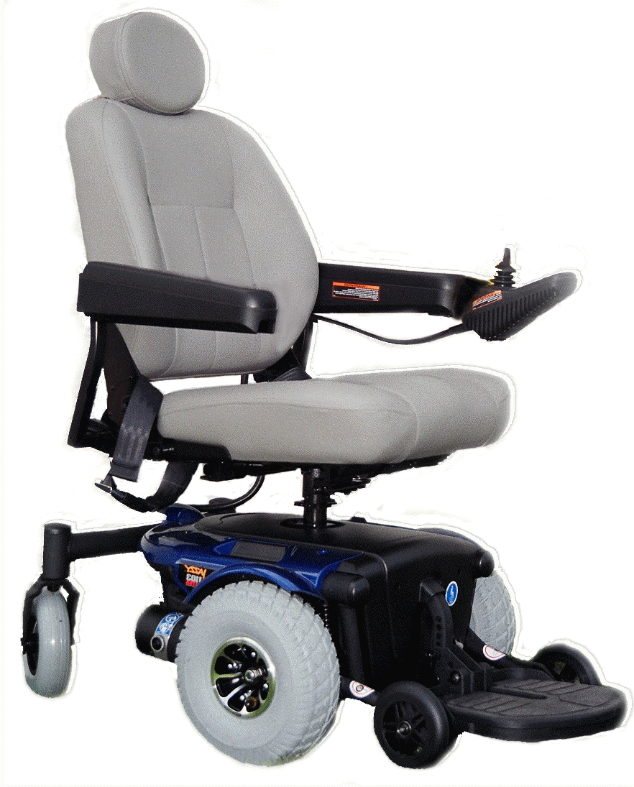
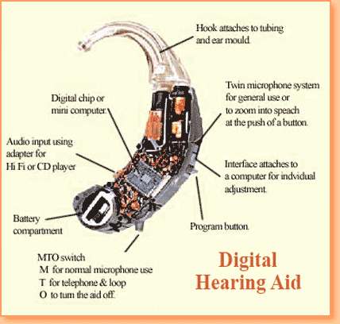
For Disabled People

Slide 20
Conclusion I
Microcontrollers and Digital Circuits
are
Key Components
in
Medical Equipment.

Slide 21
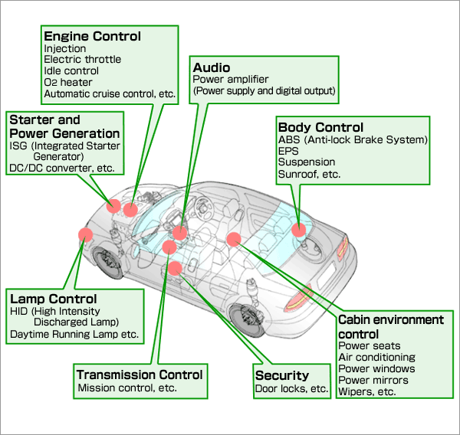



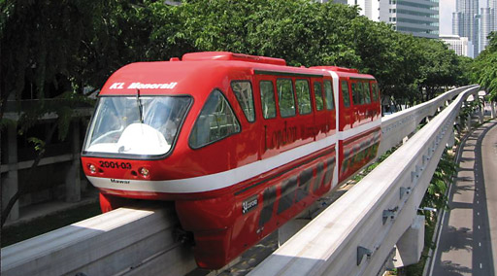
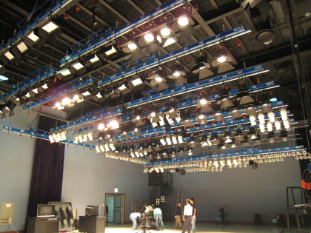
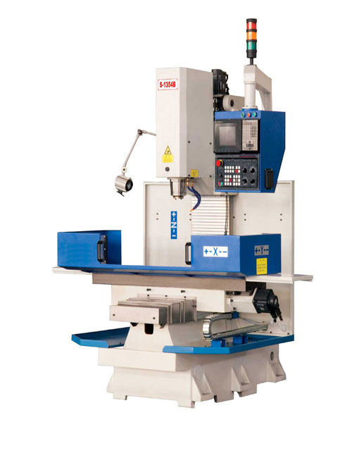
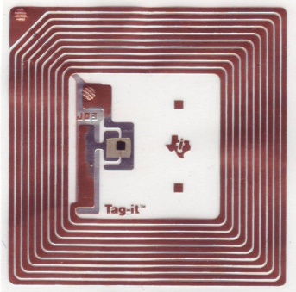
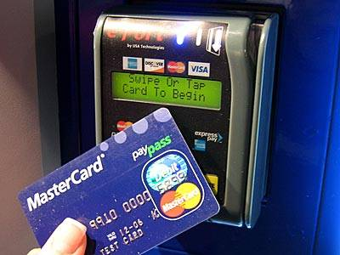
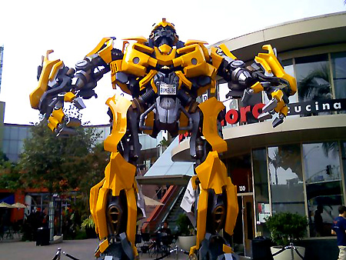
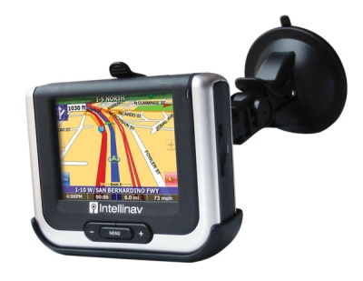
What Else? - Industrial

Slide 22

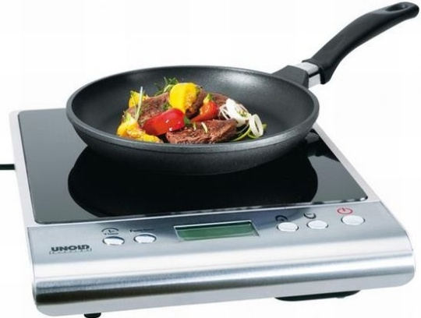
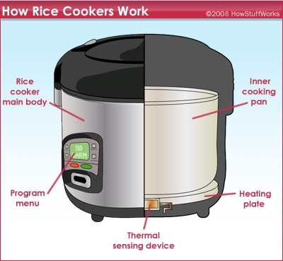
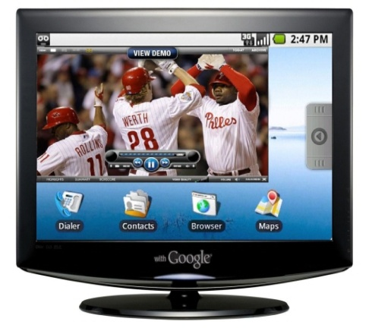
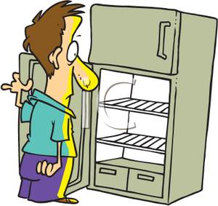
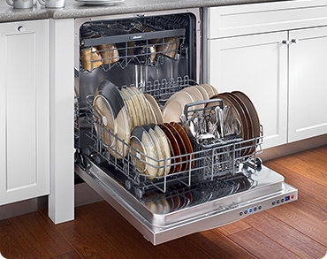
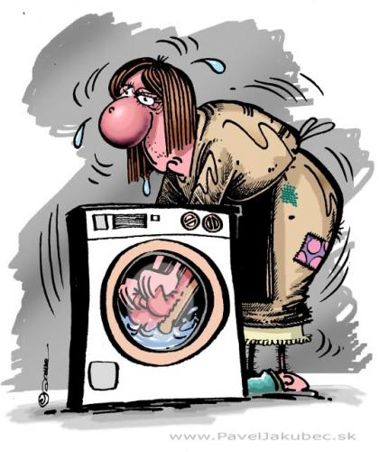
What Else? - Home Appliances

Slide 23








What Else? - Entertainment

Slide 24
Conclusion II
Microcontrollers
is
Everywhere.

Slide 25


Slide 26
의료기기의 설계 및 개발을 위한 필수 조건
사람 몸에 대한 이해
생체 신호에 대한 이해
전자회로에 대한 이해
디지털 시스템 및 컴퓨터에 대한 이해

Slide 27
Digital System and Microcomputer I
Computer Architecture

Slide 28
Computer Architecture
SOFTWARE
APPLICATION
OPERATING SYSTEM
FIRMWARE
HARDWARE

Slide 29
Computer Software (1)
Program
  A set of instructions that the computer hardware can execute
Machine Instruction / Machine Language
  All programs are stored in the computer’s memory in the form of
  binary number (machine instruction)
  It is difficult and not productive.
Ex: Machine language program
  1001 0100 0001 0011b
    stands for “increment the contents of R1 register by 1.”
  0000 1100 0010 0001b
    stands for “add the contents of R1 register to the contents of R2 register.”

Slide 30
Computer Software (2)
Assembly Language
  Invented to simplify the programming
  Consists of assembly instructions
  Mnemonic representation of a machine instruction
Ex: Assembly language program
  INC R1
  stands for “increment the contents of R1 register by 1.”
  ADD R2, R1
  stands for “add the contents of R1 register to the contents of R2 register.”

Slide 31
Computer Architecture
SOFTWARE
APPLICATION
OPERATING SYSTEM
FIRMWARE
HARDWARE

Slide 32
Computer Hardware
CPU
INPUT
CONTROL
OUTPUT
ALU
CPU: Central Processing Unit
ALU: Arithmetic Logic Unit
MEMORY

Slide 33
Central Processing Unit (CPU)
ALU
PROGRAM COUNTER
INSTRUCTION
REGISTER
STACK POINTER
CONTROL
UNIT
REGISTER
FILE
TEMPORARY
REGISTERS

Slide 34
Control Unit
PROGRAM MEMORY
CPU
0000 1100 0010 0001b
INSTRUCTION
REGISTER
INSTRUCTION
DECODER
CLOCK
CONTROL
Control Signals
To Internal Registers

Slide 35
ALU, Register File, and Control Unit
CPU
PROGRAM MEMORY
ADD R2,R1
0000 1100 0010 0001b
R1
R2
INSTRUCTION
REGISTER
ALU
INSTRUCTION
DECODER
CLOCK
CONTROL
SREG

Slide 36
Microprocessor (μP)
A processor(CPU) fabricated in a single IC
The number of bits of μP refers to
  the number of bits that μP can manipulate in one operation
Limitation of μP
  Requires external memory to execute programs.
  Cannot directly interface with I/O devices.
    Peripheral chips are needed.
  Address decoders and buffers are needed.
  Bigger system size

Slide 37

Microprocessor-Based System
SYSTEM BUS
(Address, Data, Control)
ROM
RWM
INPUT
OUTPUT
μP

Slide 38
Microcontroller
A computer implemented on a single VLSI chip
Contains everything a μP contains plus
  Memory
  Timer
  Analog-to-digital converter (ADC)
  Digital-to-analog converter (DAC)
  Parallel I/O interface
  Serial I/O interface
  Memory component interface circuitry

Slide 39

General Microcontroller
PERIPHERALS
CPU
ADD R2,R1
R1
R2
INSTRUCTION
REGISTER
ALU
INSTRUCTION
DECODER
CONTROL
SREG

Slide 40
Overview of 8-bit AVR Microcontroller
RISC architecture with CISC instruction set
  Powerful instruction set for C and Assembly
Scalable
  Same powerful AVR core in all devices
Single cycle execution
  One instruction per external clock
  Low power consumption
32 working Registers
  All directly connected to ALU!
Very efficient core
  20 MIPS @ 20MHz
High System Level Integration
  Lowest total system cost

Slide 41


Introduction to 8-bit AVR Microcontroller

Slide 42

ATmega328PB Features
Memories
  32 kBytes of In-System Self-Programmable Flash program memory
  1 kBytes EEPROM
  2 kBytes Internal SRAM
Peripherals
  Timer/Counters
  10-bit ADC
  USART
  SPI
  TWI
Operating Voltage: 1.8 - 5.5V
Speed Grade:
  0 - 4MHz @ 1.8 - 5.5V
  0 - 10MHz @ 2.7 - 5.5.V
  0 - 20MHz @ 4.5 - 5.5V

Slide 43
ATmega328PB Block Diagram

Slide 44
Summary
Number system
  Decimal, binary, and hexadecimal numbers
Computer organization
  hardware and software
Hardware
  CPU, input, output, and memory
Software
  Machine language, Assembly language
CPU
  ALU, register file, and control unit
Microprocessor
Microcontroller
AVR microcontroller

Slide 46
의료기기의 설계 및 개발을 위한 필수 조건
사람 몸에 대한 이해
생체 신호에 대한 이해
전자회로에 대한 이해
디지털 시스템 및 컴퓨터에 대한 이해

Slide 47
컴퓨터 이해를 위한 필수 조건
디지털 시스템에 대한 이해

Slide 48
What is Binary Digit?
Binary
  Two values (0, 1)
  Each digit is called as a “bit”
Good Things in Binary Number
Number representation with only two values (0, 1)
Can be implemented with simple electronics devices
  examples:
    Voltage: HIGH(1), LOW(0)
    Switch: ON(1), OFF(0)

Slide 49
Number Systems
Decimal: 0..9
Decimal | Binary | Hexadecimal
0 | 0 | 0
1 | 1 | 1
2 | 10 | 2
3 | 11 | 3
4 | 100 | 4
5 | 101 | 5
6 | 110 | 6
7 | 111 | 7
8 | 1000 | 8
9 | 1001 | 9
10 | 1010 | A
11 | 1011 | B
12 | 1100 | C
13 | 1101 | D
14 | 1110 | E
15 | 1111 | F
16 | 10000 | 10
17 | 10001 | 11
Binary: 0 and 1
Hexadecimal: 0..9 and A..F

Slide 50
Binary Arithmetic
Addition
0 + 0 = 0
0 + 1 = 1
1 + 0 = 1
1 + 1 = 10 | (carry 1 to the next column)
Example:
 | 1 | 1 | 1 | 1 |  | ← carries
13₁₀ = |  | 1 | 1 | 0 | 1
11₁₀ = |  | 1 | 0 | 1 | 1
24₁₀ = | 1 | 1 | 0 | 0 | 0
+

Slide 51







How to Implement an Adder (1)
Half Adder
Truth Table for a Half Adder
$$X Y$$ | $$C_{out} Sum$$
0 0 | 0 0
0 1 | 0 1
1 0 | 0 1
1 1 | 1 0
$$X$$
Half
Adder
$$C_{out}$$
$$Y$$
$$Sum$$
X
$$Sum=X^{′}∙Y+X{∙Y}^{′}=X⊕Y$$
+
Y
$$C_{out}=X∙Y$$
Exclusive OR
C_{out}
Sum
AND

Slide 52







How to Implement an Adder (2)
Half Adder
$$Sum=X^{′}∙Y+X{∙Y}^{′}=X⊕Y$$
$$C_{out}=X∙Y$$
$$X$$
Half
Adder
$$C_{out}$$
Exclusive OR gate
$$Y$$
$$Sum$$
X
+
Y
C_{out}
Sum
AND gate

Slide 53
Boolean Algebra
Boolean Algebra
  Developed by George Boole
  Basic mathematics for logic design
  Restrict to switching circuits
    Two state values: 0, 1
    Switching algebra
Boolean Variable : X, Y, …
  Can only have two state values: 0, 1
  Representing True(1) or False (0)

Slide 54
Boolean Algebra
Basic Operations of Boolean Algebra
  AND
  OR
  NOT
    Complement
    Inverse

Slide 55



Basic Operations (NOT)
NOT (Inverter)
$$0^{′}=1 1^{′}=0$$
$X^{′}=1 \text{if} X=0 X^{′}=0 \text{if} X=$1
Gate Symbol

Slide 56

Basic Operations (AND)
AND
$$0∙0=0 0∙1=0 1∙0=0 1∙1=1$$
Truth Table
A B | C = A · B
0 0 0 1 1 0 1 1 | 0 0 0 1
Gate Symbol

Slide 57

Basic Operations (OR)
OR
$$0+0=0 0+1=1 1+0=1 1+1=1$$
Truth Table
A B | C = A + B
0 0 0 1 1 0 1 1 | 0 1 1 1
Gate Symbol

Slide 58

Hardware Architecture for Microcontroller
CPU
PROGRAM MEMORY
ADD R2,R1
0000 1100 0010 0001b
R1
R2
INSTRUCTION
REGISTER
ALU
INSTRUCTION
DECODER
CLOCK
CONTROL
SREG

Slide 60


