Slide 1
디지털시스템 및 마이크로 컴퓨터 I
3 주차 강의
Mar., 26 2020

Slide 2
Part 1 Applications of Boolean Algebra/ Minterm and Maxterm Expansions

Slide 3
Objective
Conversion of Verbal Description to Boolean Equations
Combinational Logic Design Using a Truth Table
Minterm and Maxterm Expansions
Incompletely Specified Functions (Don’t care term)
Design of Binary Adders(Full adder) and Subtractors

Slide 4
3.1 Conversion of Verbal Description to Boolean Equations
Steps in designing a single-output combinational switching circuit
Find a switching function which specifies the desired behavior of the circuit
Find a simplified algebraic expression for the function
Realize the simplified function using available logic elements

Slide 5
3.1 Conversion of Verbal Description to Boolean Equations
Example 1
Verbal Description
Mary watches TV if it is Monday night and she has finished her homework.
F = 1 if “Mary watches TV ” is true; otherwise, F = 0;
A = 1 if “it is Monday night ” is true; otherwise, A = 0;
B = 1 if “she has finished her homework” is true; otherwise, B = 0;
F is ‘true’ if A and B are both ‘true’ → F = A·B

Slide 6
3.1 Conversion of Verbal Description to Boolean Equations
Example 2
Verbal Description
The alarm will ring iff the alarm switch is turned on and the door is not closed, or it is after 6PM and window is not closed.
Breaking Down
The alarm will ring iff
the alarm switch is turned on and the door is not closed,
or it is after 6PM and window is not closed.
Z
A
B’
C
D’

Slide 7
3.1 Conversion of Verbal Description to Boolean Equations
Verbal Description
The alarm will ring iff
the alarm switch is turned on and the door is not closed,
or it is after 6PM and window is not closed.
Z
A
B’
C
D’
Boolean Equation
$$Z=AB′+CD′$$

Slide 8
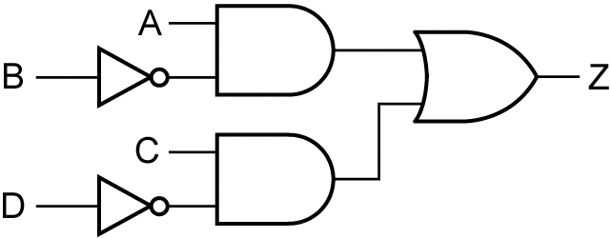
3.1 Conversion of Verbal Description to Boolean Equations
Boolean Equation
$$Z=AB′+CD′$$
Circuit Realization

Slide 9
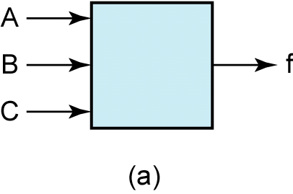
3.2 Combinational Logic Design Using a Truth Table
Verbal Description
A switching circuit with three inputs and one output.
The inputs are A, B, and C and represent a binary number N.
f = 1 if N ≥ 011₂ and f = 0 if N < 011₂

Slide 10
3.2 Combinational Logic Design Using a Truth Table
Verbal Description
A B C | f
0 0 0 | 0
0 0 1 | 0
0 1 0 | 0
0 1 1 | 1
1 0 0 | 1
1 0 1 | 1
1 1 0 | 1
1 1 1 | 1
A switching circuit with three inputs and one output.
The inputs are A, B, and C and represent a binary number N.
f = 1 if N ≥ 011₂ and f = 0 if N < 011₂

Slide 11
3.2 Combinational Logic Design Using a Truth Table
Deriving an algebraic expression for f = 1
A B C | f
0 0 0 | 0
0 0 1 | 0
0 1 0 | 0
0 1 1 | 1
1 0 0 | 1
1 0 1 | 1
1 1 0 | 1
1 1 1 | 1
$$f=A′BC+AB′C′+AB′C+ABC′+ABC$$
Simplifying the algebraic expression
$$f=A′BC+AB′C′+AB′C+ABC′+ABC \\ =A′BC+AB′+AB \\ =A′BC+A \\ =A+BC$$

Slide 12
3.2 Combinational Logic Design Using a Truth Table
Original Equation
$$f=A′BC+AB′C′+AB′C+ABC′+ABC$$
Simplified Equation
$$f=A+BC$$
Circuit Realization

Slide 13
3.2 Combinational Logic Design Using a Truth Table
Expression for f = 0 i.e. f’ = 1
A B C | f | f’
0 0 0 | 0 | 1
0 0 1 | 0 | 1
0 1 0 | 0 | 1
0 1 1 | 1 | 0
1 0 0 | 1 | 0
1 0 1 | 1 | 0
1 1 0 | 1 | 0
1 1 1 | 1 | 0
$$f′=A′B′C′+A′B′C+A′BC′$$
Taking the complement of f ’
$$f=(f′)′ \\ =(A′B′C′+A′B′C+A′BC′)′ \\ =(A′B′C′)′(A′B′C)′(A′BC′)′ \\ =(A+B+C)(A+B+C′)(A+B′+C)$$

Slide 14
3.2 Combinational Logic Design Using a Truth Table
Expression for f = 0
A B C | f | f’
0 0 0 | 0 | 1
0 0 1 | 0 | 1
0 1 0 | 0 | 1
0 1 1 | 1 | 0
1 0 0 | 1 | 0
1 0 1 | 1 | 0
1 1 0 | 1 | 0
1 1 1 | 1 | 0
$$f=(A+B+C)(A+B+C′)(A+B′+C)$$
$$A+B+C=0 \text{only} \text{if} A=B=C=0 \\ A+B+C′=0 \text{only} \text{if} A=B=0 \text{and} C=1 \\ A+B′+C=0 \text{only} \text{if} A=C=0 \text{and} B=1$$

Slide 15
3.2 Combinational Logic Design Using a Truth Table
Simplifying
A B C | f | f’
0 0 0 | 0 | 1
0 0 1 | 0 | 1
0 1 0 | 0 | 1
0 1 1 | 1 | 0
1 0 0 | 1 | 0
1 0 1 | 1 | 0
1 1 0 | 1 | 0
1 1 1 | 1 | 0
$$f=(A+B+C)(A+B+C′)(A+B′+C) \\ =(A+B)(A+B′+C) \\ =AA+AB′+AC+AB+BB′+BC \\ =A+AB′+AC+AB+BC \\ =A(1+C)+A(B+B′)+BC \\ =A+BC$$

Slide 16
3.3 Minterm and Maxterm Expansions
Literal
A variable or its complement (e.g. A, A’)
Minterm of n variables
A product of n literals in which each variable appears exactly once in either true or complemented form, but not both
Notation
m_{i}

Slide 17
3.3 Minterm and Maxterm Expansions
Minterm of 3 variables
Row No. | A B C | Minterms | Maxterms
0 1 2 3 4 5 6 7 | 0 0 0 0 0 1 0 1 0 0 1 1 1 0 0 1 0 1 1 1 0 1 1 1 | $$A^{′}B^{′}C^{′}=m_{0} \\ A^{′}B^{′}C=m_{1} \\ A^{′}BC^{′}=m_{2} \\ A^{′}BC=m_{3} \\ AB^{′}C^{′}=m_{4} \\ AB^{′}C=m_{5} \\ ABC^{′}=m_{6} \\ ABC=m_{7}$$ | A+B+C = M₀ A+B+C’ = M₁ A+B’+C = M₂ A+B’+C’ = M₃ A’+B+C = M₄ A’+B+C’ = M₅ A’+B’+C = M₆ A’+B’+C’ = M₇

Slide 18
3.3 Minterm and Maxterm Expansions
Sum of minterms
Minterm expansion
Standard sum of products
Canonical sum of products
$$f=A′BC+AB′C′+AB′C+ABC′+ABC$$
$$f(A,B,C)=m_{3}+m_{4}+m_{5}+m_{6}+m_{7}$$
$$f(A,B,C)=\sum{m(3,4,5,6,7)}$$

Slide 19
3.3 Minterm and Maxterm Expansions
Maxterm of n variables
A sum of n literals in which each variable appears exactly once in either true or complemented form, but not both
Notation
M_{i}

Slide 20
3.3 Minterm and Maxterm Expansions
Maxterm of 3 variables
Row No. | A B C | Minterms | Maxterms
0 1 2 3 4 5 6 7 | 0 0 0 0 0 1 0 1 0 0 1 1 1 0 0 1 0 1 1 1 0 1 1 1 | $$A^{′}B^{′}C^{′}=m_{0} \\ A^{′}B^{′}C=m_{1} \\ A^{′}BC^{′}=m_{2} \\ A^{′}BC=m_{3} \\ AB^{′}C^{′}=m_{4} \\ AB^{′}C=m_{5} \\ ABC^{′}=m_{6} \\ ABC=m_{7}$$ | A+B+C = M₀ A+B+C’ = M₁ A+B’+C = M₂ A+B’+C’ = M₃ A’+B+C = M₄ A’+B+C’ = M₅ A’+B’+C = M₆ A’+B’+C’ = M₇

Slide 21
3.3 Minterm and Maxterm Expansions
Product of maxterms
Maxterm expansion
Standard product of sums
Canonical product of sums
$$f=(A+B+C)(A+B+C′)(A+B′+C)$$
$$f(A,B,C)=M_{0}M_{1}M_{2}$$
$$f(A,B,C)=\prod{M(0,1,2)}$$

Slide 22
3.3 Minterm and Maxterm Expansions
Finding Complement
$$f(A,B,C)=m_{3}+m_{4}+m_{5}+m_{6}+m_{7}$$
$$f′=m_{0}+m_{1}+m_{2}=\sum{m(0,1,2)}$$
$$f(A,B,C)=M_{0}M_{1}M_{2}$$
$$f′=\prod{M(3,4,5,6,7)=M_{3}M_{4}M_{5}M_{6}M_{7}}$$

Slide 23
3.3 Minterm and Maxterm Expansions
Minterm and Maxterm expansions are complement each other
$$f(A,B,C)=m_{3}+m_{4}+m_{5}+m_{6}+m_{7}$$
$$f(A,B,C)=M_{0}M_{1}M_{2}$$
$$f^{′}={\left(m_{3}+m_{4}+m_{5}+m_{6}+m_{7}\right)}^{′} \\ =m′_{3}m′_{4}m′_{5}m′_{6}m′_{7} \\ =M_{3}M_{4}M_{5}M_{6}M_{7}$$
$$f^{′}={\left(M_{0}M_{1}M_{2}\right)}^{′} \\ =M_{0}^{′}+M_{1}^{′}+M_{2}^{′} \\ =m_{0}+m_{1}+m_{2}$$

Slide 24
3.3 Minterm and Maxterm Expansions
Introducing Missing Variables
Find the minterm expansion of
$$f\left(a,b,c,d\right)=a^{′}\left(b^{′}+d\right)+acd′$$
$$f=a^{′}\left(b^{′}+d\right)+acd^{′} \\ =a^{′}b^{′}+a^{′}d+acd^{′} \\ =a^{′}b^{′}\left(c+c^{′}\right)\left(d+d^{′}\right)+a^{′}d\left(b+b^{′}\right)\left(c+c^{′}\right)+acd^{′}\left(b+b^{′}\right) \\ =a^{′}b^{′}cd+a^{′}b^{′}cd^{′}+a^{′}b^{′}c^{′}d+a^{′}b^{′}c^{′}d^{′}+a^{′}bcd+a^{′}bc^{′}d+a^{′}b^{′}cd+a^{′}b^{′}c^{′}d+abcd^{′}+ab^{′}cd^{′} \\ =\sum{m(3, 2, 1, 0, 7, 5, 3, 1, 14, 10)}=\sum{m(0, 1, 2, 3, 5, 7, 10, 14)}$$
$$f=\prod{M(4, 6, 8, 9, 11, 12, 13, 15)}$$
Maxterm expansion

Slide 25
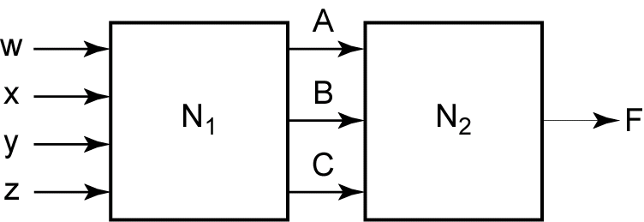
3.4 Incompletely Specified Functions
Don’t Care
Truth Table with Don’t Cares
A B C | f
0 0 0 | 1
0 0 1 | X
0 1 0 | 0
0 1 1 | 1
1 0 0 | 0
1 0 1 | 0
1 1 0 | X
1 1 1 | 1
If N₁ output does not generate all possible combination of A, B, C, the output of N₂(F) has don’t care values.

Slide 26
3.4 Incompletely Specified Functions
Don’t Care
A B C | f
0 0 0 | 1
0 0 1 | X
0 1 0 | 0
0 1 1 | 1
1 0 0 | 0
1 0 1 | 0
1 1 0 | X
1 1 1 | 1
When realize, assign values which will help simplify the function.
Case 1: assign ‘0’ on all X’s
$$F=A′B′C′+A′BC+ABC=A′B′C′+BC$$
Case 2: assign ‘1’ to the first X and ‘0’ to the second ‘X’
$$F=A′B′C′+A′B′C+A′BC+ABC=A′B′+BC$$
Case 3: assign ‘1’ on all X’s
$$F=A′B′C′+A′B′C+A′BC+ABC′+ABC=A′B′+BC+AB$$
The case 2 leads to the simplest function

Slide 27
3.4 Incompletely Specified Functions
Notation for Don’t Care Terms
A B C | f
0 0 0 | 1
0 0 1 | X
0 1 0 | 0
0 1 1 | 1
1 0 0 | 0
1 0 1 | 0
1 1 0 | X
1 1 1 | 1
Minterm expansion for incompletely specified function
$$F=\sum{m}(0,3,7)+\sum{d(1,6)}$$
Don’t Cares
Maxterm expansion for incompletely specified function
$$F=\prod{M(2,4,5)•\prod{D(1,6)}}$$
Don’t Cares

Slide 28
3.5 Design of Binary Adders and Subtractors
Half Adder
Truth Table for a Half Adder
$$X Y$$ | $$C_{out} Sum$$
0 0 | 0 0
0 1 | 0 1
1 0 | 0 1
1 1 | 1 0
$$X$$
Half
Adder
$$C_{out}$$
$$Y$$
$$Sum$$
$$\frac{\begin{matrix} & X \\ + & Y\end{matrix}}{\begin{matrix}C_{out} & Sum\end{matrix}}$$
$$Sum=X^{′}Y+XY^{′}=X⊕Y$$
$$C_{out}=XY$$

Slide 29
3.5 Design of Binary Adders and Subtractors
Full Adder
Truth Table for a Full Adder
$$X Y C_{in}$$ | $$C_{out} Sum$$
0 0 0 | 0 0
0 0 1 | 0 1
0 1 0 | 0 1
0 1 1 | 1 0
1 0 0 | 0 1
1 0 1 | 1 0
1 1 0 | 1 0
1 1 1 | 1 1
$$X$$
Full
Adder
$$C_{out}$$
$$Y$$
$$Sum$$
$$C_{in}$$
$$\frac{\begin{matrix} & C_{in} \\ & X \\ + & Y\end{matrix}}{\begin{matrix}C_{out} & Sum\end{matrix}}$$

Slide 30
3.5 Design of Binary Adders and Subtractors
Implementation of Full Adder
Truth Table for a Full Adder
$$Sum=X′Y′C_{in}+X′YC′_{in}+XY′C′_{in}+XYC_{in} \\ =X′(Y′C_{in}+YC′_{in})+X(Y′C′_{in}+YC_{in}) \\ =X′(Y⊕C_{in})+X(Y⊕C_{in})′=X⊕Y⊕C_{in}$$
$$X Y C_{in}$$ | $$C_{out} Sum$$
0 0 0 | 0 0
0 0 1 | 0 1
0 1 0 | 0 1
0 1 1 | 1 0
1 0 0 | 0 1
1 0 1 | 1 0
1 1 0 | 1 0
1 1 1 | 1 1
$$C_{out}=X′YC_{in}+XY′C_{in}+XYC′_{in}+XYC_{in} \\ =(X′YC_{in}+XYC_{in})+(XY′C_{in}+XYC_{in})+(XYC′_{in}+XYC_{in}) \\ =YC_{in}+XC_{in}+XY$$

Slide 31
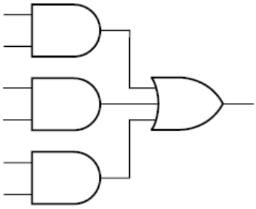
3.5 Design of Binary Adders and Subtractors
Implementation of Full Adder
X
$$Sum=X′Y′C_{in}+X′YC′_{in}+XY′C′_{in}+XYC_{in} \\ =X′(Y′C_{in}+YC′_{in})+X(Y′C′_{in}+YC_{in}) \\ =X′(Y⊕C_{in})+X(Y⊕C_{in})′=X⊕Y⊕C_{in}$$
Y
sum
C_{in}
X
Y
$$C_{out}=X′YC_{in}+XY′C_{in}+XYC′_{in}+XYC_{in} \\ =(X′YC_{in}+XYC_{in})+(XY′C_{in}+XYC_{in})+(XYC′_{in}+XYC_{in}) \\ =YC_{in}+XC_{in}+XY$$
X
C_{in}
C_{out}
Y
C_{in}

Slide 32
3.5 Design of Binary Adders and Subtractors
Parallel Adder for 4 bit Binary Numbers
$$S_{3}$$
$$S_{2}$$
$$S_{1}$$
$$S_{0}$$
$$C_{4}$$
$$C_{4}$$
1 | 0 | 1 | 1 | 0 | $$C_{i}$$
 | 1 | 0 | 1 | 1 | $$A_{i}$$
 | 1 | 0 | 1 | 1 | $$B_{i}$$
1 | 0 | 1 | 1 | 0 | $$S_{i}$$
$$X$$
$$X$$
$$X$$
$$X$$
Full
Adder
Full
Adder
Full
Adder
Full
Adder
$$+$$
$$C_{out}$$
$$C_{out}$$
$$C_{out}$$
$$C_{out}$$
$$Y$$
$$Y$$
$$Y$$
$$Y$$
$$Sum$$
$$Sum$$
$$Sum$$
$$Sum$$
$$C_{in}$$
$$C_{in}$$
$$C_{in}$$
$$C_{in}$$
$$C_{4}$$
$$C_{0}$$
$$A_{3}$$
$$B_{3}$$
$$A_{2}$$
$$B_{2}$$
$$A_{1}$$
$$B_{1}$$
$$A_{0}$$
$$B_{0}$$

Slide 33
3.5 Design of Binary Adders and Subtractors
Parallel Adder for 4 bit Binary Numbers
$$S_{3}$$
$$S_{2}$$
$$S_{1}$$
$$S_{0}$$
$$C_{4}$$
1 | 0 | 1 | 1 | 0 | $$C_{i}$$
 | 1 | 0 | 1 | 1 | $$A_{i}$$
 | 1 | 0 | 1 | 1 | $$B_{i}$$
1 | 0 | 1 | 1 | 0 | $$S_{i}$$
4-bit Parallel Adder
$$C_{4}$$
$$C_{0}$$
$$+$$
$$C_{4}$$
$$A_{3}$$
$$B_{3}$$
$$A_{2}$$
$$B_{2}$$
$$A_{1}$$
$$B_{1}$$
$$A_{0}$$
$$B_{0}$$

Slide 34
3.5 Design of Binary Adders and Subtractors
Parallel Adder Composed of Four Full Adders
Carry Ripple Adder (slow!)
$$C_{4}$$
$$S_{3}$$
$$S_{2}$$
$$S_{1}$$
$$S_{0}$$
1 | 0 | 1 | 1 | 0 | $$C_{i}$$
 | 1 | 0 | 1 | 1 | $$A_{i}$$
 | 1 | 0 | 1 | 1 | $$B_{i}$$
1 | 0 | 1 | 1 | 0 | $$S_{i}$$
Full
Adder
$$C_{3}$$
Full
Adder
$$C_{2}$$
Full
Adder
$$C_{1}$$
Full
Adder
$$C_{0}$$
$$+$$
$$C_{4}$$
0
$$C_{4}$$
$$A_{3}$$
$$B_{3}$$
$$A_{2}$$
$$B_{2}$$
$$A_{1}$$
$$B_{1}$$
$$A_{0}$$
$$B_{0}$$

Slide 35
3.5 Design of Binary Adders and Subtractors
Binary Subtractor Using Full Adder
Subtraction is done by adding the 2’s complemented number to be subtracted.
$$S_{3}$$
$$S_{2}$$
$$S_{1}$$
$$S_{0}$$
Ignore
Last
Carry
Full
Adder
$$C_{3}$$
Full
Adder
$$C_{2}$$
Full
Adder
$$C_{1}$$
Full
Adder
$$C_{0}$$
$$C_{4}$$
1
$$A_{3}$$
$$B_{3}$$
$$A_{2}$$
$$B_{2}$$
$$A_{1}$$
$$B_{1}$$
$$A_{0}$$
$$B_{0}$$

Slide 36
Summary
Conversion of Verbal Description to Boolean Equations
Combinational Logic Design Using a Truth Table
Minterm and Maxterm Expansions
Incompletely Specified Functions (Don’t care term)
Design of Binary Adders(Full adder) and Subtractors

Slide 37
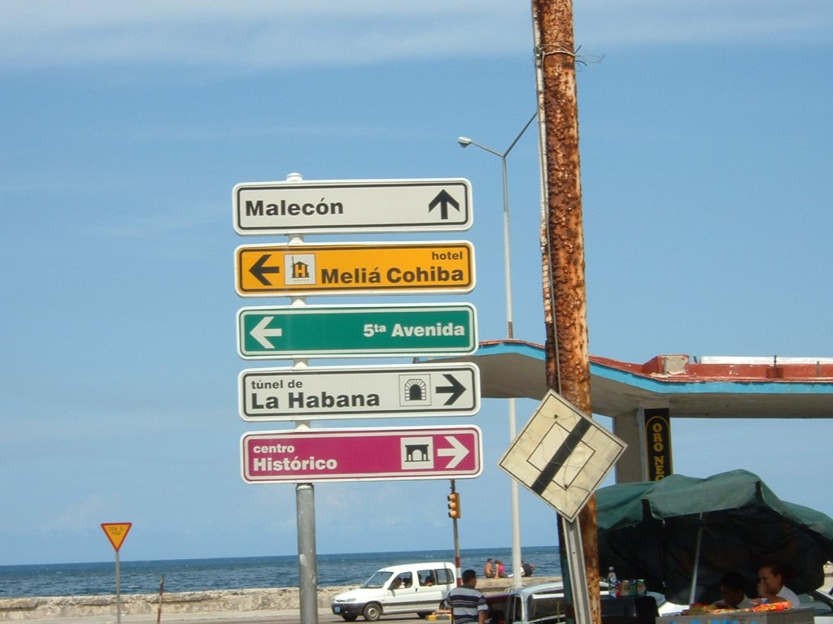

Slide 38
Part 2 Karnaugh Map
(K-Map)

Slide 39
Objectives
Given a function (completely or in completely specified) of three to five variable, plot it on a Karnaugh map. The function may be given in minterm, maxterm, or algebraic form.
Determine the essential prime implicants of a function from a map.
Obtain the minimum sum-of-products or minimum product-of-sums form of a function from the map.
Determine all of the prime implicants of a function from a map.
Understand the relation between operations performed using the map and the corresponding algebraic operation.

Slide 40
Karnaugh Maps
Two Problems of Simplifying a Switching Function Using Algebraic Techniques
Difficult to apply in a systematic way.
Difficult to tell when you have arrived at a minimum solution.
Karnaugh Map method and Quine-McCluskey Procdure
Easy and systematic to get a a minimum solution.

Slide 41
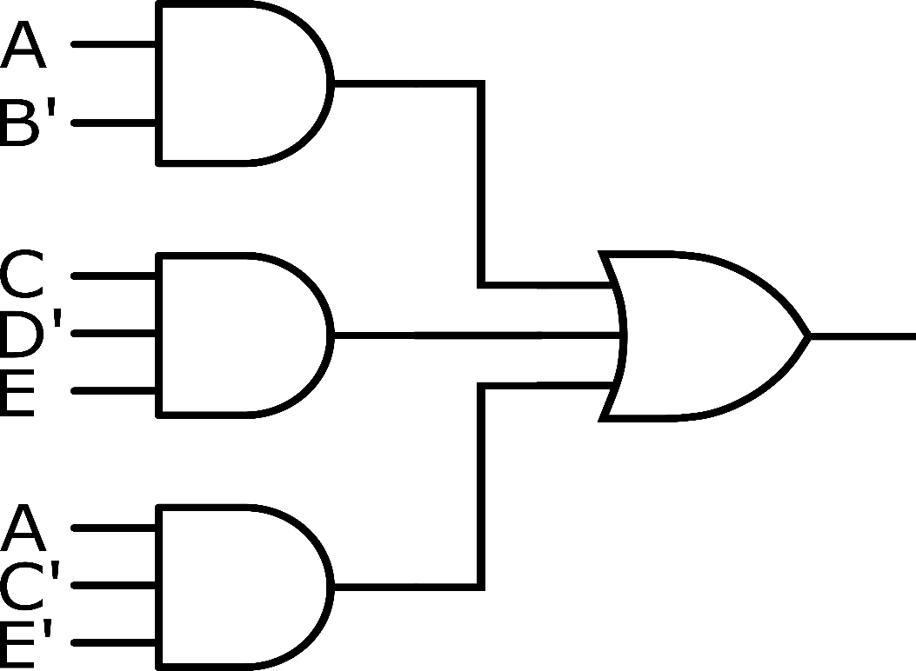
3.6 Minimum Forms of Switching Functions
Realizing a switching function using AND and OR gates
$$AB^{′}+CD^{′}E+AC^{′}E′$$
Sum-of-Products form

Slide 42
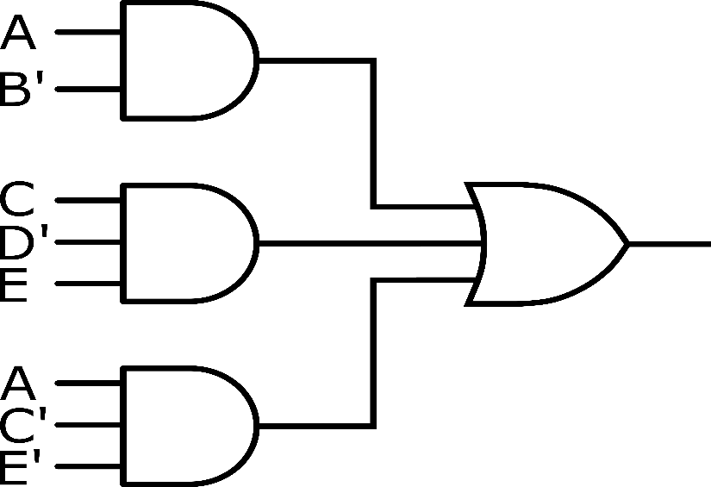
3.6 Minimum Forms of Switching Functions
$$AB^{′}+CD^{′}E+AC^{′}E′$$
Sum-of-Products form
What we want is a circuit with
Minimum number of gates
Minimum number of gate inputs
Minimum number of terms
Minimum number of literals
Minimum Sum-of-Products form

Slide 43
3.6 Minimum Forms of Switching Functions
Procedure for obtaining a minimum sum-of-products
Combine terms by using $XY^{′}+XY=X$.
Do this repeatedly to eliminates as many literals as possible.
A given term may be used more than once because $X+X=X$.

Slide 44
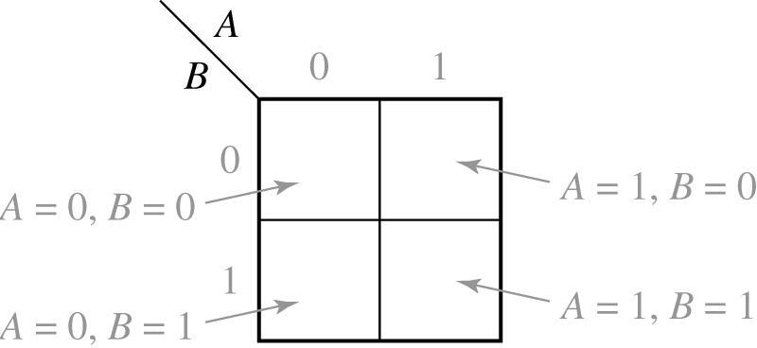
3.7 Two- and Three-Variable Karnaugh Maps
2-variable Karnaugh Map

Slide 45
3.7 Two- and Three-Variable Karnaugh Maps
Example: Truth table and Karnaugh map for a two-variable function
A B | F
0 0 0 1 1 0 1 1 | 1 1 0 0
(a)

Slide 46
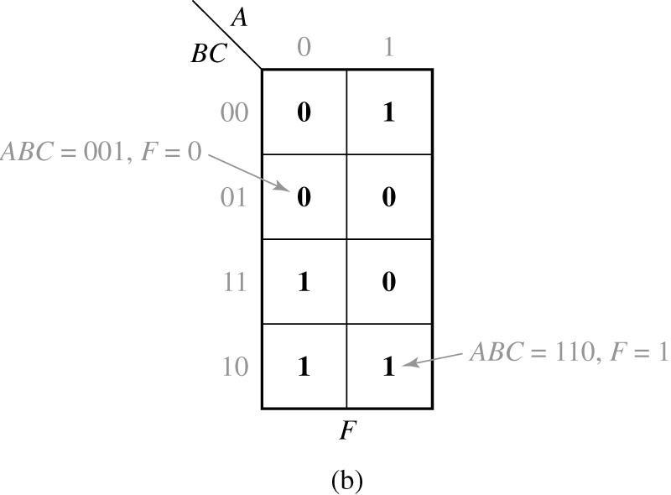
3.7 Two- and Three-Variable Karnaugh Maps
Example: Truth table and Karnaugh map for a three-variable function
A B C | F
0 0 0 0 0 1 0 1 0 0 1 1 1 0 0 1 0 1 1 1 0 1 1 1 | 0 0 1 1 1 0 1 0
(a)

Slide 47
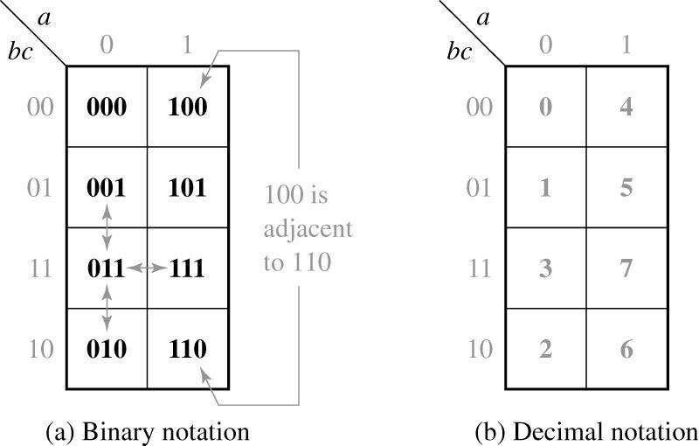
3.7 Two- and Three-Variable Karnaugh Maps
3-variable Karnaugh map
Minterms in adjacent squares differ in only one variable
Can be combined using the theorem $XY^{′}+XY=X$.

Slide 48
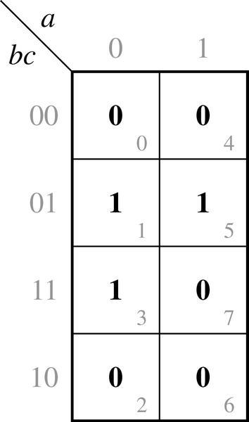
3.7 Two- and Three-Variable Karnaugh Maps
Plot of minterms and maxterms
Karnaugh Map of
Plot of minterm: mark 1
Plot of maxterm: mark 0

Slide 49
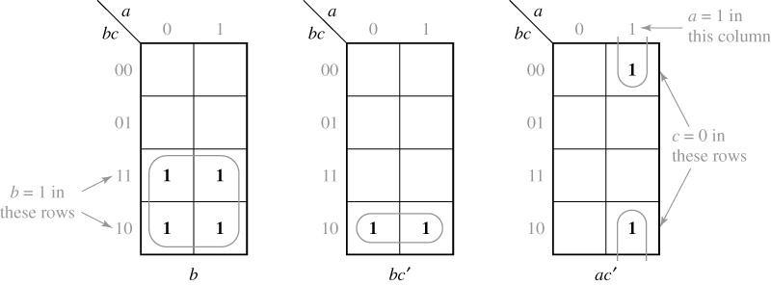
3.7 Two- and Three-Variable Karnaugh Maps
Karnaugh maps for non-minterm product terms
term b
term bc’
term ac’

Slide 50
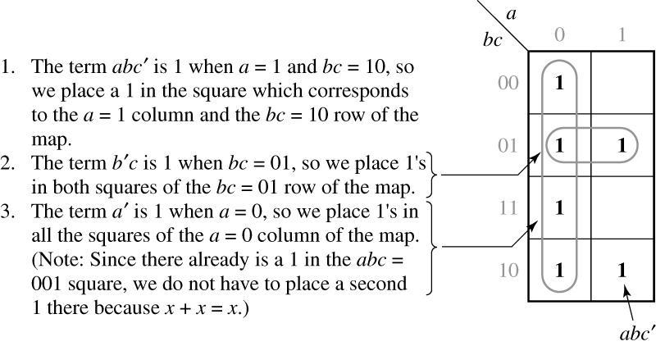
3.7 Two- and Three-Variable Karnaugh Maps
Karnaugh maps for non-minterm product terms

Slide 51
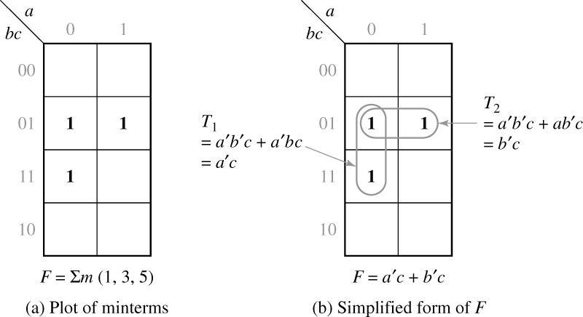
3.7 Two- and Three-Variable Karnaugh Maps
$$F\left(a,b,c\right)=\sum{m(1,3,5)}$$
Simplification of a Three-Variable Function
$$F=T_{1}+T_{2}=a^{′}c+b^{′}c$$

Slide 52
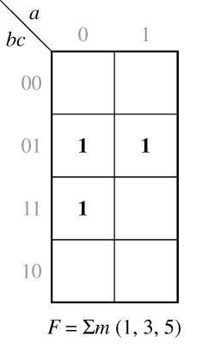
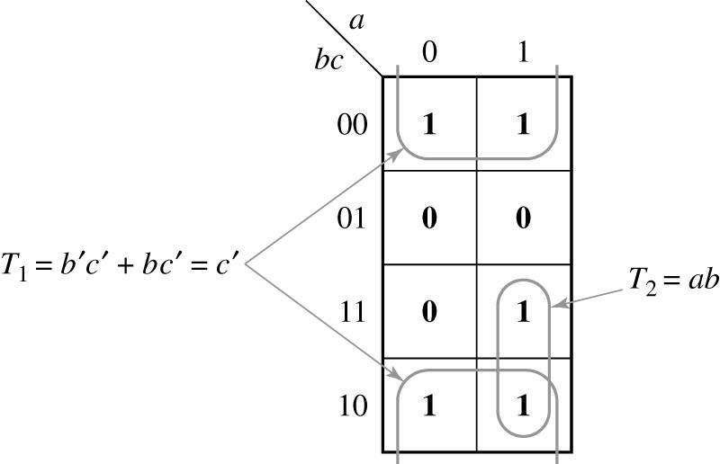
3.7 Two- and Three-Variable Karnaugh Maps
Complement of a function $F=\sum{m(1, 3, 5)}$
$F′$:
Replace 0 → 1
and 1 → 0
$$F^{′}=T_{1}+T_{2}=c^{′}+ab$$

Slide 53
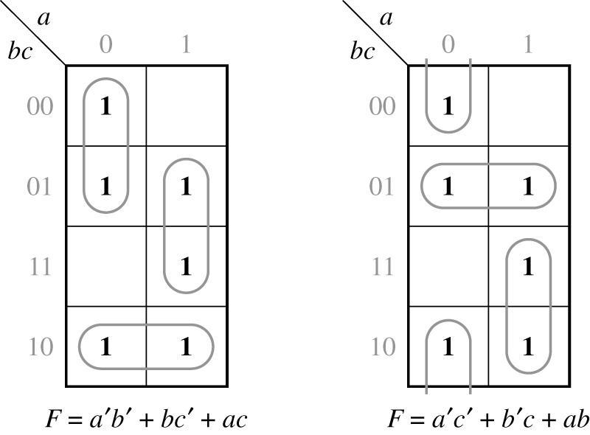
3.7 Two- and Three-Variable Karnaugh Maps
Function with two minimum forms
$$F(a,b,c)=\sum{m(}0,1,2,5,6,7)$$

Slide 54
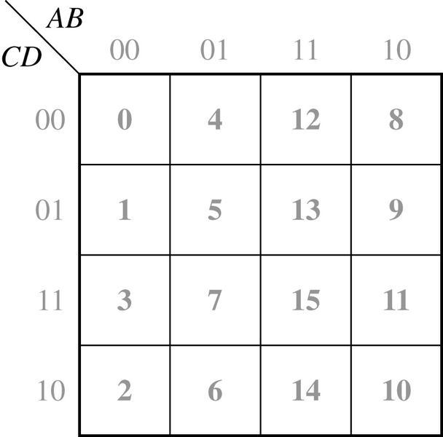
3.8 Four-Variable Karnaugh Maps
Location of minterms on four-variable Karnaugh map

Slide 55
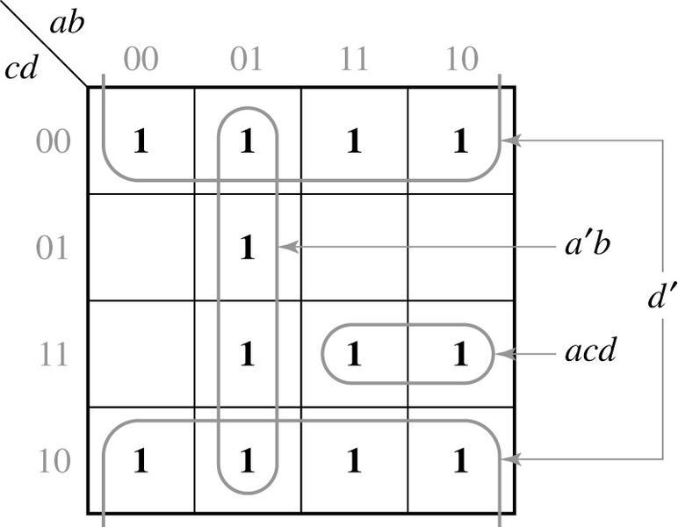
3.8 Four-Variable Karnaugh Maps
Plot of a function
$$f\left(a,b,c,d\right)=acd+a^{′}b+d′$$

Slide 56
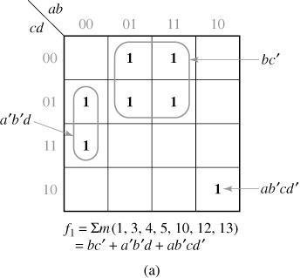
3.8 Four-Variable Karnaugh Maps
Simplification of four-variable function

Slide 57
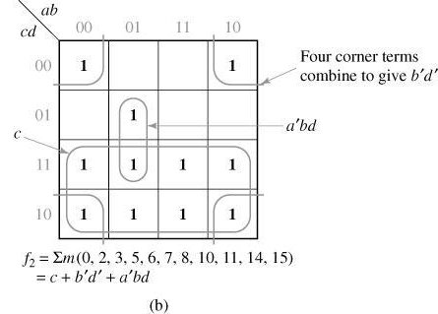
3.8 Four-Variable Karnaugh Maps
Simplification of four-variable function

Slide 58
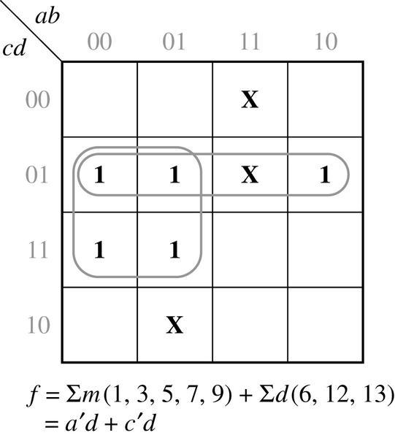
3.8 Four-Variable Karnaugh Maps
Simplification of an function with don’t care conditions
don’t care term

Slide 59
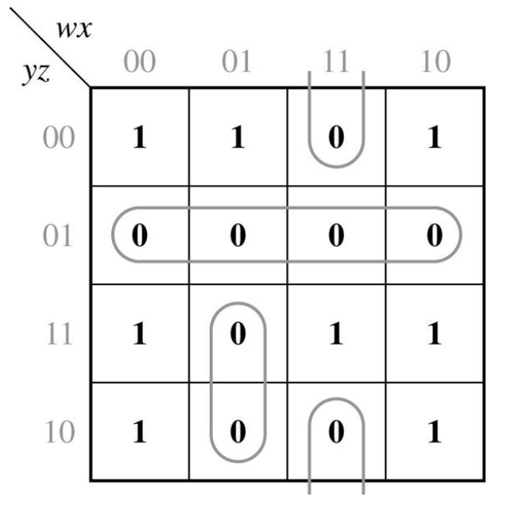
3.8 Four-Variable Karnaugh Maps
Find minimum product-of-sums by using Karnaugh map
Given $f=x^{′}z^{′}+wyz+w^{′}y^{′}z^{′}+x^{′}y$
Plot 1’s of f
Group 0’s in the map → f’
$$f^{′}=y^{′}z+wxz^{′}+w^{′}xy$$
Apply DeMorgan’s law
$$f=(y+z^{′})(w^{′}+x^{′}+z)(w+x^{′}+y^{′})$$

Slide 60
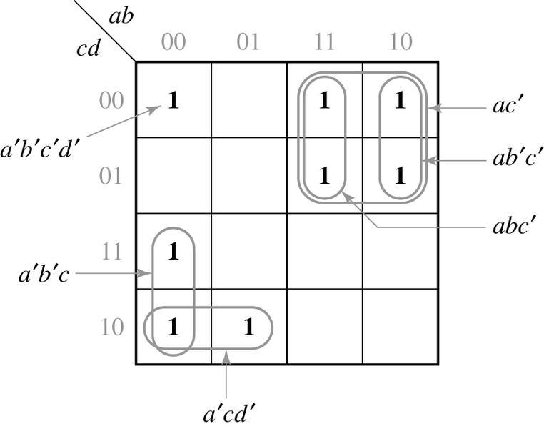
3.9 Determination of Minimum Expressions Using Essential Prime Implicants
Implicants of F
Any product term in sum-of products form
Prime Implicants of F
A product term which can not be combined with other terms to eliminate variable
Prime Implicants
Non-Prime Implicants

Slide 61
3.9 Determination of Minimum Expressions Using Essential Prime Implicants
Determination of Prime Implicants (PI)
A single 1 on a map can be a PI if it is not adjacent to any other 1’s.
Two adjacent 1’s if they are not contained in a group of four 1’s.
Four adjacent 1’s if they are not contained in a group of eight 1’s.
And so on…
Prime Implicants
Non-Prime Implicants

Slide 62
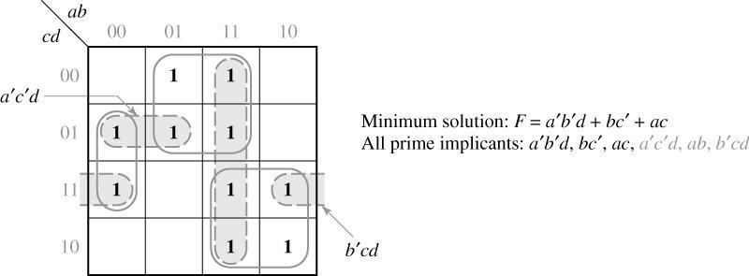
3.9 Determination of Minimum Expressions Using Essential Prime Implicants
Prime Implicants and Minimum Solution
ab

Slide 63
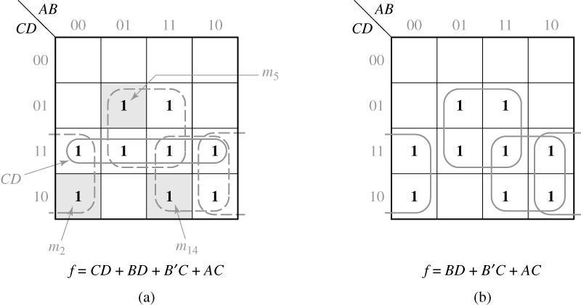
3.9 Determination of Minimum Expressions Using Essential Prime Implicants
Systematic Procedure for Selecting Prime Implicants
CD is chosen first
Other PI’s are chosen first

Slide 64
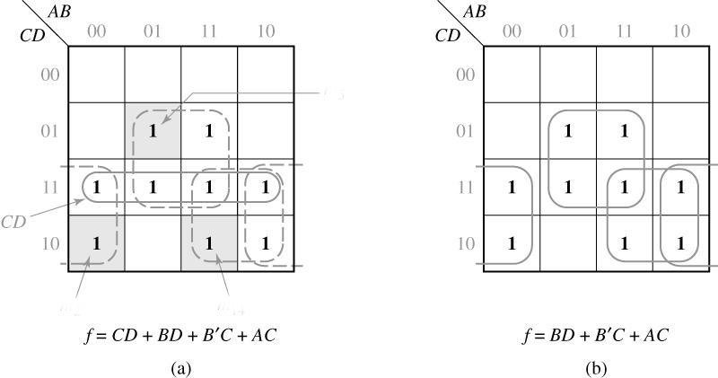
3.9 Determination of Minimum Expressions Using Essential Prime Implicants
Essential Prime Implicants (EPI)
If a minterm is covered by only one PI, the PI is said to be an EPI
m₅
m₂
m₁₄
BD, B’C, AC: EPI

Slide 65
3.9 Determination of Minimum Expressions Using Essential Prime Implicants
Procedure for Selecting EPI
AB
BC’
Loop all PI
Find minterm covered by only one PI
Select that PI as an EPI
Repeat step 2 and 3
CD
00
01
11
10
00
1
1
0
4
12
8
01
1
1
1
1
5
13
9
11
1
1
1
1. m₄ is covered by only BC’
2. m₁₀ is covered by only AC
3. BC’ and AC are EPI
3
7
15
11
10
1
1
2
6
14
10
AC

Slide 66
3.9 Determination of Minimum Expressions Using Essential Prime Implicants
Systematic Approach for Finding EPIs
If a given minterm and all of the 1’s adjacent to it are covered by a single term, then that term is an EPI.
If all of the 1’s adjacent to a given minterm are not covered by a single term, then there are two or more PIs which cover that minterm, and we cannot say whether these PIs are essential or not without checking other minterms.

Slide 67
3.9 Determination of Minimum Expressions Using Essential Prime Implicants
Systematic Approach for Finding EPIs
Check adjacent 1’s for m₀(1₀)
No single term covers 1₀, 1₁, 1₂, 1₄.
No EPIs
AB
CD
00
01
11
10
00
1
1
Check adjacent 1’s for 1₁
A’C’ covers 1₁, 1₀, 1₅.
A’C’ is an EPI.
A’C’
0
4
12
8
01
1
1
1
5
13
9
11
1
1
1
Check adjacent 1’s for 1₂
A’B’D’ covers 1₂, 1₀.
A’B’D’ is an EPI.
3
7
15
11
10
1
2
6
14
10
A’B’D’

Slide 68
3.9 Determination of Minimum Expressions Using Essential Prime Implicants
Systematic Approach for Finding EPIs
Check adjacent 1’s for 1₇
No single term covers 1₇, 1₅, 1₁₅.
No EPIs
AB
CD
00
01
11
10
00
1
1
Check adjacent 1’s for 1₁₁
ACD covers 1₁, 1₀, 1₅.
ACD is an EPI.
A’C’
0
4
12
8
01
1
1
1
5
13
9
11
1
1
1
A’BD or BCD is selected to include 1₇.
A’BD
3
7
15
11
10
1
2
6
14
10
A’B’D’
BCD
ACD

Slide 69
3.9 Determination of Minimum Expressions Using Essential Prime Implicants
Flowchart for Determining a Minimum SOP Using a Karnaugh Map
Choose a 1 which has not been covered.
NO
All uncovered 1’s checked?
Find all adjacent 1’s and X’s.
YES
Are the chosen 1 and its adjacent 1’s and X’s covered by a single term?
NO
Find a minimum set of prime implicants which cover the remaining 1’s on the map.
YES
That term is an EPI. Loop it.
Stop.

Slide 70
3.9 Determination of Minimum Expressions Using Essential Prime Implicants
A’B covers 1₆ and its adjacent → EPI
AB’D’ covers 1₁₀ and its adjacent → EPI
AC’D is chosen for minimal cover → AC’D is not an EPI
AB
CD
00
01
11
10
00
X₀
1₄
1₈
01
1₅
1₁₃
1₉
AC’D
11
X₇
X₁₅
A’B
10
1₆
1₁₀
AB’D’

Slide 71
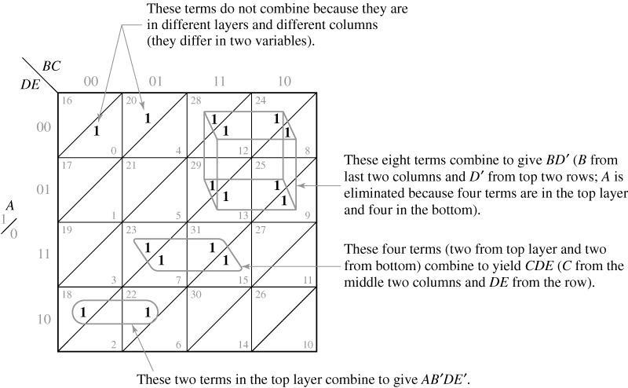
3.10 Five-Variable Karnaugh Maps
Two Layers of Four-Variable Karnaugh Map

Slide 72
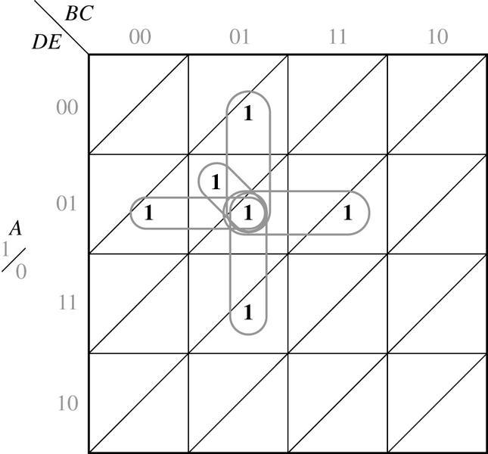
3.10 Five-Variable Karnaugh Maps
Five Adjacent Terms
Four adjacent terms in the same layer
One adjacent term in the other layer

Slide 73
Summary
Given a function (completely or in completely specified) of three to five variable, plot it on a Karnaugh map. The function may be given in minterm, maxterm, or algebraic form.
Determine the essential prime implicants of a function from a map.
Obtain the minimum sum-of-products or minimum product-of-sums form of a function from the map.
Determine all of the prime implicants of a function from a map.
Understand the relation between operations performed using the map and the corresponding algebraic operation.

