Slide 1
디지털시스템 및 마이크로 컴퓨터 I
4 주차 강의
Mar 22, 2021

Slide 2
Part 1
Quine-McCluskey Method

Slide 3
Objective
Find the prime implicants of a function by using the Quine-McCluskey method.
Given the prime implicants, find the essential prime implicants and a minimum sum-of-products expression for a function using a prime implicant chart.
Gate delays
Simulations

Slide 4
Quine-McCluskey Method
Quine-McCluskey Method
Used when the number of variables is large
Provides systematic simplification procedure which can be readily programmed for a digital computer.
Reduction Procedure
Eliminate as many literals as possible from each term by systematically applying the theorem
XY + XY’ = X
The resulting terms are called prime implicants
Use an implicant chart to select a minimum set of prime implicants

Slide 5
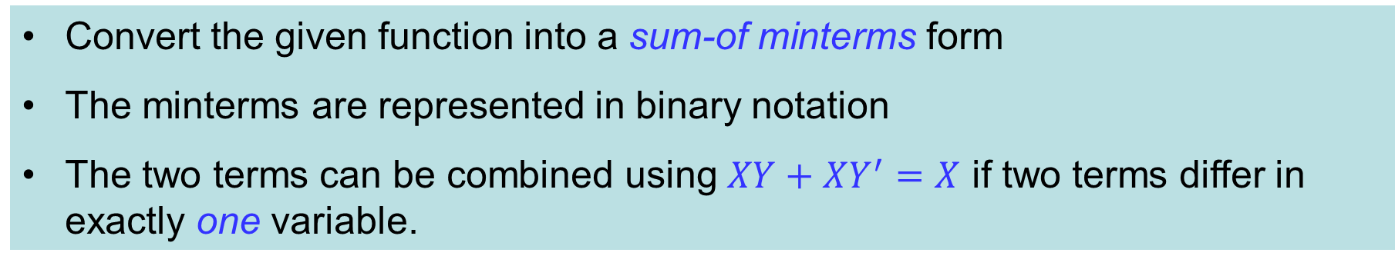
4.1 Determination of Prime Implicants
Convert the given function into a sum-of minterms form
The minterms are represented in binary notation
The two terms can be combined using $XY+XY^{′}=X$ if two terms differ in exactly one variable.

Slide 6
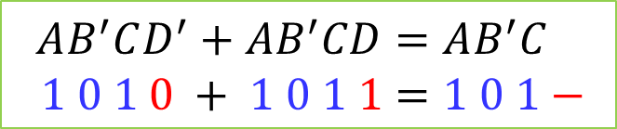

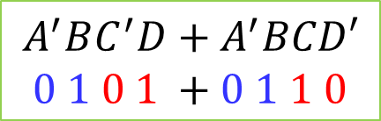
4.1 Determination of Prime Implicants
Example 1
$$AB^{′}CD^{′}+AB^{′}CD=AB^{′}C \\ 1 0 1 0 + 1 0 1 1=1 0 1−$$
The dash($−$) indicates a missing variable
Example 2
$$A^{′}BC^{′}D+A^{′}BCD′ \\ 0 1 0 1 +0 1 1 0$$
Two terms differ in two variables, so it cannot be combined.

Slide 7
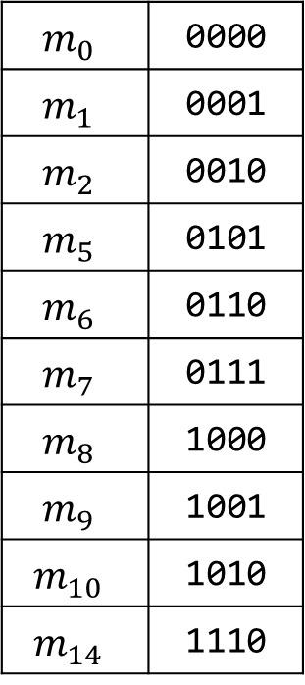
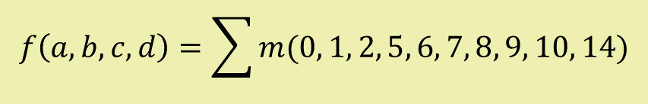
4.1 Determination of Prime Implicants
Given binary minterms are sorted into groups according to the number of 1’s in each term.
Example
$$m_{0}$$ | 0000
$$m_{1}$$ | 0001
$$m_{2}$$ | 0010
$$m_{5}$$ | 0101
$$m_{6}$$ | 0110
$$m_{7}$$ | 0111
$$m_{8}$$ | 1000
$$m_{9}$$ | 1001
$$m_{10}$$ | 1010
$$m_{14}$$ | 1110
group 0 | 0 | 0000
group 1 | 1 | 0001
 | 2 | 0010
 | 8 | 1000
group 2 | 5 | 0101
 | 6 | 0110
 | 9 | 1001
 | 10 | 1010
group 3 | 7 | 0111
 | 14 | 1110
$$f\left(a, b, c, d\right)=\sum{m(0, 1, 2, 5, 6, 7, 8, 9, 10, 14)}$$

Slide 8
4.1 Determination of Prime Implicants
Determination of Prime Implicants (1)
Column I
Column II
Column III
group 0 | 0 | 0000
group 1 | 1 2 8 | 0001 0010 1000
group 2 | 5 6 9 10 | 0101 0110 1001 1010
group 3 | 7 14 | 0111 1110
0, 1 | 000-
0, 2 | 00-0
0, 8 | -000
1, 5 | 0-01
1, 9 | -001
2, 6 | 0-10
2,10 | -010
8, 9 | 100-
8,10 | 10-0
5, 7 | 01-1
6, 7 | 011-
6,14 | -110
10,14 | 1-10
0, 1, 8, 9 0, 2, 8,10 0, 8, 1, 9 0, 8, 2,10 | -00- -0-0 -00- -0-0
2, 6,10,14 2,10, 6,14 | --10 --10

Slide 9
4.1 Determination of Prime Implicants
Determination of Prime Implicants (2)
Column I
Column II
Column III
group 0 | 0 | 0000 | √
group 1 | 1 2 8 | 0001 0010 1000 | √
 |  |  | √
 |  |  | √
group 2 | 5 6 9 10 | 0101 0110 1001 1010 | √
 |  |  | √
 |  |  | √
 |  |  | √
group 3 | 7 14 | 0111 1110 | √
 |  |  | √
0, 1 | 000-
0, 2 | 00-0
0, 8 | -000
1, 5 | 0-01
1, 9 | -001
2, 6 | 0-10
2,10 | -010
8, 9 | 100-
8,10 | 10-0
5, 7 | 01-1
6, 7 | 011-
6,14 | -110
10,14 | 1-10
0, 1, 8, 9 0, 2, 8,10 0, 8, 1, 9 0, 8, 2,10 | -00- -0-0 -00- -0-0
2, 6,10,14 2,10, 6,14 | --10 --10

Slide 10
4.1 Determination of Prime Implicants
Determination of Prime Implicants (3)
Column I
Column II
Column III
group 0 | 0 | 0000 | √
group 1 | 1 2 8 | 0001 0010 1000 | √
 |  |  | √
 |  |  | √
group 2 | 5 6 9 10 | 0101 0110 1001 1010 | √
 |  |  | √
 |  |  | √
 |  |  | √
group 3 | 7 14 | 0111 1110 | √
 |  |  | √
0, 1 | 000- | √
0, 2 | 00-0 | √
0, 8 | -000 | √
1, 5 | 0-01
1, 9 | -001 | √
2, 6 | 0-10 | √
2,10 | -010 | √
8, 9 | 100- | √
8,10 | 10-0 | √
5, 7 | 01-1
6, 7 | 011-
6,14 | -110 | √
10,14 | 1-10 | √
0, 1, 8, 9 0, 2, 8,10 0, 8, 1, 9 0, 8, 2,10 | -00- -0-0 -00- -0-0
2, 6,10,14 2,10, 6,14 | --10 --10

Slide 11
4.1 Determination of Prime Implicants
Determination of Prime Implicants (4)
Column I
Column II
Column III
group 0 | 0 | 0000 | √
group 1 | 1 2 8 | 0001 0010 1000 | √
 |  |  | √
 |  |  | √
group 2 | 5 6 9 10 | 0101 0110 1001 1010 | √
 |  |  | √
 |  |  | √
 |  |  | √
group 3 | 7 14 | 0111 1110 | √
 |  |  | √
0, 1 | 000- | √
0, 2 | 00-0 | √
0, 8 | -000 | √
1, 5 | 0-01
1, 9 | -001 | √
2, 6 | 0-10 | √
2,10 | -010 | √
8, 9 | 100- | √
8,10 | 10-0 | √
5, 7 | 01-1
6, 7 | 011-
6,14 | -110 | √
10,14 | 1-10 | √
0, 1, 8, 9 0, 2, 8,10 0, 8, 1, 9 0, 8, 2,10 | -00- -0-0 -00- -0-0
2, 6,10,14 2,10, 6,14 | --10 --10

Slide 12

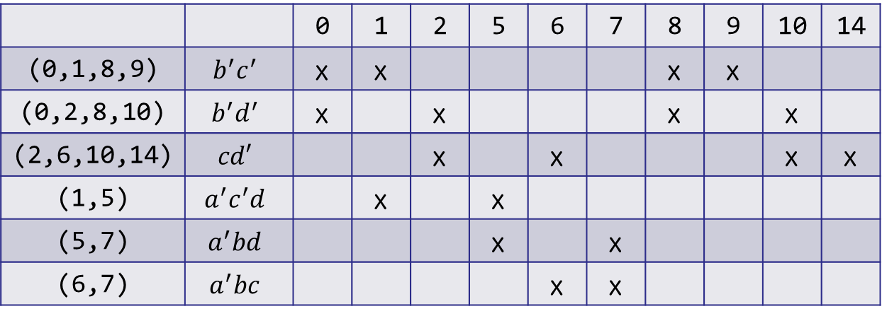

4.2 The Prime Implicant Chart
Prime Implicant Chart (Table 6-2) $⨂$
Select Essential Prime Implicants $⨂$
 |  | 0 | 1 | 2 | 5 | 6 | 7 | 8 | 9 | 10 | 14
(0,1,8,9) | $$b^{′}c^{′}$$ | x | x |  |  |  |  | x | x
(0,2,8,10) | $$b^{′}d^{′}$$ | x |  | x |  |  |  | x |  | x
(2,6,10,14) | $$cd′$$ |  |  | x |  | x |  |  |  | x | x
(1,5) | $$a^{′}c^{′}d$$ |  | x |  | x
(5,7) | $$a^{′}bd$$ |  |  |  | x |  | x
(6,7) | $$a^{′}bc$$ |  |  |  |  | x | x

Slide 13
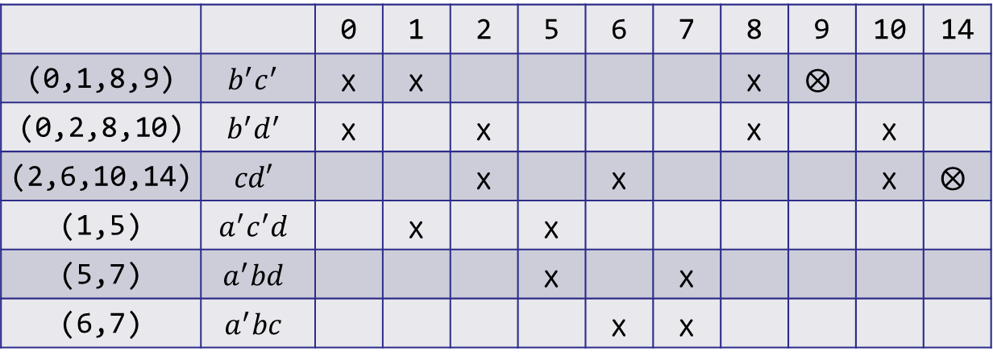
4.2 The Prime Implicant Chart
Prime Implicant Chart (Table 6-2) $⨂$
Select Essential Prime Implicants $⨂$
 |  | 0 | 1 | 2 | 5 | 6 | 7 | 8 | 9 | 10 | 14
(0,1,8,9) | $$b^{′}c^{′}$$ | x | x |  |  |  |  | x | $$⨂$$
(0,2,8,10) | $$b^{′}d^{′}$$ | x |  | x |  |  |  | x |  | x
(2,6,10,14) | $$cd′$$ |  |  | x |  | x |  |  |  | x | $$⨂$$
(1,5) | $$a^{′}c^{′}d$$ |  | x |  | x
(5,7) | $$a^{′}bd$$ |  |  |  | x |  | x
(6,7) | $$a^{′}bc$$ |  |  |  |  | x | x

Slide 14
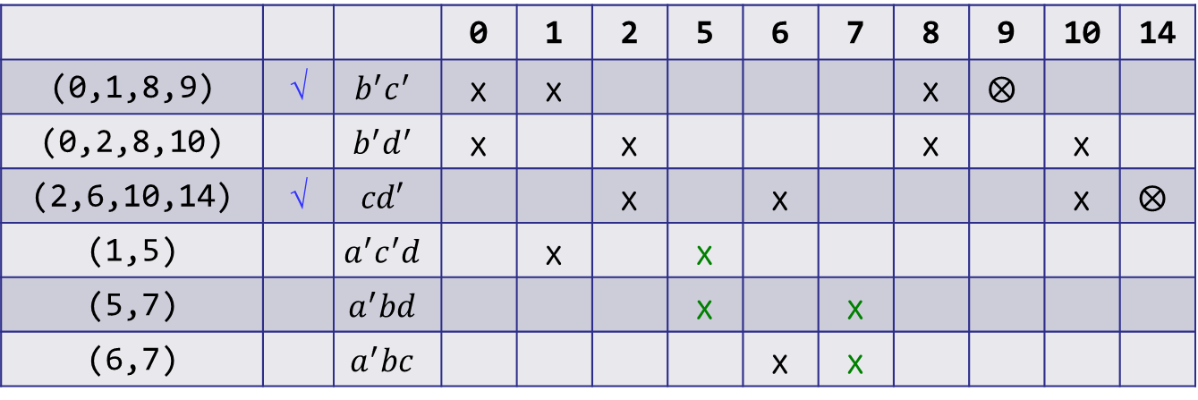
4.2 The Prime Implicant Chart
Prime Implicant Chart (Table 6-2) $⨂$
Select Essential Prime Implicants $⨂$
 |  |  | 0 | 1 | 2 | 5 | 6 | 7 | 8 | 9 | 10 | 14
(0,1,8,9) | √ | $$b^{′}c^{′}$$ | x | x |  |  |  |  | x | $$⨂$$
(0,2,8,10) |  | $$b^{′}d^{′}$$ | x |  | x |  |  |  | x |  | x
(2,6,10,14) | √ | $$cd′$$ |  |  | x |  | x |  |  |  | x | $$⨂$$
(1,5) |  | $$a^{′}c^{′}d$$ |  | x |  | x
(5,7) |  | $$a^{′}bd$$ |  |  |  | x |  | x
(6,7) |  | $$a^{′}bc$$ |  |  |  |  | x | x

Slide 15
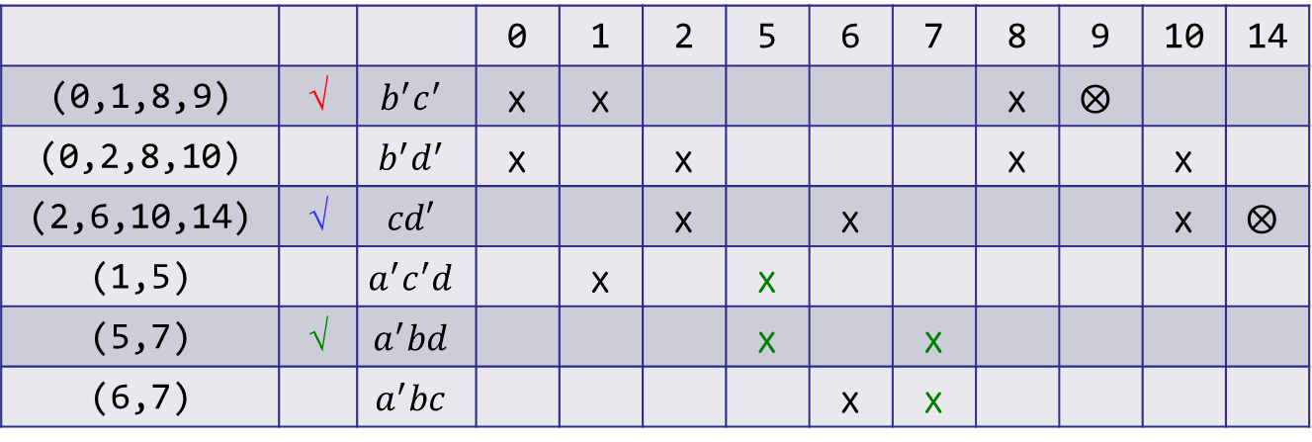

4.2 The Prime Implicant Chart
Prime Implicant Chart (Table 6-2) $⨂$
Select Essential Prime Implicants $⨂$
 |  |  | 0 | 1 | 2 | 5 | 6 | 7 | 8 | 9 | 10 | 14
(0,1,8,9) | √ | $$b^{′}c^{′}$$ | x | x |  |  |  |  | x | $$⨂$$
(0,2,8,10) |  | $$b^{′}d^{′}$$ | x |  | x |  |  |  | x |  | x
(2,6,10,14) | √ | $$cd′$$ |  |  | x |  | x |  |  |  | x | $$⨂$$
(1,5) |  | $$a^{′}c^{′}d$$ |  | x |  | x
(5,7) | √ | $$a^{′}bd$$ |  |  |  | x |  | x
(6,7) |  | $$a^{′}bc$$ |  |  |  |  | x | x
The resulting minimum sum of products is
$$f=b^{′}c^{′}+cd^{′}+a^{′}bd$$

Slide 16
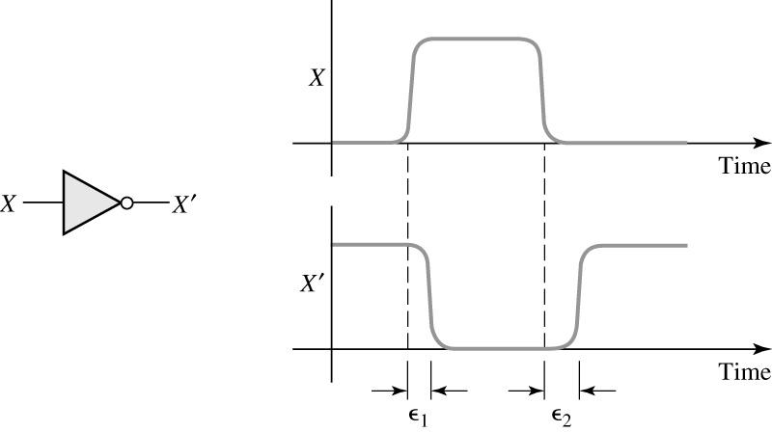
4.3 Gate Delays
Propagation Delay in an Inverter
Few ns

Slide 17
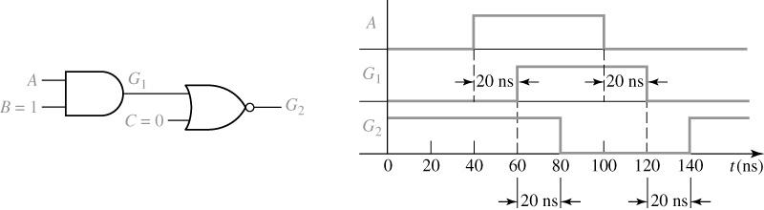
4.3 Gate Delays
Timing Diagram for AND-NOR Circuit
Assume: each gate has 20 ns propagation delay time

Slide 18
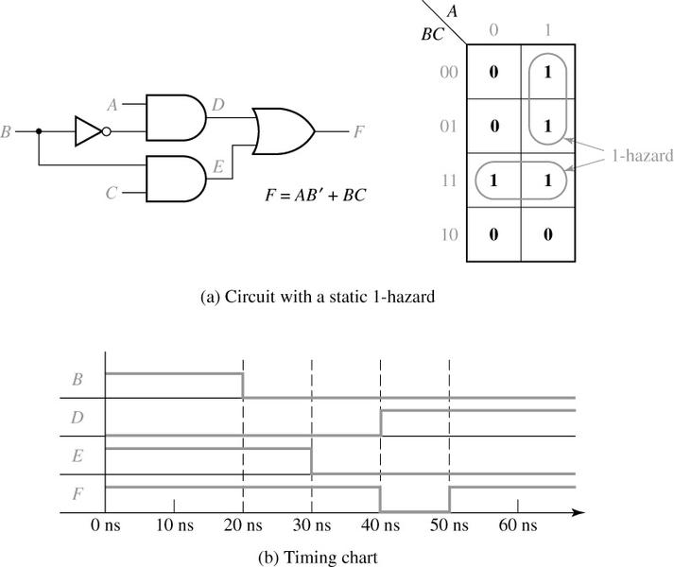
4.3 Gate Delays - Hazards
Detection of a 1-Hazard
Assume: Each gate has 10 ns pro. delay time
A = C = 1
Hazard occurs when B changes
while A = C = 1

Slide 19
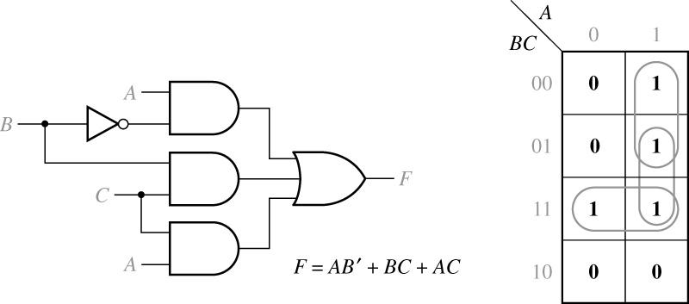
4.3 Gate Delays - Hazards
Circuit with Hazard Removed

Slide 20
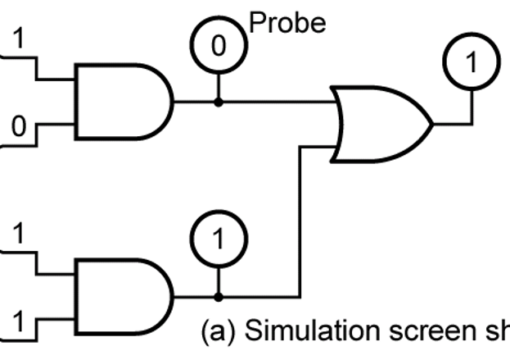
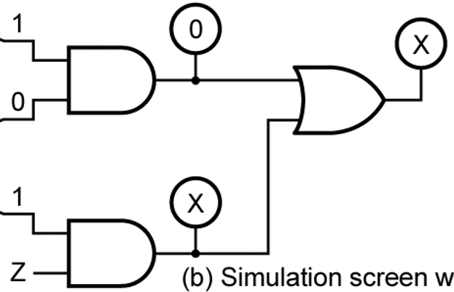
4.4 Simulation
AND and OR Functions for Four-Valued Simulation
∙ | 0 | 1 | X | Z
0 | 0 | 0 | 0 | 0
1 | 0 | 1 | X | X
X | 0 | X | X | X
Z | 0 | X | X | X
+ | 0 | 1 | X | Z
0 | 0 | 1 | X | X
1 | 1 | 1 | 1 | 1
X | X | 1 | X | X
Z | X | 1 | X | X
X: Unknown, Z: High Impedance

Slide 21
Summary
Find the prime implicants of a function by using the Quine-McCluskey method.
Given the prime implicants, find the essential prime implicants and a minimum sum-of-products expression for a function using a prime implicant chart.
Gate delays
Simulations

Slide 22
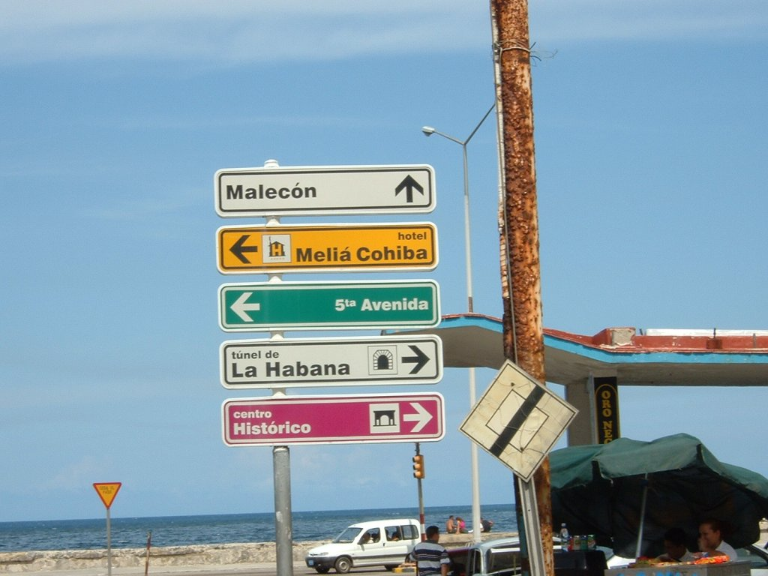

Slide 23
Part 2
Multiplexers, Three-State Buffers, Decoders, Encoders,
Programmable Logic Devices

Slide 24
Objectives
IC (Integrated Circuit)
  SSI (Small-Scale Integration)
  MSI (Medium-Scale Integration)
  LSI (Large-Scale Integration)
  VLSI (Very-Large-Scale Integration)
Multiplexers
Three-state Buffer
Decoders and Encoders
ROMs
PLD
PLA
CPLD
FPGA

Slide 25
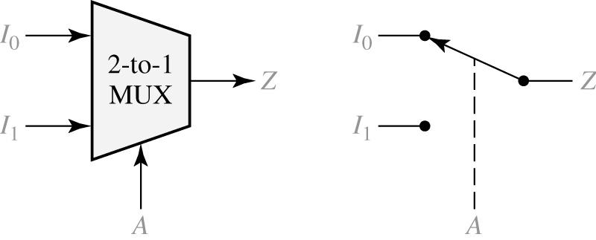

4.5 Multiplexers
Multiplexer (MUX, Data Selector)
2-to-1 Multiplexer and Switch Analog
Logic equation for the 2-to-1 MUX
$$Z=A′I_{0}+AI_{1}$$

Slide 26
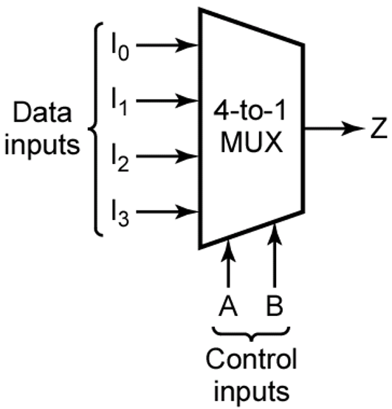

4.5 Multiplexers
4-to-1 Multiplexer
Logic equation for the 4-to-1 MUX
$$Z=A′B′I_{0}+A′BI_{1}+AB′I_{2}+ABI_{3}$$

Slide 27
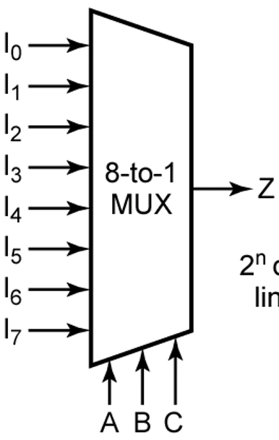
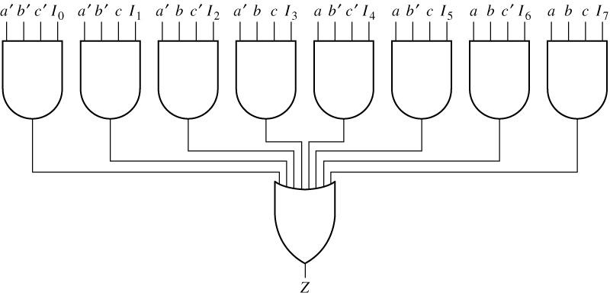








4.5 Multiplexers
8-to-1 Multiplexer
Logic equation for the 8-to-1 MUX
$$Z=A′B′C′I_{0}+A′B′CI_{1}+A′BC′I_{2}+A′BCI_{3}+AB′C′I_{4}+AB′CI_{5}+ABC′I_{6}+ABCI_{7}$$
$$A′B′C′I_{0}$$
$$A′B′CI_{1}$$
$$A′BC′I_{2}$$
$$A′BCI_{3}$$
$$AB′C′I_{4}$$
$$AB′CI_{5}$$
$$ABC′I_{6}$$
$$ABCI_{7}$$

Slide 28
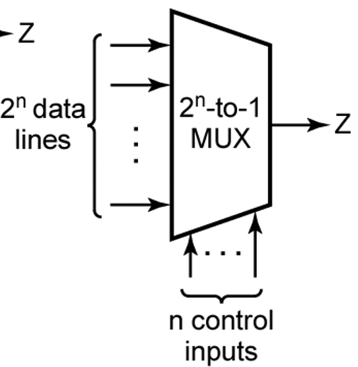
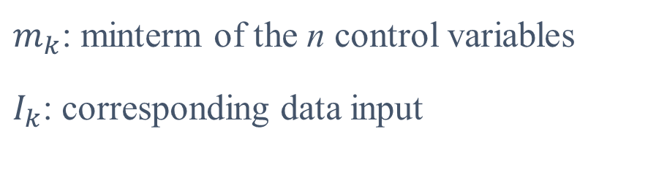

4.5 Multiplexers
2^{n}-to-1 Multiplexer
Logic equation for the 2^{n} - to - 1 MUX
$$Z=\sum_{k=0}^{2^{n}−1}{m_{k}I_{k}}$$
$m_{k}$: minterm of the n control variables
$I_{k}$: corresponding data input

Slide 29
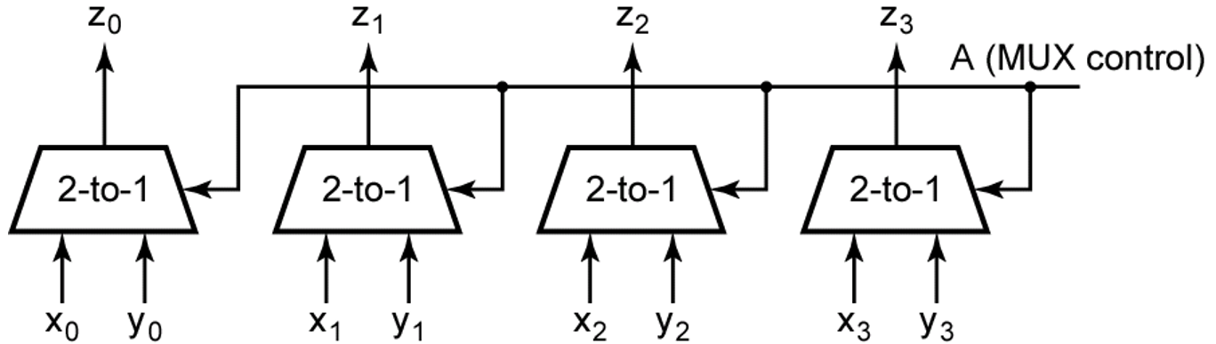
4.5 Multiplexers
Quadruple 2-to-1 Multiplexer Used to Select Data

Slide 30
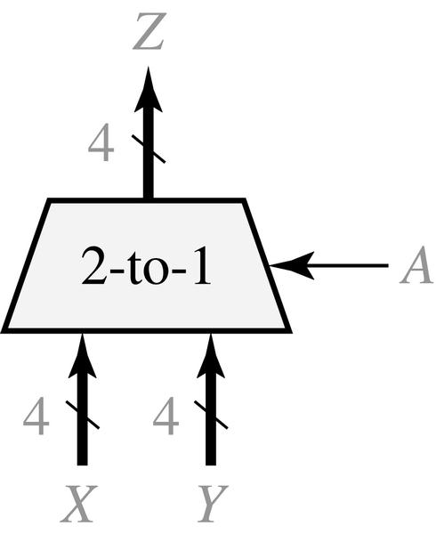
4.5 Multiplexers
Quad Multiplexer with Bus Inputs and Output
X, Y : Bus input
Z : Bus output

Slide 31
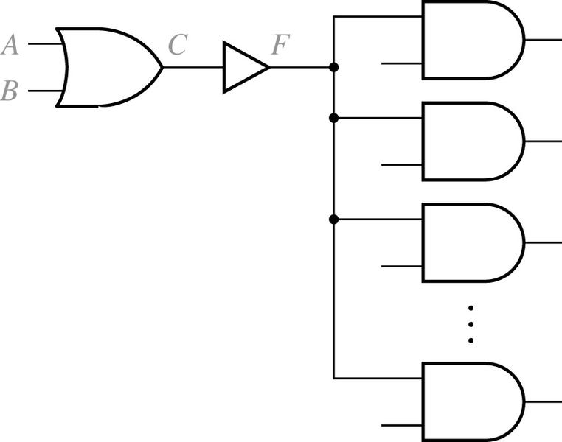
4.6 Three-State Buffers
Gate Circuit with Added Buffer
The logic of the buffer input and output are the same (F = C)
Buffer is used to increase driving capability

Slide 32
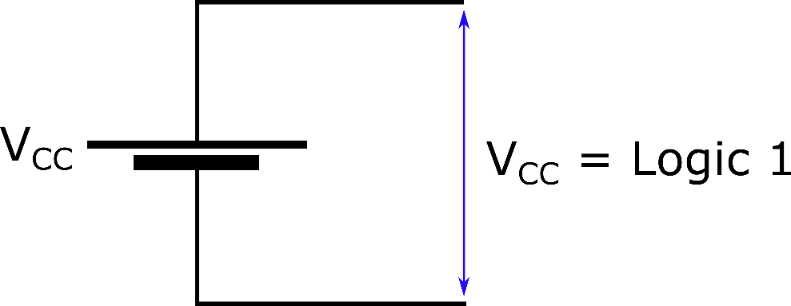
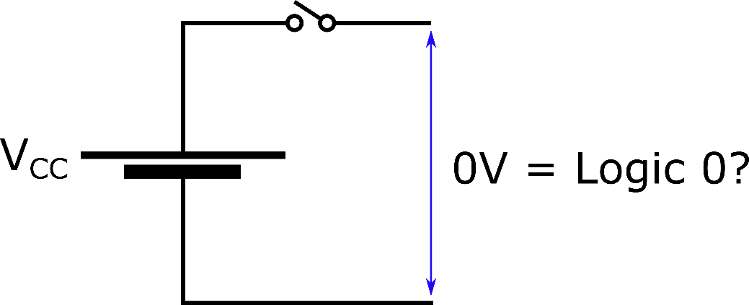
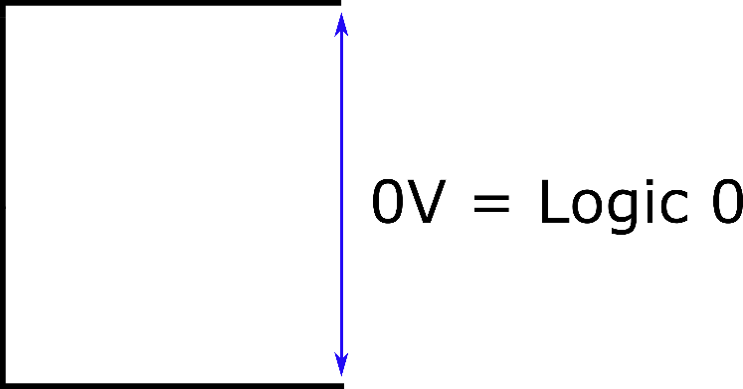
4.6 Three-State Buffers

Slide 33
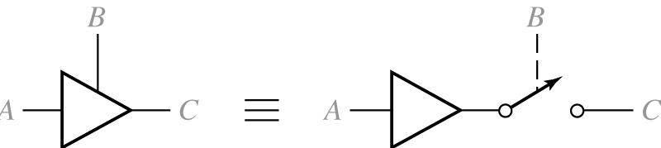
4.6 Three-State Buffers
Three-State Buffer
Tri-State Buffer
High-impedance (Hi-Z) state
The output is enabled when B = 1, disabled when B = 0

Slide 34
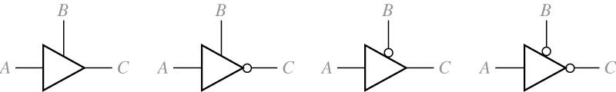
4.6 Three-State Buffers
Four Kinds of Three-State Buffers
B A | C
0 0 0 1 1 0 1 1 | Z Z 0 1
B A | C
0 0 0 1 1 0 1 1 | Z Z 1 0
B A | C
0 0 0 1 1 0 1 1 | 0 1 Z Z
B A | C
0 0 0 1 1 0 1 1 | 1 0 Z Z
(a)
(b)
(c)
(d)

Slide 35
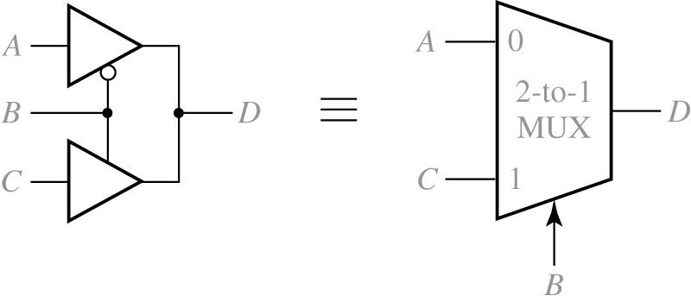

4.6 Three-State Buffers
Data Selection Using Three-State Buffers
$$D=B′A+BC$$

Slide 36
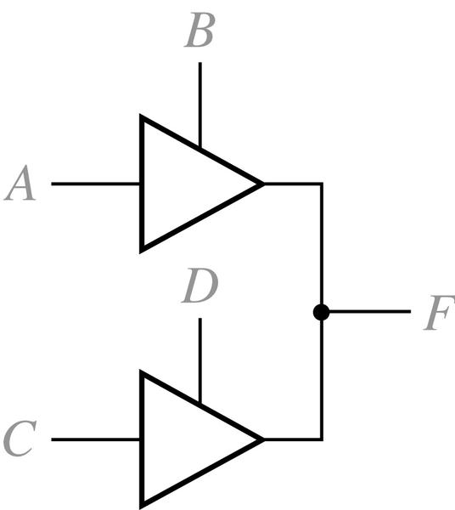
4.6 Three-State Buffers
Circuit with Two Three-State Buffers
S1
S1 | X | S2 0 | 1 | Z
X 0 1 Z | X X X X | X 0 X 0 | X X 1 1 | X 0 1 Z
S2
X = Unknown

Slide 37
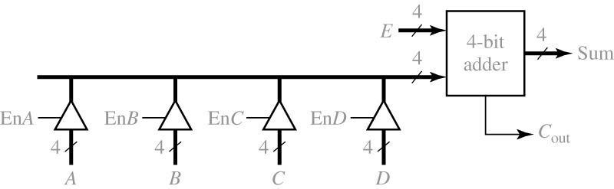
4.6 Three-State Buffers
4-Bit Adder with Four Sources for One Operand
Four Sources

Slide 38
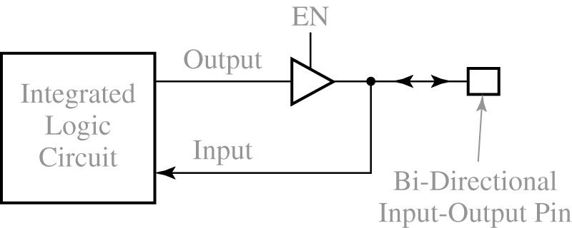
4.6 Three-State Buffers
Integrated Circuit with Bi-Directional Input/Output Pin

Slide 39
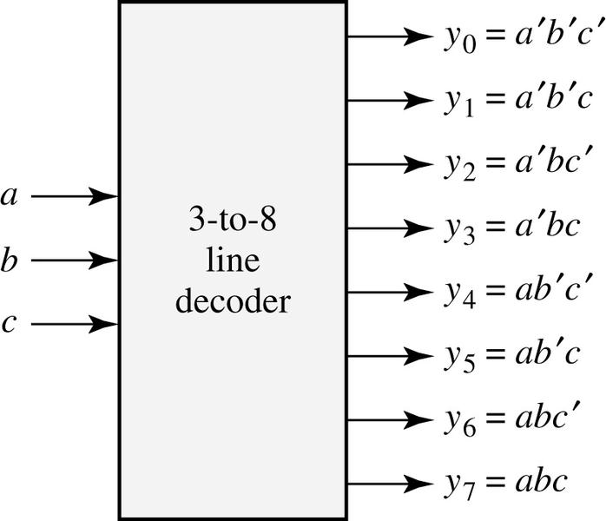
4.7 Decoders and Encoders
3-to-8 Line Decoder
a b c | y₀ | y₁ | y₂ | y₃ | y₄ | y₅ | y₆ | y₇
0 0 0 0 0 1 0 1 0 0 1 1 1 0 0 1 0 1 1 1 0 1 1 1 | 1 0 0 0 0 0 0 0 | 0 1 0 0 0 0 0 0 | 0 0 1 0 0 0 0 0 | 0 0 0 1 0 0 0 0 | 0 0 0 0 10 0 0 | 0 0 0 0 0 10 0 | 0 0 0 0 0 0 10 | 0 0 0 0 0 0 0 1

Slide 40
4.7 Decoders and Encoders
4-to-10 Line Decoder (74LS42)

Slide 41
4.7 Decoders and Encoders
4-to-10 Line Decoder (74LS42)

Slide 42
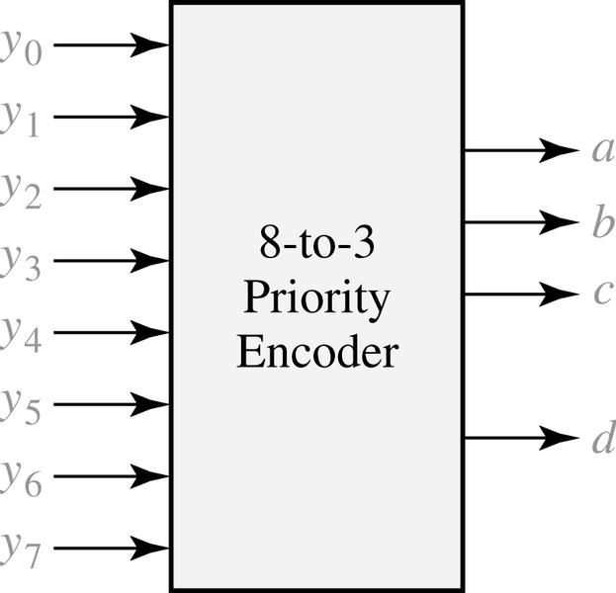
4.7 Decoders and Encoders
8-to-3 Priority Encoder
y₀ | y₁ | y₂ | y₃ | y₄ | y₅ | y₆ | y₇ | a | b | c | d
0 1 X X X X X X X | 0 0 1 X X X X X X | 0 0 0 1 X X X X X | 0 0 0 0 1 X X X X | 0 0 0 0 01 X X X | 0 0 0 0 0 0 1 X X | 0 0 0 0 0 0 0 1 X | 0 0 0 0 0 0 0 0 1 | 0 0 0 0 0 1 1 1 1 | 0 0 0 1 1 0 0 1 1 | 0 0 1 0 1 0 1 0 1 | 0 1 1 1 1 1 1 1 1

Slide 43
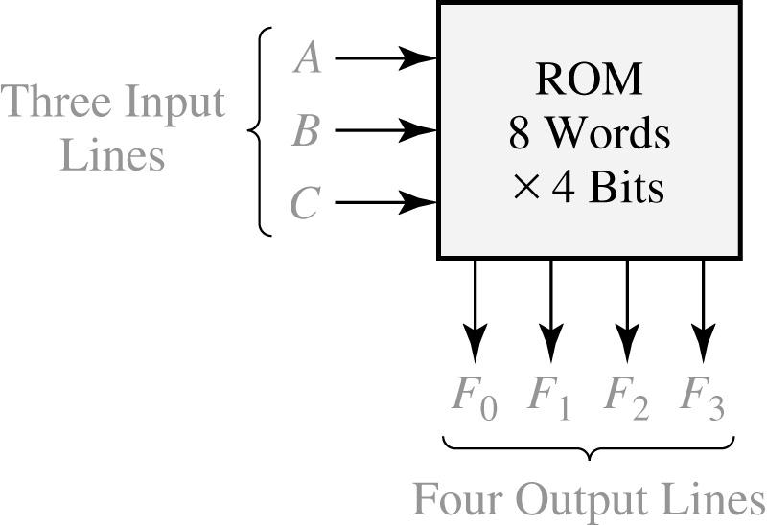
4.8 Read-Only Memories
An 8-Word x 4-Bit ROM
A | B | C |  |  | F₀ | F₁ | F₂ | F₃
0 0 0 0 1 1 1 1 | 0 0 1 1 0 0 1 1 | 0 1 0 1 0 1 0 1 |  |  | 1 1 0 0 1 0 1 0 | 0 0 1 1 1 0 1 1 | 1 1 1 0 0 0 1 0 | 0 0 1 1 0 1 1 1
typical data stored in ROM
(2³ words of
4bits each)
(a) Block diagram
(b) Truth table for ROM

Slide 44
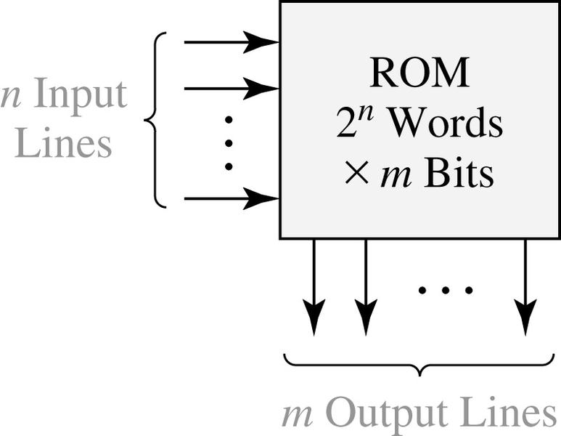
4.8 Read-Only Memories
Read-Only Memory with n Inputs and m Outputs
n input Variables |  |  |  | m output Variables
00 00 00 00 11 11 11 11 | · · · · · · · · · · · · · · · · · · · · · | 00 01 10 11 00 01 10 11 |  |  | 100 010 101 110 001 110 011 111 | · · · · · · · · · · · · · · · · · · · · · | 110 111 101 010 · · 011 110 000 101
typical data array stored in ROM
(2^{n} words of m bits each)

Slide 45
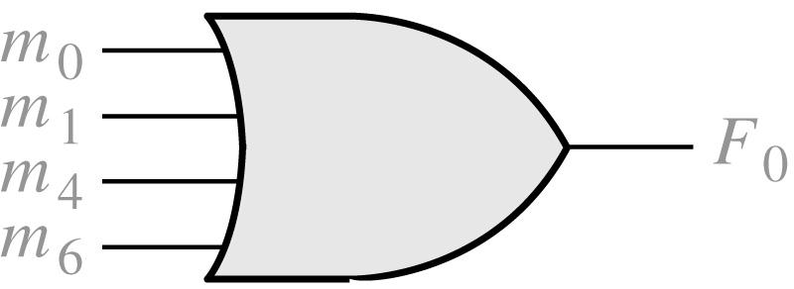
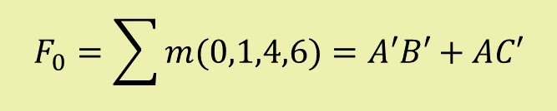
4.8 Read-Only Memories
An 8-Word x 4-Bit ROM
Equivalent OR Gate for F₀
A | B | C |  |  | F₀ | F₁ | F₂ | F₃
0 0 0 0 1 1 1 1 | 0 0 1 1 0 0 1 1 | 0 1 0 1 0 1 0 1 |  |  | 1 1 0 0 1 0 1 0 | 0 0 1 1 1 0 1 1 | 1 1 1 0 0 0 1 0 | 0 0 1 1 0 1 1 1
$$F_{0}=\sum{m(0,1,4,6)=A′B′+AC′}$$
(b) Truth table for ROM

Slide 46
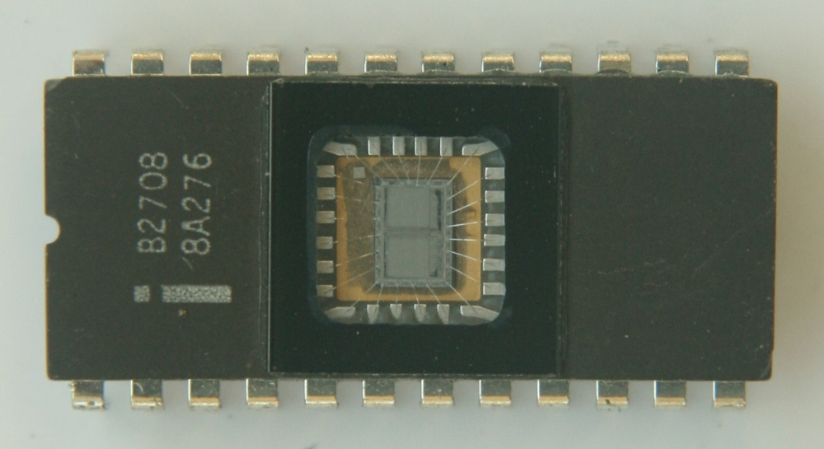
4.8 Read-Only Memories
Types of ROMs
Mask ROM
Programmable ROM
Electrically Erasable Programmable ROM
Flash Memory

Slide 47
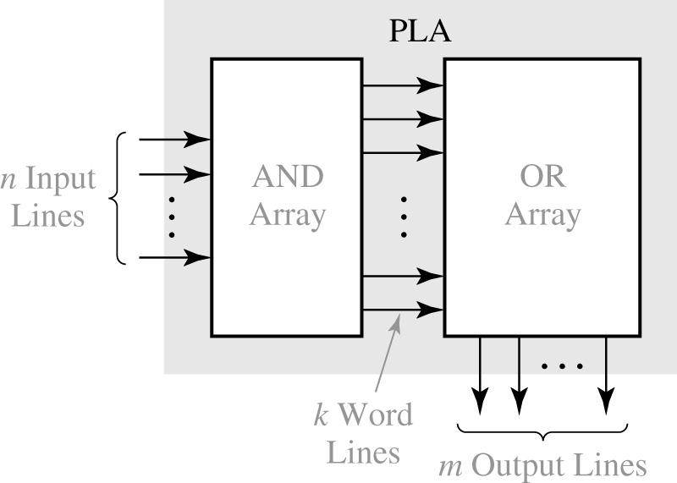
4.9 Programmable Logic Devices (PLD)
Programmable Logic Array (PLA) Structure
Both AND array and OR array are programmable.

Slide 48
4.9 Programmable Logic Devices (PLD)
Programmable Array Logic (PAL)
AND array is programmable and OR array is fixed.
PAL

Slide 49
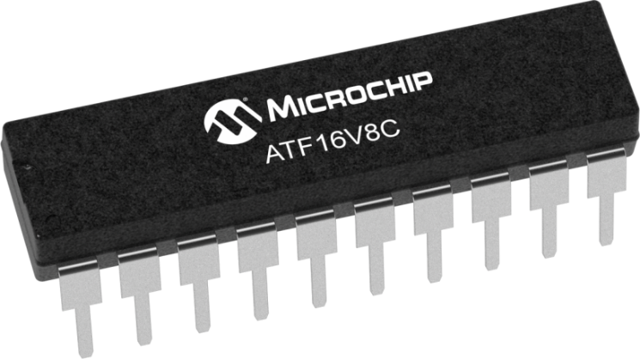
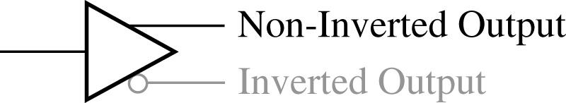
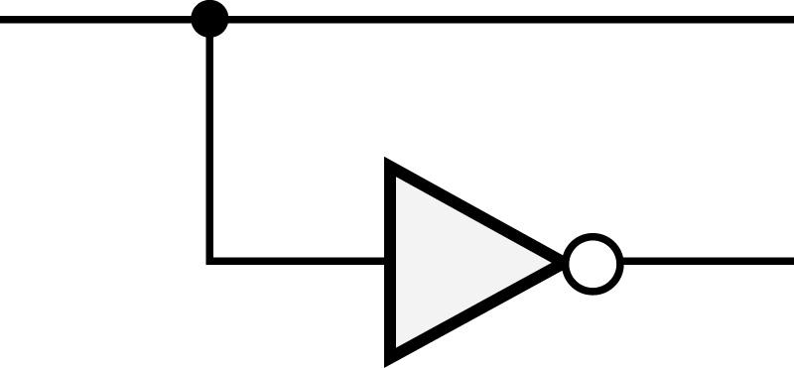
4.9 Programmable Logic Devices (PLD)
Programmable Array Logic (PAL)
AND array is programmable and OR array is fixed.
logically equal

Slide 50
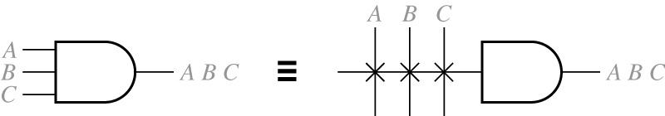
4.9 Programmable Logic Devices (PLD)
Programmable Array Logic
Connections to the AND gate inputs in a PAL is represented by X

Slide 51
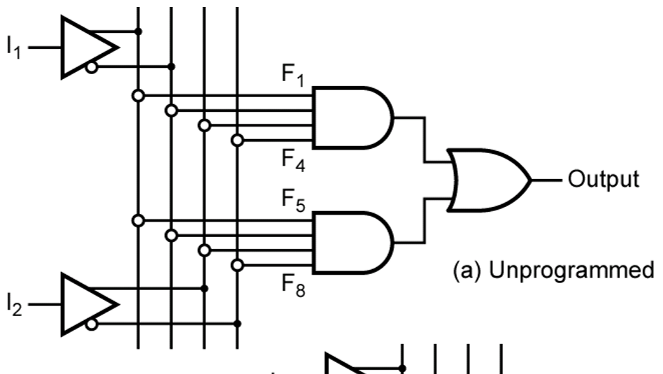
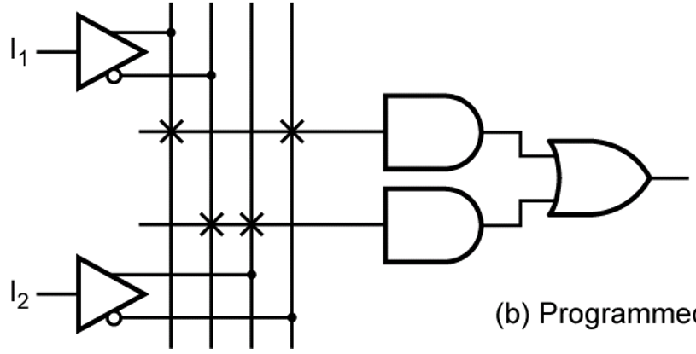

4.9 Programmable Logic Devices (PLD)
PAL Segment
$$I_{1}I_{2}^{′}+I_{1}′I_{2}$$
Unprogrammed
Programmed

Slide 52
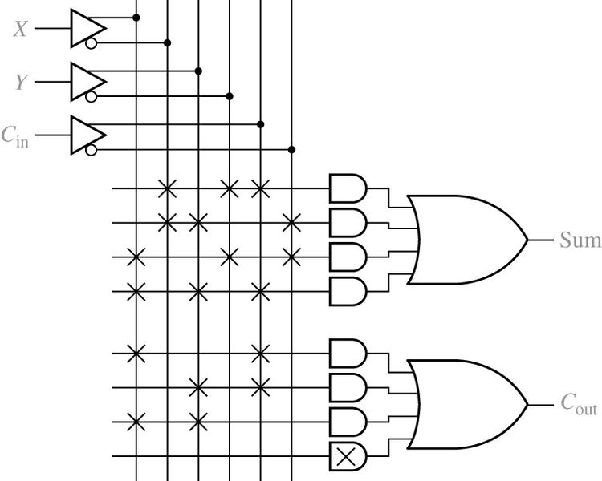

4.9 Programmable Logic Devices (PLD)
Implementation of a Full Adder Using a PAL
$$Sum=X′Y′C_{in}+X′YC′_{in}+XY′C′_{in}+XYC_{in}$$
$$Cout=XC_{in}+YC_{in}+XY$$

Slide 53
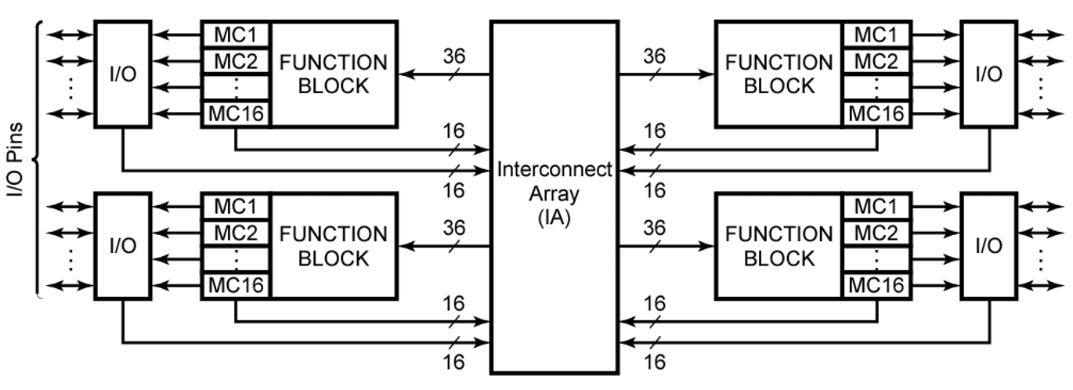
4.10 Complex Programmable Logic Devices (CPLD)
Basic Architecture of Xilinx XCR3064XL CPLD
4 Function Blocks: programmable AND-OR array
16 Macrocells per Block: flip-flop and MUXs

Slide 54

4.10 Complex Programmable Logic Devices (CPLD)
CPLD Function Block and Macrocell (A Simplified Version of XCR3064XL)

Slide 55


4.11 Field Programmable Gate Arrays (FPGA)
Layout of a typical FPGA

Slide 56

4.11 Field Programmable Gate Arrays (FPGA)
Simplified Configurable Logic Block (CLB)
LUT: Look Up Table
Reprogrammable
Flip-flop Output
Function Generator
Combinational
Output
Flip-flop Output
Function Generator
Combinational
Output

Slide 57

4.11 Field Programmable Gate Arrays (FPGA)
Implementation of a Function Generator (Lookup Table, LUT)

Slide 58
Summary
IC (Integrated Circuit)
  SSI (Small-Scale Integration)
  MSI (Medium-Scale Integration)
  LSI (Large-Scale Integration)
  VLSI (Very-Large-Scale Integration)
Multiplexers
Three-state Buffer
Decoders and Encoders
ROMs
PLD
PLA
CPLD
FPGA

Slide 59


