Slide 1
디지털시스템 및 마이크로 컴퓨터 I
5 주차 강의
인제대학교 의용공학부
조 종만 교수
Apr., 01 2021

Slide 2
Part 1
Introduction to VHDL (1)

Slide 3
Objectives
Represent gates and combinational logic by concurrent VHDL statements.
Given a set of concurrent VHDL statements, draw the corresponding combinational logic circuit.
Write a VHDL code for a combinational circuit.
Compile and simulate a VHDL module.
Use the basic VHDL operators and understand their order of precedence.
Use the VHDL types : std_logic, std_logic_vector, bit, bit_vector, Boolean, and integer.

Slide 4
Introduction to VHDL
HDL
Hardware Description Language
Allows a digital system to be designed and debugged at a higher level before implementation
VHDL and Verilog
VHDL
VHSIC(Very High Speed IC) Hardware Description Language
Can describe the Behavior Level, Data Flow Level, Structural Level
Became an IEEE standard in 1987, revised in 1993

Slide 5
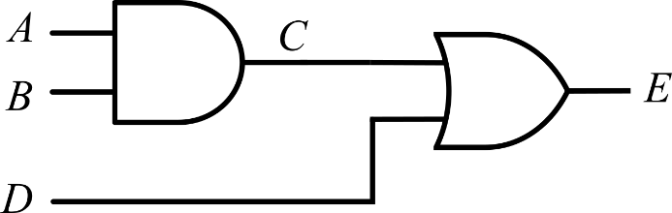
VHDL Modules
Complete VHDL Module
entity
  Declare all of the inputs and outputs
architecture
  Specify the internal operation of the module
Example: Two Gates
library ieee;
use ieee.std_logic_1164.all;
entity two_gates is
port (A, B, D: in std_logic;
E: out std_logic);
end two_gates;
architecture gates of two_gates is
signal C: std_logic;
begin
C <= A and B;
E <= C or D;
end gates;

Slide 6

VHDL Modules (Entity)
entity declaration form: includes a list of interface signals
entity entity-name is
[port (interface-signal-declaration);]
end [entity][entity-name];
library ieee;
use ieee.std_logic_1164.all;
entity two_gates is
port (A, B, D: in std_logic;
E: out std_logic);
end two_gates;
architecture gates of two_gates is
signal C: std_logic;
begin
C <= A and B;
E <= C or D;
end gates;

Slide 7
VHDL Modules (Entity)
entity entity-name is
[port (interface-signal-declaration);]
end [entity][entity-name];
list-of-interface-signals: mode type [:=initial-value]
mode
in: input signal
out: output signal
inout: bi-directional signal
buffer: output signal,
but used internally
type
bit
bit_vector
std_logic
std_logic_vector
integer
other types
library ieee;
use ieee.std_logic_1164.all;
entity two_gates is
port (A, B, D: in std_logic;
E: out std_logic);
end two_gates;
architecture gates of two_gates is
signal C: std_logic;
begin
C <= A and B;
E <= C or D;;
end gates;

Slide 8
VHDL Modules (Signal Modes)
signal mode
in: input signal
out: output signal
inout: bi-directional signal
buffer: output signal, but can be read internally

Slide 9
VHDL Modules (Signal Types)
Predefined data types in VHDL
bit ‘0’ or ‘1’
bit_vector an array with each element of type bit
boolean FALSE or TRUE
integer An integer in the range -(2³¹ -1) to +(2³¹ -1)
positive An integer in the range 1 to 2³¹-1 (positive integers)
natural An integer in the range 0 to 2³¹-1 (positive integers and zero)
real Floating-point number in the range -1.0E38 to +1.0E38
character Any legal VHDL character
time An integer with units fs, ps, ns, us, ms, sec, min, or hr
signal types
bit
bit_vector
std_logic
std_logic_vector
integer
other types
IEEE standard 1164 defines a std_logic type of nine values:
U, X, 0, 1, Z, W, L, H, -

Slide 10
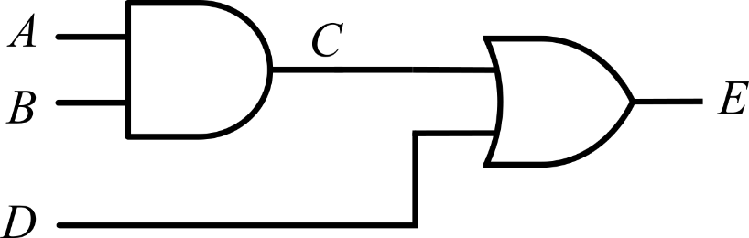
VHDL Modules (Architecture)
architecture declaration form
architecture architecture-name of entity-name is
[declarations]
begin
architecture body -- concurrent statements only
end [architecture] [architecture-name];
Example: Architecture Declaration
library ieee;
use ieee.std_logic_1164.all;
entity two_gates is
port (A, B, D: in std_logic;
E: out std_logic);
end two_gates;
architecture gates of two_gates is
signal C: std_logic;
begin
C <= A and B;
E <= C or D;
end gates;

Slide 11
Standard Models in VHDL Architectures
The architecture body can contain any or all of the following VHDL models.
Each model can contain concurrent statements and / or sequential statements.
  Behavioral model
    Highest level of abstraction.
    Describes a system in terms of what it does (or how it behaves)
  Data-flow model
  Structural model
    Components from libraries are connected together.
    Designs are hierarchical.

Slide 12
Concurrent Statements
Each concurrent statement is interpreted as acting in parallel (concurrently) to other concurrent statements.
Four types of concurrent statements
  Concurrent signal assignment statement
  Conditional signal assignment statement
  Selected signal assignment statement
  Process statement
The process statement is a concurrent statement that contains a series of sequential statements which will be executed in a sequential manner, one after the other.

Slide 13
Sequential Statements
Statements appearing within the process statement are sequential statements.
Three types of sequential statements
  signal assignment statement
  if statement
  case statement

Slide 14
Concurrent Signal Assignment Statement
(Concurrent Statements)
The order of the following concurrent statement is unimportant.
library ieee;
use ieee.std_logic_1164.all;
entity two_gates is
port (A,B,D: in std_logic;
E: out std_logic);
end two_gates;
architecture gates of two_gates is
signal C: std_logic;
begin
C <= A and B; -- concurrent statements
E <= C or D; -- concurrent statements
end gates;
library ieee;
use ieee.std_logic_1164.all;
entity two_gates is
port (A,B,D: in std_logic;
E: out std_logic);
end two_gates;
architecture gates of two_gates is
signal C: std_logic;
begin
E <= C or D; -- concurrent statements
C <= A and B; -- concurrent statements
end gates;
≡

Slide 15

Concurrent Signal Assignment Statements
(Concurrent Statements)
Example: Write the VHDL code that implements a three-input NAND gate. The three input signals are named A, B and C and the output signal name is F.
-- library declaration
library IEEE;
use IEEE.std_logic_1164.all;
--entity
entity nand3 is
port(A, B, C : in std_logic;
F : out std_logic);
end nand3;
--architecture
architecture my_nand3 of nand3 is
begin
F <= not (A and B and C);
end my_nand3;
nand3
$$F=(ABC)′$$

Slide 16
Concurrent Signal Assignment Statements
(Concurrent Statements)
Example: Write the VHDL code to implement the function expressed by the following logic equation: $F3=L^{′}∙M′∙N+L∙M$
-- library declaration
library IEEE;
use IEEE.std_logic_1164.all;
--entity
entity ckt_f3 is
port(L, M, N : in std_logic;
F3 : out std_logic);
end ckt_f3;
--architecture
architecture my_ckt_f3 of ckt_f3 is
begin
F3 <= ((not L) and (not M) and N) or (L and M);
end my_ckt_f3;
ckt_f3

Slide 17
Concurrent Signal Assignment Statements
(Concurrent Statements)
Example: Write the VHDL code to implement the function expressed by the following logic equation: $F3=L^{′}∙M′∙N+L∙M$
library IEEE;
use IEEE.std_logic_1164.all;
--entity
entity ckt_f3 is
port(L, M, N : in std_logic;
F3 : out std_logic);
end ckt_f3;
--architecture
architecture my_ckt_f3 of ckt_f3 is
signal A1, A2: std_logic; -- intermediate signals
begin
A1 <= ((not L) and (not M) and N);
A2 <= L and M;
F3 <= A1 or A2;
end my_ckt_f3;
ckt_f3

Slide 18
Conditional Signal Assignment Statements – when-else
(Concurrent Statements)
General form of a Conditional Signal Assignment statement
signal_name <= expression1 when condition1 else
expression2 when condition2 else
expressionN;

Slide 19
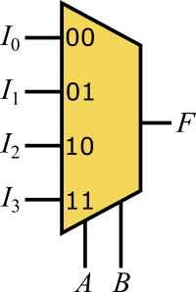
Conditional Signal Assignment Statements – when-else
(Concurrent Statements)
Example: 4-to-1 MUX
-- library declaration
library IEEE;
use IEEE.std_logic_1164.all;
--entity
entity mux4to1 is
port(I3, I2, I1, I0: in std_logic;
A,B: in std_logic;
F: out std_logic);
end mux4to1;
--architecture
architecture my_mux4to1 of mux4to1 is
begin
F <= I0 when A='0' and B='0' else
I1 when A='0' and B='1' else
I2 when A='1' and B='0' else
I3 when A='1' and B='1' else
'0';
end my_mux4to1;

Slide 20
Conditional Signal Assignment Statements – when-else
(Concurrent Statements)
Example: 4-to-1 MUX (Alternative solution)
std_logic_vector
-- library declaration
library IEEE;
use IEEE.std_logic_1164.all;
--entity
entity mux4to1 is
port(I3, I2, I1, I0: in std_logic;
A,B: in std_logic;
F: out std_logic);
end mux4to1;
--architecture
architecture my_mux4to1 of mux4to1 is
signal sel: std_logic_vector(1 downto 0);
begin
sel <= A&B;
F <= I0 when sel=“00” else
I1 when sel=“01” else
I2 when sel=“10” else
I3 when sel=“11” else
'0';
end my_mux4to1;

Slide 21
Conditional Signal Assignment Statements – when-else
(Concurrent Statements)
Example: Conditional signal assignment statement for the function: $F3=L^{′}∙M′∙N+L∙M$
-- library declaration
library IEEE;
use IEEE.std_logic_1164.all;
--entity
entity ckt_f3 is
port(L, M, N : in std_logic;
F3 : out std_logic);
end ckt_f3;
--architecture
architecture my_ckt_f3 of ckt_f3 is
begin
F3 <= '1' when (L = '0' AND M = '0' AND N = '1') else
'1' when (L = '1' AND M = '1') else
'0';
end my_ckt_f3;
ckt_f3

Slide 22
Selected Signal Assignment Statements - with select
(Concurrent Statements)
General form of a Selected Signal Assignment statement
with choose_expression select
signal_name <= expression1 when choice1,
expression2 when choice2,
expressionN when choiceN;

Slide 23
Selected Signal Assignment Statements - with select
(Concurrent Statements)
Example: 4-to-1 MUX
-- library declaration
library IEEE;
use IEEE.std_logic_1164.all;
--entity
entity mux4to1 is
port(I3, I2, I1, I0: in std_logic;
A,B: in std_logic;
F: out std_logic);
end mux4to1;
--architecture
architecture my_mux4to1 of mux4to1 is
signal sel: std_logic_vector(1 downto 0);
begin
sel <= A&B;
with sel select
F <= I0 when "00",
I1 when "01",
I2 when "10",
I3 when "11",
'0' when others;
end my_mux4to1;

Slide 24
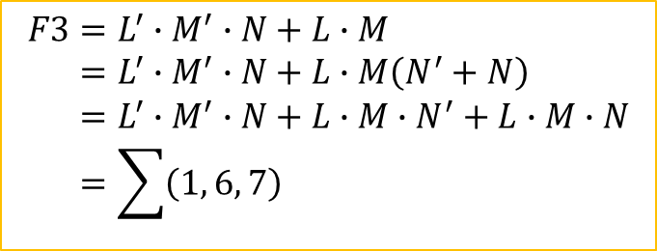
Selected Signal Assignment Statements - with select
(Concurrent Statements)
Example: Selected signal assignment statement: $F3=L^{′}∙M′∙N+L∙M$
-- library declaration
library IEEE;
use IEEE.std_logic_1164.all;
--entity
entity ckt_f3 is
port(L, M, N: in std_logic;
F3: out std_logic);
end ckt_f3;
--architecture
architecture my_ckt_f3 of ckt_f3 is
signal sig: std_logic_vector(2 downto 0);
begin
sig <= L & M & N; -- concatenation operator
with sig select
F3 <= '1' when "001" | "110" | "111",
'0' when others;
end my_ckt_f3;
$$\begin{aligned}F3&=L^{′}∙M^{′}∙N+L∙M \\ &=L^{′}∙M^{′}∙N+L∙M\left(N^{′}+N\right) \\ &=L^{′}∙M^{′}∙N+L∙M∙N^{′}+L∙M∙N \\ &=\sum{\left(1, 6, 7\right)}\end{aligned}$$
ckt_f3

Slide 25
Part 2
Introduction to VHDL (2)

Slide 26
Structural Model
Example: Entity and Architecture Declaration for A Full Adder Module
entity FullAdder is
port (X, Y, Cin: in std_logic;
Cout, Sum: out std_logic);
end FullAdder;
X
FullAdder
Cout
Y
Cin
Sum
architecture Equations of FullAdder is
begin
Sum <= X xor Y xor Cin;
Cout <= (X and Y) or (X and Cin) or (Y and Cin);
end Equations;

Slide 27

















Structural Model
Application of the FullAdder: 4-Bit Full Adder
$$S_{3}$$
$$S_{2}$$
$$S_{1}$$
$$S_{0}$$
Full
Adder
$$C_{3}$$
Full
Adder
$$C_{2}$$
Full
Adder
$$C_{1}$$
Full
Adder
$$C_{i}$$
$$C_{o}$$
$$A_{3}$$
$$B_{3}$$
$$A_{2}$$
$$B_{2}$$
$$A_{1}$$
$$B_{1}$$
$$A_{0}$$
$$B_{0}$$

Slide 28
Structural Model
Structural Description of the 4-Bit Full Adder (1 / 2)
-- library declaration
library IEEE;
use IEEE.std_logic_1164.all;
--entity
entity FullAdder is
port (X, Y, Cin: in std_logic;
Cout, Sum: out std_logic);
end FullAdder;
--architecture
architecture my_fa of FullAdder is
begin
Sum <= X xor Y xor Cin;
Cout <= (X and Y) or (X and Cin) or (Y and Cin);
end my_fa;

Slide 29
Structural Model
Structural Description of the 4-Bit Full Adder (2 / 2)
-- library declaration
library IEEE;
use IEEE.std_logic_1164.all;
--entity for 4-bit FA
entity Adder4 is
port (A, B: in std_logic_vector(3 downto 0); Ci: in std_logic;
S: out std_logic_vector(3 downto 0); Co: out std_logic);
end Adder4;
--architecture for 4-bit FA
architecture my_adder4 of Adder4 is
component FullAdder
port (X, Y, Cin: in std_logic; -- Inputs
Cout, Sum: out std_logic); -- Outputs
end component;
signal C: std_logic_vector(3 downto 1);
begin -- instantiate four copies of the FullAdder
FA0: FullAdder port map (A(0), B(0), Ci, C(1), S(0));
FA1: FullAdder port map (A(1), B(1), C(1), C(2), S(1));
FA2: FullAdder port map (A(2), B(2), C(2), C(3), S(2));
FA3: FullAdder port map (A(3), B(3), C(3), Co, S(3));
end my_adder4;
Adder4를 entity로 사용할 것.

Slide 30
VHDL Modules - Component
Components used within the architecture are declared at the beginning of the architecture.
Components Declaration Form
component component-name
port (list-of-interface-signals-and-their-types);
end component;
label: component-name port map (list-of-actual-signals);

Slide 31
Signals and Constants
Internal Signal Declaration Form
signal list_of_signal_names: type_name [constraint] [:= initial_value];
Example
signal A,B,C: std_logic_vector(3 downto 0):= “1111”;
-- A, B, and C are 4-bit vectors dimensioned 3 downto 0 and initialized to 1111.
signal E,F: integer range 0 to 15;
-- E and F are integers range from 0 to 15, initialized by default to 0.

Slide 32
Signals and Constants
Constant Declaration Form
constant constant_name: type_name [constraint] [:=constant_value];
Example
constant limit : integer := 17;
-- A constant named limit of type integer with a value of 17
constant delay1 : time := 5 ns;
-- A constant named delay1 of type time with the value of 5 ns
Example: Use of Constant
A <= B and C after delay1;

Slide 33
Signals and Constants
Predefined data types that can be used as signals or constants
bit ‘0’ or ‘1’
bit_vector an array with each element of type bit
boolean FALSE or TRUE
integer An integer in the range -(2³¹ -1) to +(2³¹ -1)
(some implementations support a wider range)
positive An integer in the range 1 to 2³¹-1 (positive integers)
natural An integer in the range 0 to 2³¹-1 (positive integers and zero)
real Floating-point number in the range -1.0E38 to +1.0E38
character Any legal VHDL character including upper- and lower case letters,
digits, and special characters; each printable character must be
enclosed in single quotes, e.g.,’d’,’7’,’+’
time An integer with units fs, ps, ns, us, ms, sec, min, or hr

Slide 34
Signals and Constants
Example of User-defined Types – enumeration type
type state_type is (S0,S1,S2,S3,S4,S5);
signal state : state_type := S1;
state <= S3;

Slide 35
Arrays
In order to use an array in VHDL
  Declare an array type
  Declare an array object
Declaration of a one-dimensional array type named SHORT_WORD
type SHORT_WORD is array (15 downto 0) of std_logic;
Declaration of array objects of type SHORT_WORD
signal DATA_WORD: SHORT_WORD;
-- DATA_WORD is a signal array of 16 bits, indexed 15 down to 0, initialized by default to all ‘0’ bits
signal ALT_WORD: SHORT_WORD := “0101010101010101”;
-- ALT_WORD is a signal array of 16 bits which is initialized as above
constant ONE_WORD: SHORT_WORD := (others =>’1’);
--ONE_WORD is a constant array of 16 bits; all bits are set to ‘1’ by (others =>’1’)

Slide 36
Arrays
General Form of Array Type and Array Object Declaration
type array_type_name is array index_range of element_type;
signal array_name: array_type_name[:= initial_values];
signal may be replaced with constant

Slide 37

VHDL Operators
VHDL Operators
Low Priority High
binary logical operators: and or nand nor xor xnor
relational operators: = /= < <= > >=
shift operators: sll srl sla sra rol ror
adding operators: + - & (concatenation)
unary sign operators: + -
multiplying operators: * / mod rem
miscellaneous operators: not abs **
Operator Precedence: Order of Evaluation
There is no precedence defined within a group. Must use parenthesis to define order.
Best practice is to use parenthesis in all cases.
$$F3=L^{′}∙M′∙N+L∙M$$
illegal
F3 <= not L and not M and N or L and M;
legal
F3 <= (not L and not M and N) or (L and M);

Slide 38
VHDL Operators
Example of Relational Operator - Comparator for Integers
library ieee;
use ieee.std_logic_1164.all;
entity comparator is
port (A, B: in integer range 0 to 15;
L, E, G: out boolean);
end comparator;
architecture my_comparator of comparator is
begin
L <= A < B;
E <= A = B;
G <= A > B;
end architecture;
Comparator
<
L
A
=
E
B
>
G

Slide 39
VHDL Operators
Shift Operators – shift or rotate a std_logic_vector
Example: A is an 8-bit vector equal to “10010101”
A sll 2 is “01010100” (shift left logical, filled with ‘0’)
A srl 3 is “00010010” (shift right logical, filled with ‘0’)
A sla 3 is “10101111: (shift left arithmetic, filled with rightmost bit)
A sra 2 is “11100101” (shift right arithmetic, filled with leftmost bit)
A rol 3 is “10101100” (rotate left)
A ror 5 is “10101100” (rotate right)
Shifting Using Concatenation Operator – Shift right arithmetic two places
A(7)&A(7)&A(7 downto 2) = ‘1’&’1’&”1000101” = “11100101”

Slide 40
Packages and Libraries
Packages and Libraries – Frequently used functions and components
Packages Declaration Form
Package declaration
package package-name is
package declarations
end [package][package-name];
Optional package body
package body package-name is
package body declarations
end [package body][package-name];

Slide 41
Packages and Libraries
bit_pack package (compiled library name: BITLIB)
- includes components and functions (inside CD-ROM attached)
Component Declaration for Nor2
component Nor2
port (A1,A2: in bit; Z: out bit);
end component;
--2-input NOR gate
entity Nor2 is
port (A1,A2: in bit; Z: out bit);
end Nor2;
architecture concur of Nor2 is
begin
Z<=not(A1 or A2) after 10ns;
end concur;

Slide 42
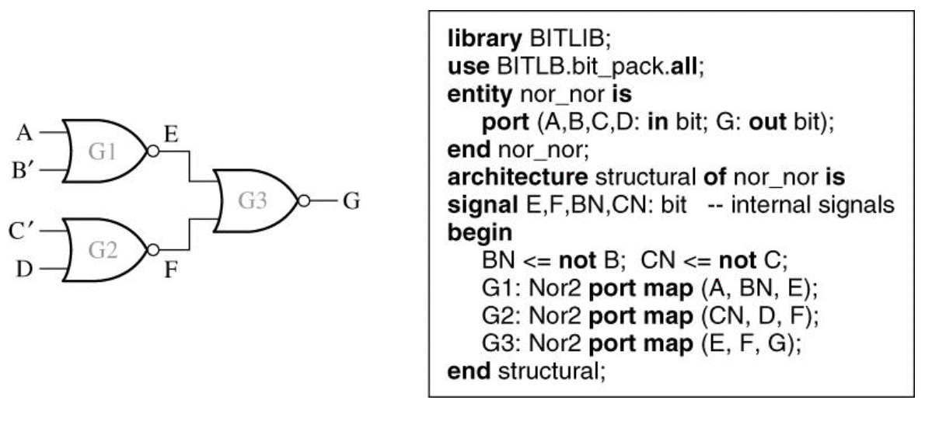
Packages and Libraries
To access components and functions within a package requires a library and a use.
libraray BITLIB;
use BITLIB.bit_pack.all;
use BITLIB.bit_pack.Nor2;
NOR-NOR Circuit and Structural VHDL Code Using Library Components

Slide 43
IEEE Standard Logic
IEEE-1164 standard logic: std_ulogic and std_logic
'U', -- uninitialized (the signal hasn't been set yet.)
'X', -- strong drive, unknown logic value (Impossible to determine this value/result.)
'0', -- strong drive, logic zero
'1', -- strong drive, logic one
'Z', -- high impedance
'W', -- weak drive, unknown logic value (can't tell if it should be 0 or 1)
'L', -- weak drive, logic zero (that should probably go to 0, model of pull-down)
'H', -- weak drive, logic one (that should probably go to 1, model of pull-up)
'-' -- unspecified (don’t care)

Slide 44
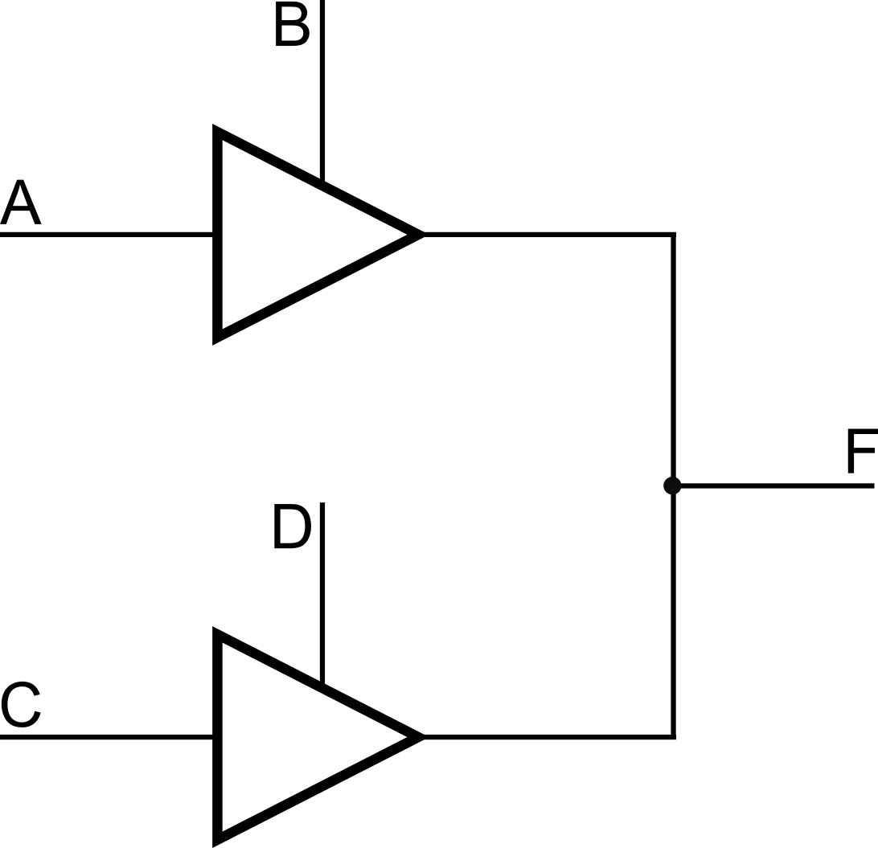
IEEE Standard Logic
IEEE-1164 standard logic: std_ulogic and std_logic
CONSTANT resolution_table : stdlogic_table := (
-----------------------------------------------------------
--| U X 0 1 Z W L H - | |
-----------------------------------------------------------
( 'U', 'U', 'U', 'U', 'U', 'U', 'U', 'U', 'U' ), -- | U |
( 'U', 'X', 'X', 'X', 'X', 'X', 'X', 'X', 'X' ), -- | X |
( 'U', 'X', '0', 'X', '0', '0', '0', '0', 'X' ), -- | 0 |
( 'U', 'X', 'X', '1', '1', '1', '1', '1', 'X' ), -- | 1 |
( 'U', 'X', '0', '1', 'Z', 'W', 'L', 'H', 'X' ), -- | Z |
( 'U', 'X', '0', '1', 'W', 'W', 'W', 'W', 'X' ), -- | W |
( 'U', 'X', '0', '1', 'L', 'W', 'L', 'W', 'X' ), -- | L |
( 'U', 'X', '0', '1', 'H', 'W', 'W', 'H', 'X' ), -- | H |
( 'U', 'X', 'X', 'X', 'X', 'X', 'X', 'X', 'X’ ) -- | - |
);

Slide 45
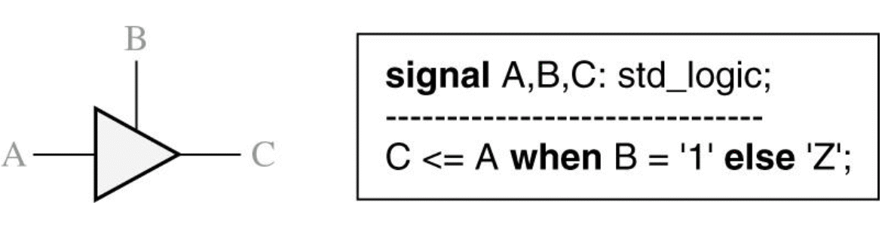
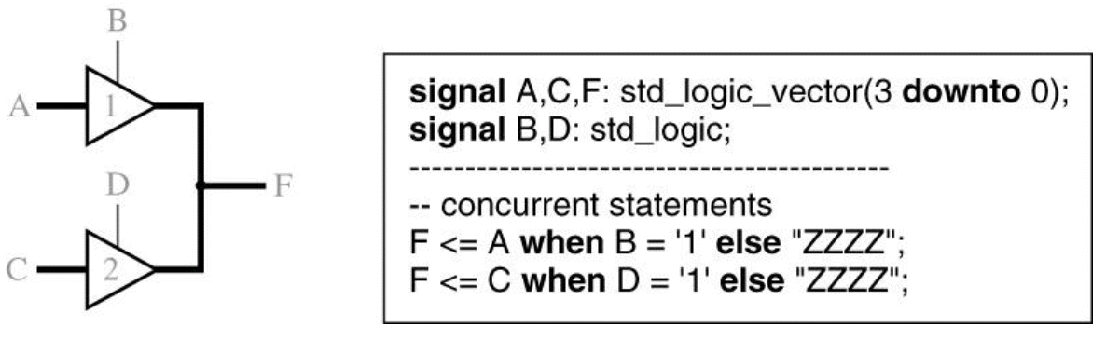
IEEE Standard Logic
IEEE standard 1164 defines a std_logic type of nine values: U, X, 0, 1, Z, W, L, H, -
Tri-state Buffer
Tri-state Buffers Driving a Bus

Slide 46
IEEE Standard Logic
std_logic_vector
One dimensional array of std_logic signals
Index starts with 0
-- library declaration
library IEEE;
use IEEE.std_logic_1164.all;
--entity
entity quad_and_gates is
port(A3, A2, A1, A0: in std_logic;
B3, B2, B1, B0: in std_logic;
C3, C2, C1, C0: out std_logic);
end quad_and_gates;
--architecture
architecture my_vector of quad_and_gates is
begin
C3 <= A3 and B3; -- hard way
C2 <= A2 and B2;
C1 <= A1 and B1;
C0 <= A0 and B0;
end my_vector;
-- library declaration
library IEEE;
use IEEE.std_logic_1164.all;
--entity
entity quad_and_gates is
port(A, B: in std_logic_vector (3 downto 0);
C: out std_logic_vector (3 downto 0));
end quad_and_gates;
--architecture
architecture my_vector of quad_and_gates is
begin
C <= A and B; -- easy way
end my_vector;
A3
C3
B3
A2
C2
B2
A1
C1
B1
A0
C0
B0

Slide 47
Compilation and Simulation of VHDL Code
Compilation, Simulation, and Synthesis of VHDL Code

Slide 48


