Slide 1
디지털시스템 및 마이크로 컴퓨터 I
8 주차 강의
인제대학교 의용공학부
조 종만 교수
Apr., 15, 2021

Slide 2
Part 1
Analysis of Clocked Sequential Circuits

Slide 3
Objectives
For a given a sequential circuit
  Write the next-state equations for the flip-flops
  Derive the state graph or state table.
  Using the state graph, determine
    The state sequence
    Output sequence
Mealy machine and Moore machine
For a given a state table
  Construct the corresponding state graph

Slide 4
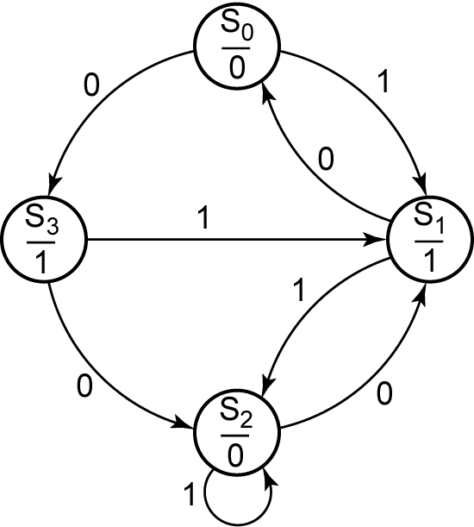
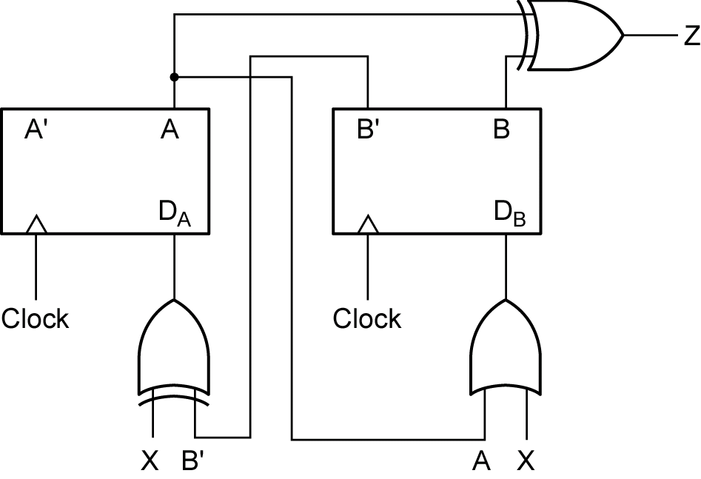
Moore Machine
The output is a function of the present state only
The state graph has the output associated with the state

Slide 5
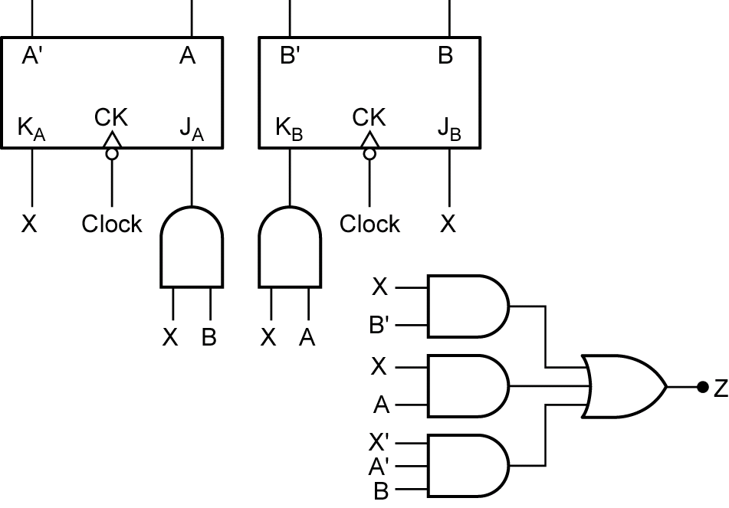
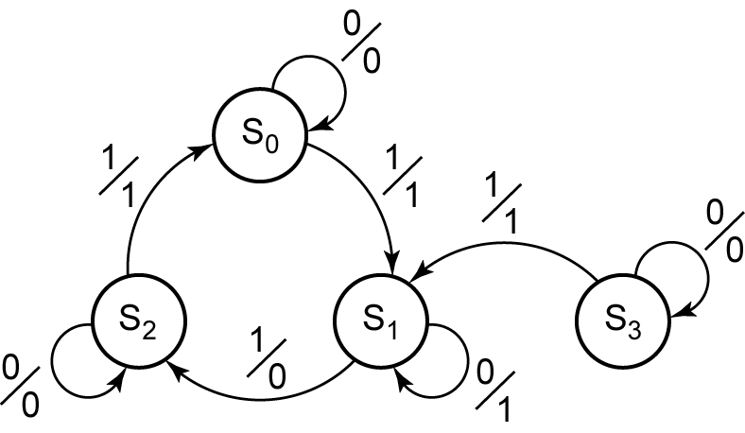
Mealy Machine
The output is a function of the present state and the input
The state graph has the output associated with the arrow

Slide 6
Construction of State Table and Graphs
Systematic Approach to Analyze Sequential Circuits
Determine the flip-flop input equations and the output equations from the circuit.
Derive the next-state equation for each flip-flop from its input equations, using one of the following relations:
D flip-flop Q⁺ = D (1)
D-CE flip-flop Q⁺ = D·CE + Q·CE’ (2)
T-flip-flop Q⁺ = T XOR Q (3)
S-R flip-flop Q⁺ = S + R’Q (4)
J-K flip-flop Q⁺ = JQ’ + K’Q (5)
3. Plot a next-state equations for the flip-flop.
4. Combine these maps to form the state table. Such a state table, which gives the next state of the flip-flops as a function of their present state and the circuit inputs, is frequently referred to as a transition table.

Slide 7
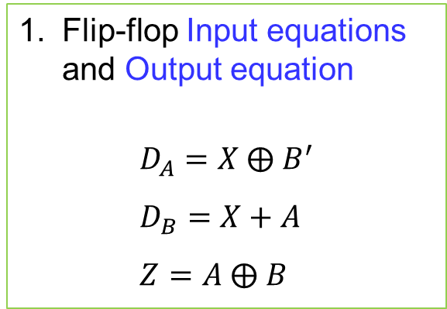
Construction of State Table and Graphs
Example: To derive the State Table (Moore Machine)
Flip-flop Input equations and Output equation
$$D_{A}=X ⨁{ B}^{′} \\ D_{B}=X+A \\ Z=A ⨁ B$$

Slide 8

Construction of State Table and Graphs
Example: To derive the State Table
1. Determine flip-flop Input equations and Output equations
$$D_{A}=X ⨁{ B}^{′} D_{B}=X+A Z=A ⨁ B$$
2. Derive the next-state equation for each flip-flop from its input equation
$$A^{+}=X ⊕ B^{′} B^{+}=X+A$$

Slide 9
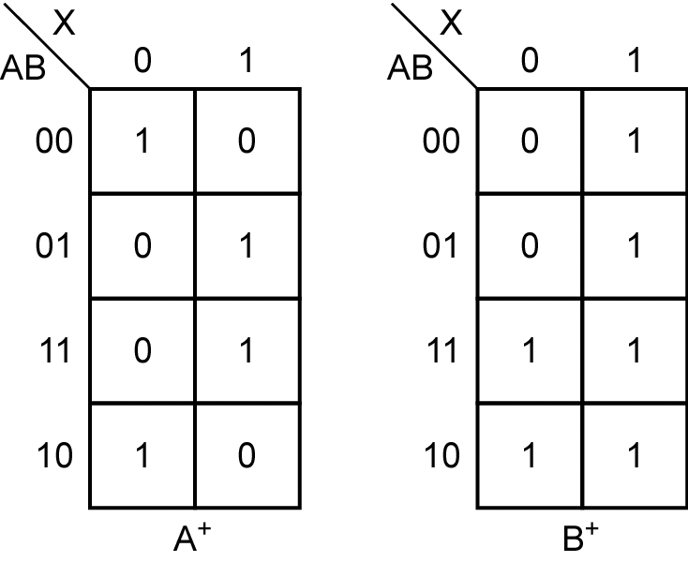

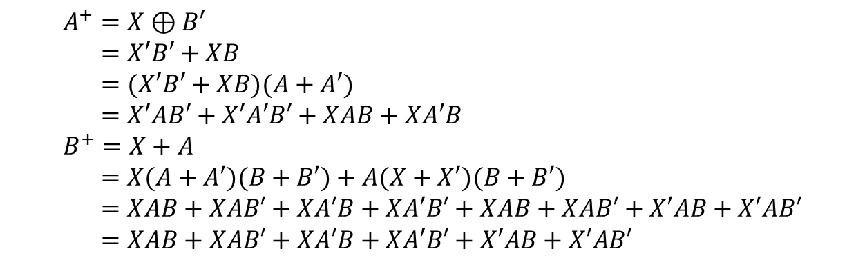
Construction of State Table and Graphs
Example: To derive the State Table
2. The next-state equation
$$A^{+}=X ⊕ B^{′} B^{+}=X+A$$
3. Karnaugh Maps (Next State Map)
$$A^{+}=X⊕B′ \\ =X′B′+XB \\ =(X′B′+XB)(A+A′) \\ =X′AB′+X′A′B′+XAB+XA′B \\ B^{+}=X+A \\ =X(A+A′)(B+B′)+A(X+X′)(B+B′) \\ =XAB+XAB′+XA′B+XA′B′+XAB+XAB′+X′AB+X′AB′ \\ =XAB+XAB′+XA′B+XA′B′+X′AB+X′AB′$$

Slide 10
Construction of State Table and Graphs
4. To Derive a Transition Table
AB | A⁺B⁺ X = 0 X = 1 | Z
00 01 11 10 | 10 01 00 11 01 11 11 01 | 0 1 0 1
Present State | Next State |  | Present Output (Z)
 | X = 0 | X = 1
S₀ S₁ S₂ S₃ | S₃ S₀ S₁ S₂ | S₁ S₂ S₂ S₁ | 0 1 0 1

Slide 11
Construction of State Table and Graphs
5. To Derive a State Graph for Moore Machine
state
Present State | Next State X = 0 X = 1 | Present Output (Z)
S₀ S₁ S₂ S₃ | S₃ S₁ S₀ S₂ S₁ S₂ S₂ S₁ | 0 1 0 1
input
output

Slide 12
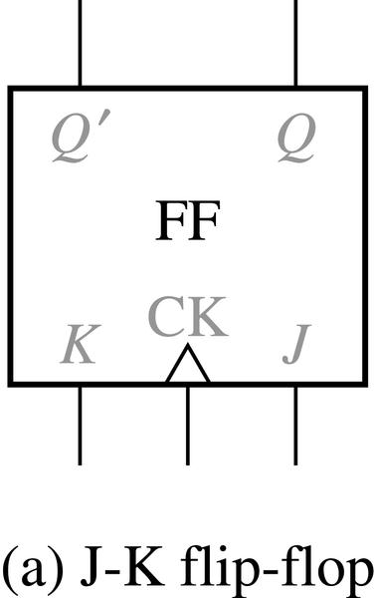

Construction of State Table and Graphs
J-K Flip-Flop (Rising Edge Trigger Type)
J K Q | Q⁺
0 0 0 0 0 1 0 1 0 0 1 1 1 0 0 1 0 1 1 1 0 1 1 1 | 0 1 0 0 1 1 1 0
Q JK | Q=0 | Q=1
00 | 0 | 1
01 | 0 | 0
11 | 1 | 0
10 | 1 | 1
$$Q^{+}=JQ^{′}+K^{′}Q$$
Next state table and characteristic equation

Slide 13

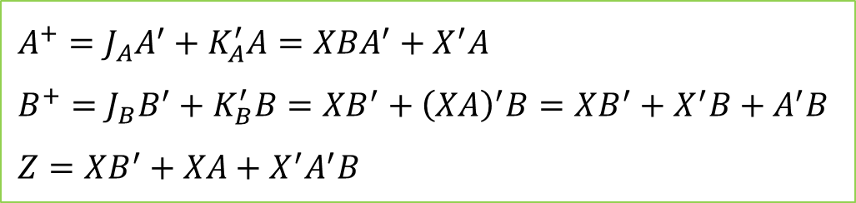
Construction of State Table and Graphs
Example: To derive the State Table (Mealy Machine)
The next-state and output equations are
$$Q^{+}=JQ^{′}+K^{′}Q$$
$$A^{+}=J_{A}A^{′}+K_{A}^{′}A=XBA^{′}+X^{′}A \\ B^{+}=J_{B}B^{′}+K_{B}^{′}B=XB^{′}+{\left(XA\right)}^{′}B=XB^{′}+X^{′}B+A^{′}B \\ Z=XB^{′}+XA+X^{′}A^{′}B$$

Slide 14
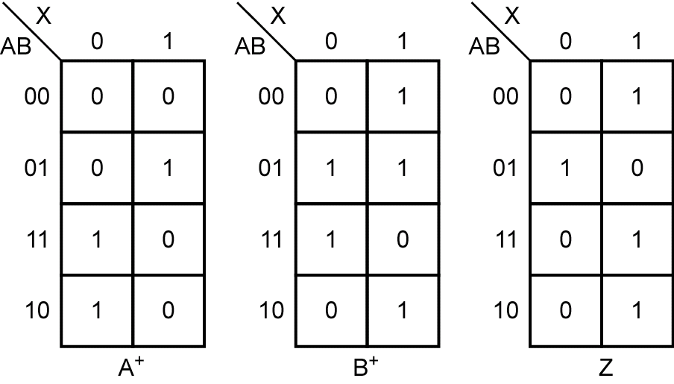
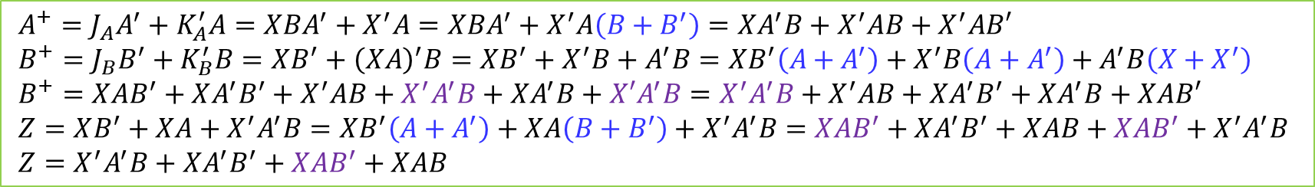
Construction of State Table and Graphs
The next-state and output maps
$$A^{+}=J_{A}A^{′}+K_{A}^{′}A=XBA^{′}+X^{′}A=XBA^{′}+X^{′}A\left(B+B^{′}\right)=XA^{′}B+X^{′}AB+X^{′}AB′ \\ B^{+}=J_{B}B^{′}+K_{B}^{′}B=XB^{′}+{\left(XA\right)}^{′}B=XB^{′}+X^{′}B+A^{′}B=XB^{′}\left(A+A^{′}\right)+X^{′}B\left(A+A^{′}\right)+A^{′}B\left(X+X^{′}\right) \\ B^{+}=XAB^{′}+XA^{′}B^{′}+X^{′}AB+X^{′}A^{′}B+{XA}^{′}B+{X′A}^{′}B=X^{′}A^{′}B+X^{′}AB+XA^{′}B^{′}+XA^{′}B+XAB′ \\ Z=XB^{′}+XA+X^{′}A^{′}B=XB^{′}\left(A+A^{′}\right)+XA\left(B+B^{′}\right)+X^{′}A^{′}B=XAB^{′}+XA^{′}B^{′}+XAB+XAB^{′}+X^{′}A^{′}B \\ Z=X^{′}A^{′}B+XA^{′}B^{′}+XAB^{′}+XAB$$

Slide 15
Construction of State Table and Graphs
Transition Table
AB | A⁺B⁺ |  | Z
 | X=0 | X=1 | X=0 | X=1
00 01 11 10 | 00 01 11 10 | 01 11 00 01 | 0 1 0 0 | 1 0 1 1
Present State | Next State X=0 X=1 | Present Output X=0 X=1
S₀ S₁ S₂ S₃ | S₀ S₁ S₁ S₂ S₂ S₀ S₃ S₁ | 0 1 1 0 0 1 0 1

Slide 16
Construction of State Table and Graphs
State Graph for Mealy Machine
Present State | Next State X=0 X=1 | Present Output X=0 X=1
S₀ S₁ S₂ S₃ | S₀ S₁ S₁ S₂ S₂ S₀ S₃ S₁ | 0 1 1 0 0 1 0 1
input
output
state

Slide 17


Slide 18
Part 2
Derivation of State Graphs and Tables

Slide 19
Objectives
Given a problem statement for the design of a Mealy or Moore sequential circuit,
  find the corresponding state graph and table.
Explain the significance of each state in your graph or table
  in terms of the input sequences required to reach that state.
Check your state graph using appropriate input sequences.

Slide 20
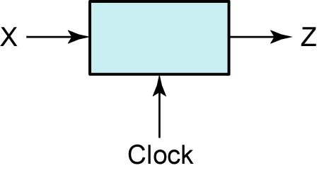
Design of a Sequence Detector (1)
Sequence Detector to be Designed
Z=1 for input sequence of ‘101’
X = | 0 | 0 | 1 | 1 | 0 | 1 | 1 | 0 | 0 | 1 | 0 | 1 | 0 | 1 | 0 | 0
Z = | 0 | 0 | 0 | 0 | 0 | 1 | 0 | 0 | 0 | 0 | 0 | 1 | 0 | 1 | 0 | 0
(time: | 0 | 1 | 2 | 3 | 4 | 5 | 6 | 7 | 8 | 9 | 10 | 11 | 12 | 13 | 14 | 15)

Slide 21
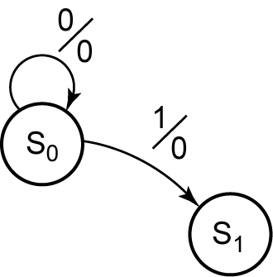
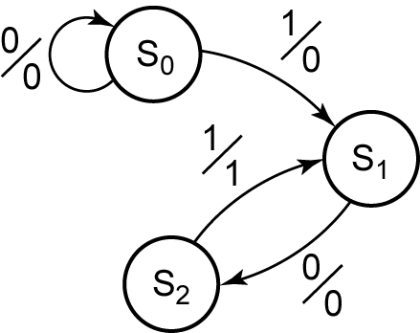
Design of a Sequence Detector (1-1)
Mealy Formation of State Graph

Slide 22
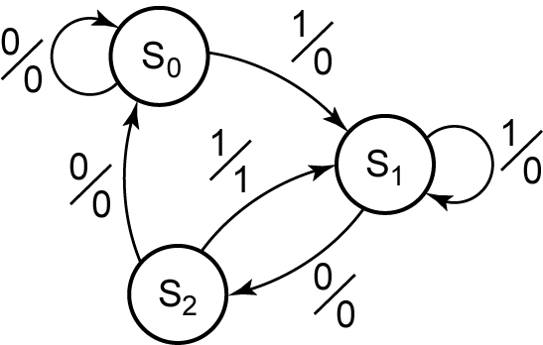
Design of a Sequence Detector (1-1)
Mealy State Graph for Sequence Detector

Slide 23
Design of a Sequence Detector (1-1)
State Table
Present State | Next State |  | Present Output
 | X=0 | X=1 | X=0 | X=1
S₀ | S₀ | S₁ | 0 | 0
S₁ | S₂ | S₁ | 0 | 0
S₂ | S₀ | S₁ | 0 | 1
Transition Table with State Assignment
AB | A⁺B⁺ |  | Z
 | X=0 | X=1 | X=0 | X=1
00 | 00 | 01 | 0 | 0
01 | 10 | 01 | 0 | 0
10 | 00 | 01 | 0 | 1

Slide 24
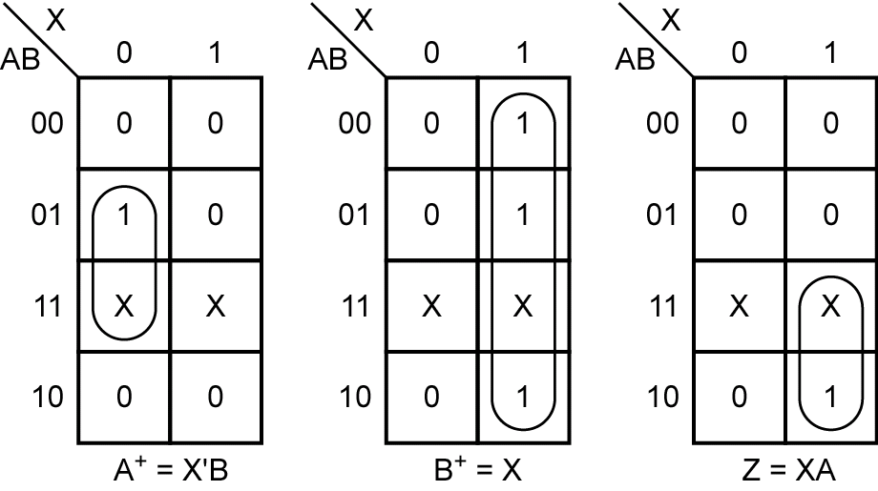
Design of a Sequence Detector (1-1)
Map for the Next State
Map Output Function Z
AB | A⁺B⁺ |  | Z
 | X=0 | X=1 | X=0 | X=1
00 | 00 | 01 | 0 | 0
01 | 10 | 01 | 0 | 0
10 | 00 | 01 | 0 | 1

Slide 25
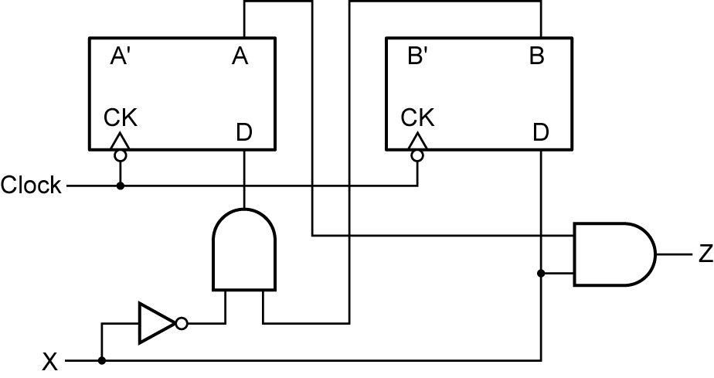
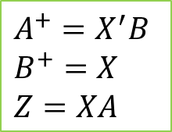
Design of a Sequence Detector (1-1)
Final Circuit
$$A^{+}=X^{′}B \\ B^{+}=X \\ Z=XA$$

Slide 26
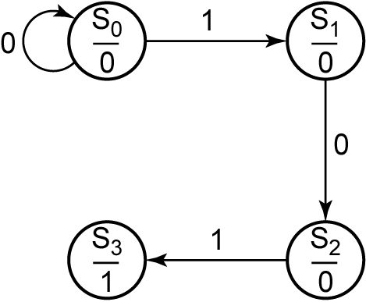
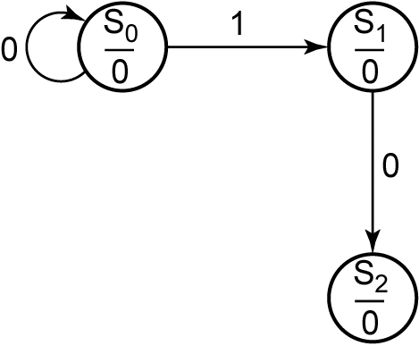
Design of a Sequence Detector (1-2)
Moore Machine Design Process

Slide 27
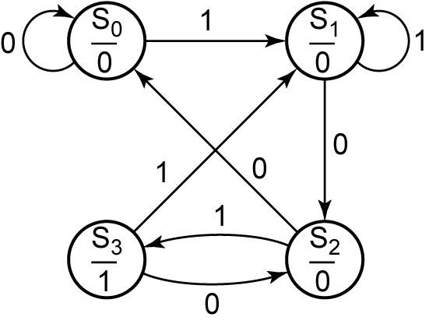
Design of a Sequence Detector (1-2)
Moore State Graph for Sequence Detector

Slide 28
Design of a Sequence Detector (1-2)
State Table
Transition Table with State Assignment
Present State | Next State |  | Present Output (Z)
 | X=0 | X=1
S₀ | S₀ | S₁ | 0
S₁ | S₂ | S₁ | 0
S₂ | S₀ | S₃ | 0
S₃ | S₂ | S₁ | 1
AB | A⁺B⁺ |  | Z
 | X=0 | X=1
00 | 00 | 01 | 0
01 | 11 | 01 | 0
11 | 00 | 10 | 0
10 | 11 | 01 | 1

Slide 29
Design of a Sequence Detector (2)
The circuit to be designed (Mealy)
Output Z=1 if input sequence ends in either 010 or 1001
X= | 0 | 0 | 1 | 0 | 1 | 0 | 0 | 1 | 0 | 0 | 0 | 1 | 0 | 0 | 1 | 1 | 0
 |  |  |  | ↑ |  | ↑ |  | ↑ | ↑ |  |  |  | ↑ |  | ↑
 |  |  |  | a |  | b |  | c | d |  |  |  | e |  | f
Z= | 0 | 0 | 0 | 1 | 0 | 1 | 0 | 1 | 1 | 0 | 0 | 0 | 1 | 0 | 1 | 0 | 0

Slide 30
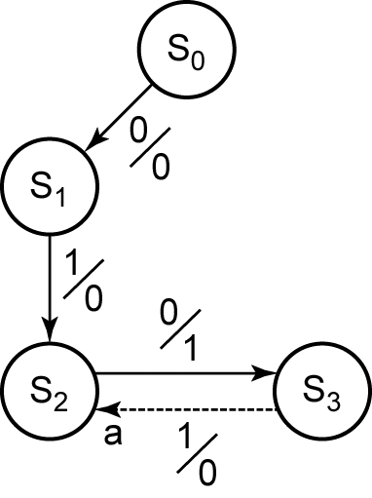
Design of a Sequence Detector (2)
Formation of State Graph (010 sequence)
state | sequence received
S₀ S₁ S₂ S₃ | reset 0 01 010

Slide 31
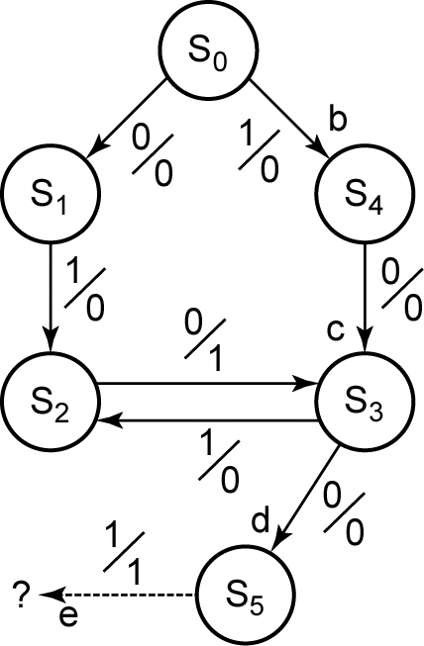
Design of a Sequence Detector (2)
Formation of State Graph (1001 sequence)
state | sequence ends in
S₀ S₁ S₂ S₃ S₄ S₅ | reset 0 (but not 10) 01 10 1 (but not 01) 100

Slide 32
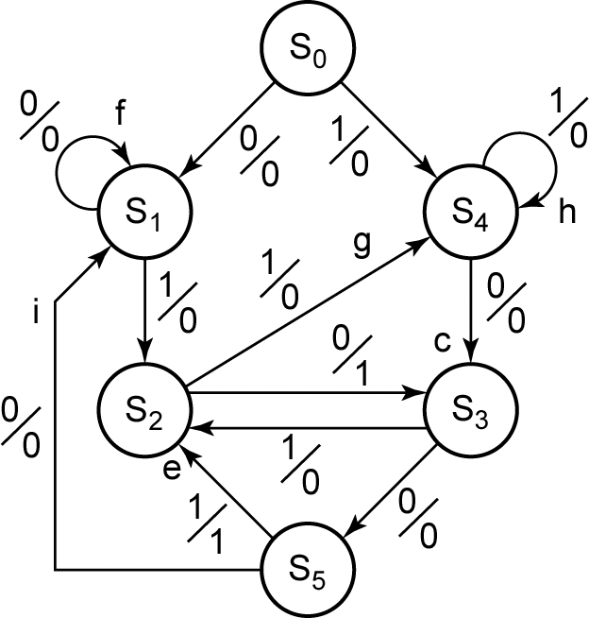
Design of a Sequence Detector (2)
Completed State Graph for a Sequence Detector to be Designed
state | sequence ends in
S₀ S₁ S₂ S₃ S₄ S₅ | reset 0 (but not 10) 01 10 1 (but not 01) 100

Slide 33
Design of a Sequence Detector (3)
The circuit to be designed (Moore)
Output Z=1 if the total number of 1’s received is odd and at least two consecutive 0’s have been received
X= | 1 | 0 | 1 | 1 | 0 | 0 | 1 | 1
 | ↑ |  |  | ↑ |  | ↑ | ↑ | ↑
 | a |  |  | b |  | c | d | e
Z= | (0) | 0 | 0 | 0 | 0 | 1 | 0 | 1

Slide 34
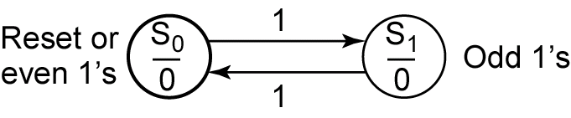
Design of a Sequence Detector (3)
Formation of State Graph (Step 1)

Slide 35
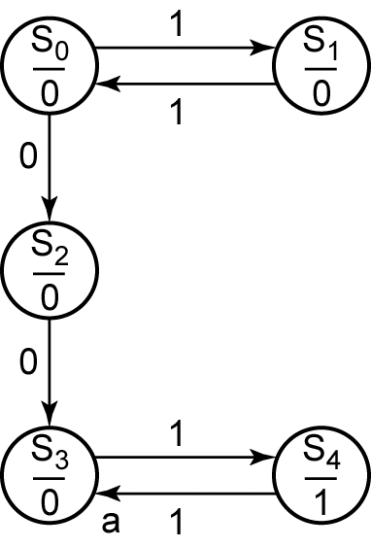
Design of a Sequence Detector (3)
Formation of State Graph (Step 2)
state | sequence ends in
S₀ S₁ S₂ S₃ S₄ | reset or even 1’s odd 1’s even 1’s and ends in 0 even 1’s and 00 has occurred 00 has occurred and odd 1’s

Slide 36
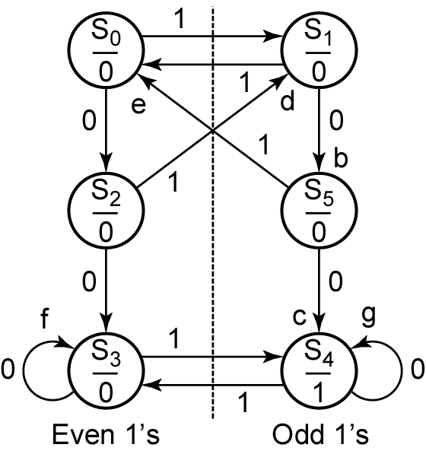
Design of a Sequence Detector (3)
Completed State Graph for a Sequence Detector to be Designed
state | sequence ends in
S₀ S₁ S₂ S₃ S₄ S₅ | reset or even 1’s odd 1’s even 1’s and ends in 0 even 1’s and 00 has occurred odd 1’s and 00 has occurred odd 1’s and ends in 0

Slide 37
Design of a Sequence Detector (4)
Example: Z=1 when input sequence 0101 or 1001 occurs.
The circuit resets after every four inputs.
Mealy Circuit
A typical sequence of input and output
X = | 0101 | 0010 | 1001 | 0100
Z = | 0001 | 0000 | 0001 | 0000

Slide 38
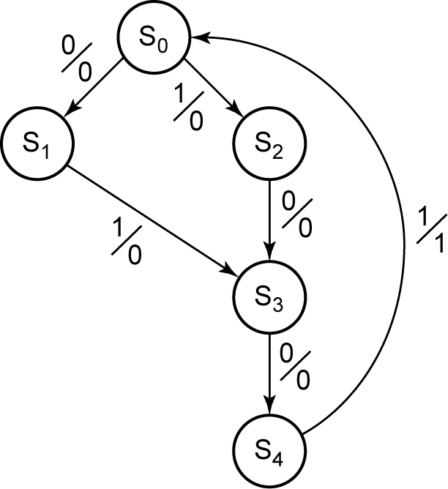
Design of a Sequence Detector (4)
Partial State Graph for Example
State | Sequence Received
S₀ | reset
S₁ | 0
S₂ | 1
S₃ | 01 or 10
S₄ | 010 or 100
The circuit goes to the same state if either 01 or 10 received.

Slide 39
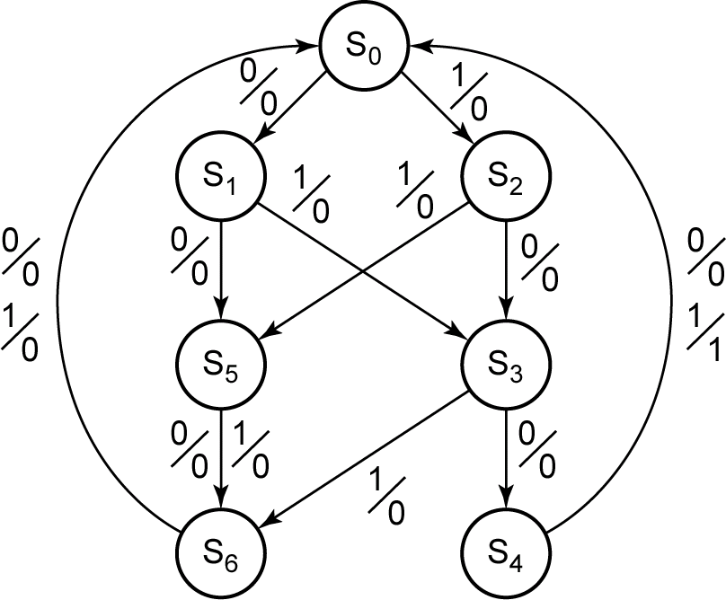
Design of a Sequence Detector (4)
Complete State Graph for Example
state | sequence received
S₀ S₁ S₂ S₃ S₄ S₅ S₆ | reset 0 1 01 or 10 010 or 100 2 inputs received, no 1 output is possible 3 inputs received, no 1 output is possible

Slide 41
Part 3
Reduction of State Tables State Assignment

Slide 42
Objectives
Define equivalent states, state several ways of testing for state equivalence, and determine if two states are equivalent.
Define equivalent sequential circuits and determine if two circuits are equivalent.
Reduce a state table to a minimum number of rows.

Slide 43
Elimination of Redundant States
Example: Z=1 when input sequence 0101 or 1001 occurs.
The circuit resets after every four inputs.
Mealy Circuit
A typical sequence of input and output
X = | 0101 | 0010 | 1001 | 0100
Z = | 0001 | 0000 | 0001 | 0000

Slide 44
Elimination of Redundant States
State Table for Sequence Detector (0101, 1001)
Input Sequence | Present State | Next State |  | Present Output
 |  | X=0 | X=1 | X=0 | X=1
reset | A | B | C | 0 | 0
0 | B | D | E | 0 | 0
1 | C | F | G | 0 | 0
00 | D | H | I | 0 | 0
01 | E | J | K | 0 | 0
10 | F | L | M | 0 | 0
11 | G | N | P | 0 | 0
000 | H | A | A | 0 | 0
001 | I | A | A | 0 | 0
010 | J | A | A | 0 | 1
011 | K | A | A | 0 | 0
100 | L | A | A | 0 | 1
101 | M | A | A | 0 | 0
110 | N | A | A | 0 | 0
111 | P | A | A | 0 | 0

Slide 45
Elimination of Redundant States
State Table for Sequence Detector (0101, 1001)
Input Sequence | Present State | Next State |  | Present Output
 |  | X=0 | X=1 | X=0 | X=1
reset | A | B | C | 0 | 0
0 | B | D | E | 0 | 0
1 | C | F | G | 0 | 0
00 | D | H | I | 0 | 0
01 | E | J | K | 0 | 0
10 | F | L | M | 0 | 0
11 | G | N | P | 0 | 0
000 | H | A | A | 0 | 0
001 | I | A | A | 0 | 0
010 | J | A | A | 0 | 1
011 | K | A | A | 0 | 0
100 | L | A | A | 0 | 1
101 | M | A | A | 0 | 0
110 | N | A | A | 0 | 0
111 | P | A | A | 0 | 0
Same Next State and Outputs
for the same inputs
H ≡ I

Slide 46
Elimination of Redundant States
State Table for Sequence Detector (0101, 1001)
Input Sequence | Present State | Next State |  | Present Output
 |  | X=0 | X=1 | X=0 | X=1
reset | A | B | C | 0 | 0
0 | B | D | E | 0 | 0
1 | C | F | G | 0 | 0
00 | D | H | I | 0 | 0
01 | E | J | K | 0 | 0
10 | F | L | M | 0 | 0
11 | G | N | P | 0 | 0
000 | H | A | A | 0 | 0
001 | I | A | A | 0 | 0
010 | J | A | A | 0 | 1
011 | K | A | A | 0 | 0
100 | L | A | A | 0 | 1
101 | M | A | A | 0 | 0
110 | N | A | A | 0 | 0
111 | P | A | A | 0 | 0
H
H ≡ I
Replace I with H

Slide 47
Elimination of Redundant States
State Table for Sequence Detector (0101, 1001)
Input Sequence | Present State | Next State |  | Present Output
 |  | X=0 | X=1 | X=0 | X=1
reset | A | B | C | 0 | 0
0 | B | D | E | 0 | 0
1 | C | F | G | 0 | 0
00 | D | H | H | 0 | 0
01 | E | J | K | 0 | 0
10 | F | L | M | 0 | 0
11 | G | N | P | 0 | 0
000 | H | A | A | 0 | 0
010 | J | A | A | 0 | 1
011 | K | A | A | 0 | 0
100 | L | A | A | 0 | 1
101 | M | A | A | 0 | 0
110 | N | A | A | 0 | 0
111 | P | A | A | 0 | 0
Remove I

Slide 48
Elimination of Redundant States
State Table for Sequence Detector (0101, 1001)
Present State | Next State |  | Present Output
 | X=0 | X=1 | X=0 | X=1
A | B | C | 0 | 0
B | D | E | 0 | 0
C | F | G | 0 | 0
D | H | H | 0 | 0
E | J | K | 0 | 0
F | L | M | 0 | 0
G | N | P | 0 | 0
H | A | A | 0 | 0
J | A | A | 0 | 1
K | A | A | 0 | 0
L | A | A | 0 | 1
M | A | A | 0 | 0
N | A | A | 0 | 0
P | A | A | 0 | 0
H ≡ K, M, N, P
Replace K, M, N, P with H

Slide 49
Elimination of Redundant States
State Table for Sequence Detector (0101, 1001)
Present State | Next State |  | Present Output
 | X=0 | X=1 | X=0 | X=1
A | B | C | 0 | 0
B | D | E | 0 | 0
C | F | G | 0 | 0
D | H | H | 0 | 0
E | J | K H | 0 | 0
F | L | M H | 0 | 0
G | N H | P H | 0 | 0
H | A | A | 0 | 0
J | A | A | 0 | 1
K | A | A | 0 | 0
L | A | A | 0 | 1
M | A | A | 0 | 0
N | A | A | 0 | 0
P | A | A | 0 | 0
H ≡ K, M, N, P
Replace K, M, N, P with H

Slide 50
Elimination of Redundant States
State Table for Sequence Detector (0101, 1001)
Present State | Next State |  | Present Output
 | X=0 | X=1 | X=0 | X=1
A | B | C | 0 | 0
B | D | E | 0 | 0
C | F | G | 0 | 0
D | H | H | 0 | 0
E | J | H | 0 | 0
F | L | H | 0 | 0
G | H | H | 0 | 0
H | A | A | 0 | 0
J | A | A | 0 | 1
L | A | A | 0 | 1
Remove K, M, N, P

Slide 51
Elimination of Redundant States
State Table for Sequence Detector (0101, 1001)
Present State | Next State |  | Present Output
 | X=0 | X=1 | X=0 | X=1
A | B | C | 0 | 0
B | D | E | 0 | 0
C | F | G | 0 | 0
D | H | H | 0 | 0
E | J | H | 0 | 0
F | L | H | 0 | 0
G | H | H | 0 | 0
H | A | A | 0 | 0
J | A | A | 0 | 1
L | A | A | 0 | 1
J ≡ L
Replace L with J

Slide 52
Elimination of Redundant States
State Table for Sequence Detector (0101, 1001)
Present State | Next State |  | Present Output
 | X=0 | X=1 | X=0 | X=1
A | B | C | 0 | 0
B | D | E | 0 | 0
C | F | G | 0 | 0
D | H | H | 0 | 0
E | J | H | 0 | 0
F | L J | H | 0 | 0
G | H | H | 0 | 0
H | A | A | 0 | 0
J | A | A | 0 | 1
L | A | A | 0 | 1
J ≡ L
Replace L with J

Slide 53
Elimination of Redundant States
State Table for Sequence Detector (0101, 1001)
Present State | Next State |  | Present Output
 | X=0 | X=1 | X=0 | X=1
A | B | C | 0 | 0
B | D | E | 0 | 0
C | F | G | 0 | 0
D | H | H | 0 | 0
E | J | H | 0 | 0
F | J | H | 0 | 0
G | H | H | 0 | 0
H | A | A | 0 | 0
J | A | A | 0 | 1
Remove L

Slide 54
Elimination of Redundant States
State Table for Sequence Detector (0101, 1001)
Present State | Next State |  | Present Output
 | X=0 | X=1 | X=0 | X=1
A | B | C | 0 | 0
B | D | E | 0 | 0
C | F | G | 0 | 0
D | H | H | 0 | 0
E | J | H | 0 | 0
F | J | H | 0 | 0
G | H | H | 0 | 0
H | A | A | 0 | 0
J | A | A | 0 | 1
D ≡ G
Replace G with D

Slide 55
Elimination of Redundant States
State Table for Sequence Detector (0101, 1001)
Present State | Next State |  | Present Output
 | X=0 | X=1 | X=0 | X=1
A | B | C | 0 | 0
B | D | E | 0 | 0
C | F | G D | 0 | 0
D | H | H | 0 | 0
E | J | H | 0 | 0
F | J | H | 0 | 0
G | H | H | 0 | 0
H | A | A | 0 | 0
J | A | A | 0 | 1
D ≡ G
Replace G with D

Slide 56
Elimination of Redundant States
State Table for Sequence Detector (0101, 1001)
Present State | Next State |  | Present Output
 | X=0 | X=1 | X=0 | X=1
A | B | C | 0 | 0
B | D | E | 0 | 0
C | F | D | 0 | 0
D | H | H | 0 | 0
E | J | H | 0 | 0
F | J | H | 0 | 0
H | A | A | 0 | 0
J | A | A | 0 | 1
E ≡ F
Replace F with E

Slide 57
Elimination of Redundant States
State Table for Sequence Detector (0101, 1001)
Present State | Next State |  | Present Output
 | X=0 | X=1 | X=0 | X=1
A | B | C | 0 | 0
B | D | E | 0 | 0
C | F E | D | 0 | 0
D | H | H | 0 | 0
E | J | H | 0 | 0
F | J | H | 0 | 0
H | A | A | 0 | 0
J | A | A | 0 | 1
E ≡ F
Replace F with E

Slide 58
Elimination of Redundant States
State Table for Sequence Detector (0101, 1001) (Reduced)
Present State | Next State |  | Present Output
 | X=0 | X=1 | X=0 | X=1
A | B | C | 0 | 0
B | D | E | 0 | 0
C | E | D | 0 | 0
D | H | H | 0 | 0
E | J | H | 0 | 0
H | A | A | 0 | 0
J | A | A | 0 | 1

Slide 59
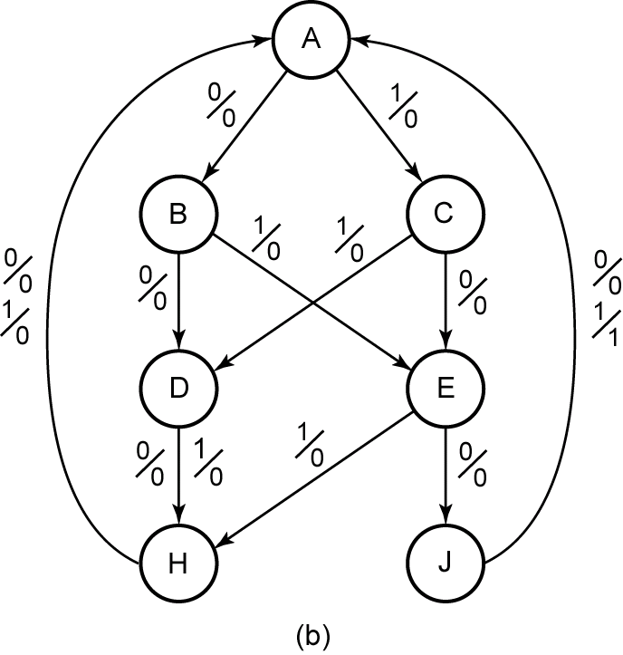
Elimination of Redundant States
Reduced State Table and Graph for Sequence Detector (0101, 1001)
P.S. | N.S. |  | Output
 | X=0 | X=1 | X=0 | X=1
A | B | C | 0 | 0
B | D | E | 0 | 0
C | E | D | 0 | 0
D | H | H | 0 | 0
E | J | H | 0 | 0
H | A | A | 0 | 0
J | A | A | 0 | 1
Row Matching
- Finding equivalent states

Slide 60
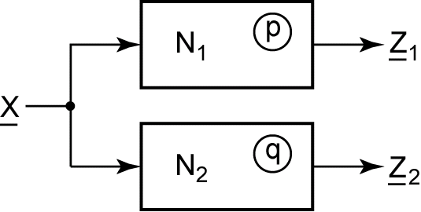

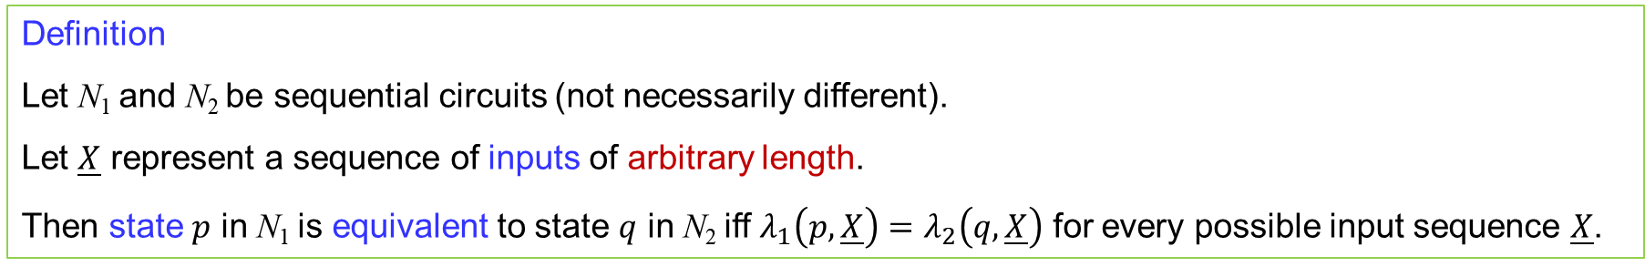
Equivalent States
Definition
Let N₁ and N₂ be sequential circuits (not necessarily different).
Let $\underline{X}$ represent a sequence of inputs of arbitrary length.
Then state $p$ in N₁ is equivalent to state $q$ in N₂ iff $λ_{1}\left(p,\underline{X}\right)=λ_{2}\left(q,\underline{X}\right)$ for every possible input sequence $\underline{X}$.
Not practical
$λ_{1}\left(p,\underline{X}\right) and λ_{2}\left(q,\underline{X}\right)$ are output sequences.

Slide 61
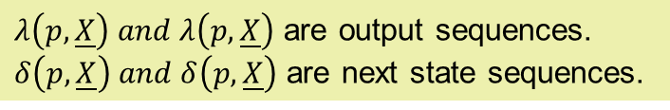
Equivalent States
$λ\left(p,\underline{X}\right) and λ\left(p,\underline{X}\right)$ are output sequences.
$δ\left(p,\underline{X}\right) and δ\left(p,\underline{X}\right)$ are next state sequences.
Theorem
Two states p and q of a sequential circuit are equivalent iff for every single input X, the outputs are the same and the next states are equivalent, that is,
Equivalent

Slide 62


Determination of State Equivalence Using an Implication Table
Example: Table 9-1
Implication Chart for Table 9-1
$$a≡b \text{iff} d≡f \text{and} c≡h$$
Present State | Next State |  | Present Output
 | X=0 | X=1
a | d | c | 0
b | f | h | 0
c | e | d | 1
d | a | e | 0
e | c | a | 1
f | f | b | 1
g | b | h | 0
h | c | g | 1
b | d-f c-h
c
d | a-d c-e | a-f e-h
e |  |  | c-e a-d
f |  |  | e-f b-d |  | c-f a-b
g | b-d c-h | b-f |  | a-b e-h
h |  |  | c-e d-g |  | a-g | c-f b-g
 | a | b | c | d | e | f | g
$$a≠b \text{because} \text{the} \text{outputs} \text{differ}$$

Slide 63
Determination of State Equivalence Using an Implication Table
Example: Table 9-1
Implication Chart for Table 9-1
Present State | Next State |  | Present Output
 | X=0 | X=1
a | d | c | 0
b | f | h | 0
c | e | d | 1
d | a | e | 0
e | c | a | 1
f | f | b | 1
g | b | h | 0
h | c | g | 1
b | d-f c-h
c
d | a-d c-e | a-f e-h
e |  |  | c-e a-d
f |  |  | e-f b-d |  | c-f a-b
g | b-d c-h | b-f |  | a-b e-h
h |  |  | c-e d-g |  | a-g | c-f b-g
 | a | b | c | d | e | f | g
Remove Self-implied

Slide 64
Determination of State Equivalence Using an Implication Table
Example: Table 9-1
Implication Chart for Table 9-1
Present State | Next State |  | Present Output
 | X=0 | X=1
a | d | c | 0
b | f | h | 0
c | e | d | 1
d | a | e | 0
e | c | a | 1
f | f | b | 1
g | b | h | 0
h | c | g | 1
b | d-f c-h
c
d | c-e | a-f e-h
e |  |  | a-d
f |  |  | e-f b-d |  | c-f a-b
g | b-d c-h | b-f |  | a-b e-h
h |  |  | c-e d-g |  | a-g | c-f b-g
 | a | b | c | d | e | f | g
After removing Self-implied

Slide 65
Determination of State Equivalence Using an Implication Table
Example: Table 9-1
Implication Chart for Table 9-1
Present State | Next State |  | Present Output
 | X=0 | X=1
a | d | c | 0
b | f | h | 0
c | e | d | 1
d | a | e | 0
e | c | a | 1
f | f | b | 1
g | b | h | 0
h | c | g | 1
b | d-f c-h
c
d | c-e | a-f e-h
e |  |  | a-d
f |  |  | e-f b-d |  | c-f a-b
g | b-d c-h | b-f |  | a-b e-h
h |  |  | c-e d-g |  | a-g | c-f b-g
 | a | b | c | d | e | f | g
Remove non-equivalent pairs

Slide 66
Determination of State Equivalence Using an Implication Table
Example: Table 9-1
Implication Chart for Table 9-1
Present State | Next State |  | Present Output
 | X=0 | X=1
a | d | c | 0
b | f | h | 0
c | e | d | 1
d | a | e | 0
e | c | a | 1
f | f | b | 1
g | b | h | 0
h | c | g | 1
b | d-f c-h
c
d | c-e | a-f e-h
e |  |  | a-d
f |  |  | e-f b-d |  | c-f a-b
g | b-d c-h | b-f |  | a-b e-h
h |  |  | c-e d-g |  | a-g | c-f b-g
 | a | b | c | d | e | f | g
Remove non-equivalent pairs

Slide 67
Determination of State Equivalence Using an Implication Table
Example: Table 9-1
Implication Chart for Table 9-1
Present State | Next State |  | Present Output
 | X=0 | X=1
a | d | c | 0
b | f | h | 0
c | e | d | 1
d | a | e | 0
e | c | a | 1
f | f | b | 1
g | b | h | 0
h | c | g | 1
b | d-f c-h
c
d | c-e | a-f e-h
e |  |  | a-d
f |  |  | e-f b-d |  | c-f a-b
g | b-d c-h | b-f |  | a-b e-h
h |  |  | c-e d-g |  | a-g | c-f b-g
 | a | b | c | d | e | f | g
Remove non-equivalent pairs

Slide 68
Determination of State Equivalence Using an Implication Table
Example: Table 9-1
Implication Chart for Table 9-1
Present State | Next State |  | Present Output
 | X=0 | X=1
a | d | c | 0
b | f | h | 0
c | e | d | 1
d | a | e | 0
e | c | a | 1
f | f | b | 1
g | b | h | 0
h | c | g | 1
b | d-f c-h
c
d | c-e | a-f e-h
e |  |  | a-d
f |  |  | e-f b-d |  | c-f a-b
g | b-d c-h | b-f |  | a-b e-h
h |  |  | c-e d-g |  | a-g | c-f b-g
 | a | b | c | d | e | f | g
Remove non-equivalent pairs

Slide 69
Determination of State Equivalence Using an Implication Table
Example: Table 9-1
Implication Chart for Table 9-1
Present State | Next State |  | Present Output
 | X=0 | X=1
a | d | c | 0
b | f | h | 0
c | e | d | 1
d | a | e | 0
e | c | a | 1
f | f | b | 1
g | b | h | 0
h | c | g | 1
b | d-f c-h
c
d | c-e | a-f e-h
e |  |  | a-d
f |  |  | e-f b-d |  | c-f a-b
g | b-d c-h | b-f |  | a-b e-h
h |  |  | c-e d-g |  | a-g | c-f b-g
 | a | b | c | d | e | f | g
Remove non-equivalent pairs

Slide 70
Determination of State Equivalence Using an Implication Table
Example: Table 9-1
Implication Chart for Table 9-1
Present State | Next State |  | Present Output
 | X=0 | X=1
a | d | c | 0
b | f | h | 0
c | e | d | 1
d | a | e | 0
e | c | a | 1
f | f | b | 1
g | b | h | 0
h | c | g | 1
b | d-f c-h
c
d | c-e | a-f e-h
e |  |  | a-d
f |  |  | e-f b-d |  | c-f a-b
g | b-d c-h | b-f |  | a-b e-h
h |  |  | c-e d-g |  | a-g | c-f b-g
 | a | b | c | d | e | f | g
Remove non-equivalent pairs

Slide 71
Determination of State Equivalence Using an Implication Table
Example: Table 9-1
Implication Chart for Table 9-1
Present State | Next State |  | Present Output
 | X=0 | X=1
a | d | c | 0
b | f | h | 0
c | e | d | 1
d | a | e | 0
e | c | a | 1
f | f | b | 1
g | b | h | 0
h | c | g | 1
b | d-f c-h
c
d | c-e | a-f e-h
e |  |  | a-d
f |  |  | e-f b-d |  | c-f a-b
g | b-d c-h | b-f |  | a-b e-h
h |  |  | c-e d-g |  | a-g | c-f b-g
 | a | b | c | d | e | f | g
Remove non-equivalent pairs

Slide 72
Determination of State Equivalence Using an Implication Table
Example: Table 9-1
Implication Chart for Table 9-1
Present State | Next State |  | Present Output
 | X=0 | X=1
a | d | c | 0
b | f | h | 0
c | e | d | 1
d | a | e | 0
e | c | a | 1
f | f | b | 1
g | b | h | 0
h | c | g | 1
b | d-f c-h
c
d | c-e | a-f e-h
e |  |  | a-d
f |  |  | e-f b-d |  | c-f a-b
g | b-d c-h | b-f |  | a-b e-h
h |  |  | c-e d-g |  | a-g | c-f b-g
 | a | b | c | d | e | f | g
After first pass

Slide 73
Determination of State Equivalence Using an Implication Table
Example: Table 9-1
Implication Chart for Table 9-1
Present State | Next State |  | Present Output
 | X=0 | X=1
a | d | c | 0
b | f | h | 0
c | e | d | 1
d | a | e | 0
e | c | a | 1
f | f | b | 1
g | b | h | 0
h | c | g | 1
b | d-f c-h
c
d | c-e | a-f e-h
e |  |  | a-d
f |  |  | e-f b-d |  | c-f a-b
g | b-d c-h | b-f |  | a-b e-h
h |  |  | c-e d-g |  | a-g | c-f b-g
 | a | b | c | d | e | f | g
Remove non-equivalent pairs

Slide 74
Determination of State Equivalence Using an Implication Table
Example: Table 9-1
Implication Chart for Table 9-1
Present State | Next State |  | Present Output
 | X=0 | X=1
a | d | c | 0
b | f | h | 0
c | e | d | 1
d | a | e | 0
e | c | a | 1
f | f | b | 1
g | b | h | 0
h | c | g | 1
b | d-f c-h
c
d | c-e | a-f e-h
e |  |  | a-d
f |  |  | e-f b-d |  | c-f a-b
g | b-d c-h | b-f |  | a-b e-h
h |  |  | c-e d-g |  | a-g | c-f b-g
 | a | b | c | d | e | f | g
Remove non-equivalent pairs

Slide 75
Determination of State Equivalence Using an Implication Table
Example: Table 9-1
Implication Chart for Table 9-1
Present State | Next State |  | Present Output
 | X=0 | X=1
a | d | c | 0
b | f | h | 0
c | e | d | 1
d | a | e | 0
e | c | a | 1
f | f | b | 1
g | b | h | 0
h | c | g | 1
b | d-f c-h
c
d | c-e | a-f e-h
e |  |  | a-d
f |  |  | e-f b-d |  | c-f a-b
g | b-d c-h | b-f |  | a-b e-h
h |  |  | c-e d-g |  | a-g | c-f b-g
 | a | b | c | d | e | f | g
Remove non-equivalent pairs

Slide 76
Determination of State Equivalence Using an Implication Table
Example: Table 9-1
Implication Chart for Table 9-1
Present State | Next State |  | Present Output
 | X=0 | X=1
a | d | c | 0
b | f | h | 0
c | e | d | 1
d | a | e | 0
e | c | a | 1
f | f | b | 1
g | b | h | 0
h | c | g | 1
b | d-f c-h
c
d | c-e | a-f e-h
e |  |  | a-d
f |  |  | e-f b-d |  | c-f a-b
g | b-d c-h | b-f |  | a-b e-h
h |  |  | c-e d-g |  | a-g | c-f b-g
 | a | b | c | d | e | f | g
After second pass

Slide 77
Determination of State Equivalence Using an Implication Table
Implication Chart After Second Pass
b | d-f c-h
c
d | c-e | a-f e-h
e |  |  | a-d
f |  |  | e-f b-d |  | c-f a-b
g | b-d c-h | b-f |  | a-b e-h
h |  |  | c-e d-g |  | a-g | c-f b-g
 | a | b | c | d | e | f | g
Present State | Next State |  | Present Output
 | X=0 | X=1
a | d | c | 0
b | f | h | 0
c | e c | d | 1
d | a | e c | 0
e | c | a | 1
f | f | b | 1
g | b | h | 0
h | c | g | 1
Replace e with c

Slide 78
Determination of State Equivalence Using an Implication Table
Implication Chart After Second Pass
b | d-f c-h
c
d | c-e | a-f e-h
e |  |  | a-d
f |  |  | e-f b-d |  | c-f a-b
g | b-d c-h | b-f |  | a-b e-h
h |  |  | c-e d-g |  | a-g | c-f b-g
 | a | b | c | d | e | f | g
Present State | Next State |  | Present Output
 | X=0 | X=1
a | d a | c | 0
b | f | h | 0
c | c | d a | 1
d | a | c | 0
f | f | b | 1
g | b | h | 0
h | c | g | 1
Replace d with a

Slide 79
Determination of State Equivalence Using an Implication Table
State table before reduction
State table after reduction
Present State | Next State |  | Present Output
 | X=0 | X=1
a | d | c | 0
b | f | h | 0
c | e | d | 1
d | a | e | 0
e | c | a | 1
f | f | b | 1
g | b | h | 0
h | c | g | 1
Present State | Next State |  | Present Output
 | X=0 | X=1
a | a | c | 0
b | f | h | 0
c | c | a | 1
f | f | b | 1
g | b | h | 0
h | c | g | 1

Slide 80


